Slide 1
Advanced Mixed-Effects Analyses Presented at CARMA June 9-11, 2016 Paul D. Bliese

Slide 2
Introduction
Most courses on mixed-effects analyses cover the basics
Two-level models of nested data
Basic growth models
In this course, we use R and show how variants of the two-level nested model and the basic growth model can be applied to interesting and complex data

Slide 3
Course Overview
Purpose:
Extend the basic ideas underlying multilevel analyses to handle more complex data
Enhance skills working with R
Course Provides:
Resources to conduct multilevel analyses
Written materials (overheads, exercises)
R software
Hands-on experience
An environment where we can learn and (hopefully) have some fun

Slide 4
Course Overview
Course is a challenge
Concepts are involved and we cover a lot of ground
The R language can be difficult particularly if you were recently introduced to it
What I want from you
Do not over-emphasize the R program. Make sure you get the theoretical concepts!
Help your neighbor with exercises

Slide 5
Course Outline
Introduction
Models Related to Time
The Basic Growth Modeling
Discontinuous Growth Models
Multilevel Mediation
Empirical Bayes Estimates
Specialized Models for Complex Data
Dichotomous Outcome (glmms)
Three-level models and other extensions
Concluding Comments/Questions
Half-day working with participant data (maybe)

Slide 6
Intro: Basic Models
Big Picture: We care about mixed-effects (multilevel) methods for two main reasons:
The methods allow us to model higher-level effects
Contextual effects in nested groups
Level-2 (often person-level) effects in repeated measures
The methods help partition variance in ways that improve our statistical models

Slide 7
Intro: Model Context
Each cell represents one Army Company.
Note the differences in
slopes and intercepts (mean well-being values).
Are these reliable differences?
If so, what group-level variables explain these differences?
Notes:
xyplot(WBEING~HRS|as.factor(GRP),data=bh1996[1:1582,],
subset=HRS>5&HRS<19,
type=c("p","g","r"),col="dark blue",col.line="black",
xlab="Work Hours",
ylab="Well-Being")

Slide 8
Intro: Model Context
Simulated data with 25 groups; 75 observations per group and a correlation of -.17 between X and Y
Notes:
tfun<-function(gsize,ngroup,rho){
OUTPUT<-data.frame(GRP=rep(NA,gsize*ngroup),X=rep(NA,gsize*ngroup),
Y=rep(NA,gsize*ngroup))
for(i in 1:ngroup){
Y<-rnorm(gsize)
X<-rho*Y+sqrt(1-rho^2)*rnorm(gsize)
OUTPUT[((i * gsize - gsize) + 1):(i *gsize),]<-data.frame(GRP=i,X=X,Y=Y)
}
return(OUTPUT)
}
TDAT<-tfun(75,25,-.17)
xyplot(Y~X|GRP,TDAT,
type=c("p","g","r"),col.line="black")

Slide 9
Soldier Resiliency
Platoon-Level Variation in the Relationship Between Combat Exposures and Acute Stress
Page 9
Notes:
9

Slide 10
Intro: Model Context and Time
Modeling dynamic processes over time is a key variation on modeling context.
Individuals are the typically the higher-level variable and the repeated observations from individuals are the lower-level observations.
Goal is to model how attributes of the higher-level variable relate to:
Overall mean differences
Patterns of change over time

Slide 11
Intro: Model Context and Time
Decreasing Slope
Low Intercept
High Intercept
Increasing Slope

Slide 12
Intro: Model Context and Time
Bliese, McGurk, Thomas, Balkin & Wesensten (2007)

Slide 13
Adaptability & Task-Change Paradigm
Lang & Bliese (2009)
Notes:
######### using 5,5,5,5,5,5 instead of zeros for PERIOD1XC
soardata[1:12,c("PERIOD1C","TRANSC","PERIOD2C","PERIOD1XC")]
tmod3<-lme(score~PERIOD1C+TRANSC+PERIOD2C+I(PERIOD1XC^2)+I(PERIOD2C^2)+GMF+
PERIOD1C:GMF+TRANSC:GMF+PERIOD2C:GMF+I(PERIOD1XC^2):GMF+
I(PERIOD2C^2):GMF,random=~1|ID,data=soardata)
summary(tmod3)$tTable
#Low
TDAT<-data.frame(GMF=-1,soardata[1:12,c("PERIOD1C","TRANSC","PERIOD2C","PERIOD1XC")])
VALS<-predict(tmod3,TDAT,level=0)
write.table(t(VALS),file="clipboard",sep="\t",row.names=F,col.names=F)
#Average
TDAT<-data.frame(GMF=0,soardata[1:12,c("PERIOD1C","TRANSC","PERIOD2C","PERIOD1XC")])
VALS<-predict(tmod3,TDAT,level=0)
write.table(t(VALS),file="clipboard",sep="\t",row.names=F,col.names=F)
#High
TDAT<-data.frame(GMF=1,soardata[1:12,c("PERIOD1C","TRANSC","PERIOD2C","PERIOD1XC")])
VALS<-predict(tmod3,TDAT,level=0)
write.table(t(VALS),file="clipboard",sep="\t",row.names=F,col.names=F)

Slide 14
Banking Sleep
Rupp, Wesensten, Bliese & Balkin (2009)

Slide 15
Intro: Model Context
Why it is important to use mixed-effects models (summary of Point 1)
Model the role of social context
Model level-2 (often person-level) effects in repeated measures

Slide 16
Intro: Account for variance
Second reason why it is important to consider clustering of data is to correctly account for sources of variance
Unaccounted for clustered variance can impact the validity of statistical tests:
Standard errors may be biased resulting in
t-values that are biased resulting in
Incorrect conclusions about what is and is not significant

Slide 17
Intro: Account for Variance
GRP | PERS.COHES | GRP.COHES | WBEING
1 | 3.25 | 2.93 | 3.33
1 | 3.38 | 2.93 | 2.11
1 | 3.75 | 2.93 | 4.39
1 | 4.00 | 2.93 | 1.72
17 | 2.13 | 3.43 | 2.83
17 | 3.00 | 3.43 | 3.22
17 | 3.00 | 3.43 | 3.28
17 | 3.25 | 3.43 | 3.17
80 | 1.50 | 2.57 | 3.00
80 | 1.75 | 2.57 | 1.83
80 | 2.88 | 2.57 | 0.94

Slide 18
Intro: Account for variance
Group-Level Variable (consistent for members in same group)
 | Value | Std.Error | t-value
Group Cohesion: OLS | 0.281 | 0.051 | 5.505
Group Cohesion: lme | 0.314 | 0.097 | 3.233
Individual-Level Variable (different values for group members)
 | Value | Std.Error | t-value
Personal Cohesion: OLS | 0.254 | 0.014 | 18.121
Personal Cohesion: lme | 0.249 | 0.012 | 20.78
Bliese (2002)

Slide 19
Intro: Account for variance
Bliese & Hanges (2004) simulation

Slide 20
Intro: Account for variance
Summary of Point 2: It is important to consider clustering of data because:
One needs to account for known (or suspected) sources of variance
Reduce bias in statistical models

Slide 21
Case Study: Account for Variance
A National Guard Army group assigned embedded behavioral health providers to companies
5 Companies with embeds (n=453)
7 Companies without embeds (n=679)
Question: Does having an embedded provider result in any positive outcomes?
Large sample of individuals in each condition
Estimate regression models for depression sum and collective efficacy
Regress depression sum on embed (0/1)
Regress collective efficacy sum on embed (0/1)

Slide 22
Data Structure
ID | GRP.ID | Depression | Colleff | Provider
1 | 1 | 3.5 | 3 | 1
2 | 1 | 4.1 | 3.3 | 1
3 | 1 | 2.3 | 2.1 | 1
4 | 1 | 2.2 | 3.2 | 1
5 | 1 | 1.3 | 3.3 | 1
6 | 2 | 3.5 | 2.1 | 0
7 | 2 | 2.2 | 3.1 | 0
8 | 2 | 3.1 | 4.1 | 0
9 | 2 | 3.4 | 3.2 | 0
10 | 3 | 2.2 | 4.2 | 1
11 | 3 | 4.3 | 3.3 | 1
12 | 3 | 2.1 | 2.1 | 1
13 | 3 | 2.5 | 3.1 | 1
14 | 3 | 3.6 | 3.4 | 1
15 | 3 | 2.1 | 2.2 | 1

Slide 23
Case Study: Account for Variance
Depression results (NS)
Collective Efficacy results (Very Encouraging!)
> round(summary(lm(MDDsum~embedprov,data=embed,
na.action=na.omit))$coef,dig=4)
Estimate Std. Error t value Pr(>|t|)
(Intercept) 11.7835 0.1801 65.4371 0.0000
embedprov 0.5032 0.2850 1.7656 0.0777
> round(summary(lm(rdnssum~embedprov,data=embed,
na.action=na.omit))$coef,dig=4)
Estimate Std. Error t value Pr(>|t|)
(Intercept) 13.5682 0.1395 97.2891 0.0000
embedprov 0.6942 0.2209 3.1426 0.0017

Slide 24
Case Study: Account for Variance
Results suggested that having an embedded provider:
Was not directly related mental health
Was related to unit performance indices (a good news story!)
Paper was submitted and one reviewer noted:
“The correct unit of analysis is the NG units, not the individuals who compose those units. The multivariate analyses do not appear to control for clustering of individuals within units, and it is not clear whether there are a sufficient number of units in terms of power.”

Slide 25
Case Study: Account for Variance
Reviewer was right on target!
Because our regression models had level-2 predictors (predictors constant among members of the same groups) our results were likely to be highly biased and overly liberal.
The only way our regression results would have been okay in this design is if the level of non-independence in the outcome was zero; however we were not so lucky….

Slide 26
Data Structure
ID | GRP.ID | Depression | Colleff | Provider
1 | 1 | 3.5 | 3 | 1
2 | 1 | 4.1 | 3.3 | 1
3 | 1 | 2.3 | 2.1 | 1
4 | 1 | 2.2 | 3.2 | 1
5 | 1 | 1.3 | 3.3 | 1
6 | 2 | 3.5 | 2.1 | 0
7 | 2 | 2.2 | 3.1 | 0
8 | 2 | 3.1 | 4.1 | 0
9 | 2 | 3.4 | 3.2 | 0
10 | 3 | 2.2 | 4.2 | 1
11 | 3 | 4.3 | 3.3 | 1
12 | 3 | 2.1 | 2.1 | 1
13 | 3 | 2.5 | 3.1 | 1
14 | 3 | 3.6 | 3.4 | 1
15 | 3 | 2.1 | 2.2 | 1

Slide 27
Case Study: Account for Variance
Depression results (sample sizes equal)
> tmod<-aov(MDDsum~as.factor(bn.co),embed,
na.action=na.omit)
> ICC1(tmod)
[1] 0.03868019
> round(summary(lm(MDDsum~embedprov,data=embed,
na.action=na.omit))$coef,dig=4)
Estimate Std. Error t value Pr(>|t|)
(Intercept) 11.7835 0.1801 65.4371 0.0000
embedprov 0.5032 0.2850 1.7656 0.0777
> round(summary(lme(MDDsum~embedprov,random=~1|bn.co,
data=embed,na.action=na.omit))$tTable,dig=4)
Value Std.Error DF t-value p-value
(Intercept) 11.9314 0.4251 1080 28.0660 0.0000
embedprov 0.7510 0.6645 10 1.1302 0.2848

Slide 28
Case Study: Account for Variance
Collective Efficacy results (sample sizes equal)
> tmod<-aov(rdnssum~as.factor(bn.co),data=embed,
na.action=na.omit)
> ICC1(tmod)
[1] 0.08008846
> round(summary(lm(rdnssum~embedprov,data=embed,
na.action=na.omit))$coef,dig=4)
Estimate Std. Error t value Pr(>|t|)
(Intercept) 13.5682 0.1395 97.2891 0.0000
embedprov 0.6942 0.2209 3.1426 0.0017
> round(summary(lme(rdnssum~embedprov,random=~1|bn.co,
data=embed,na.action=na.omit))$tTable,dig=4)
Value Std.Error DF t-value p-value
(Intercept) 13.5797 0.4841 1097 28.0521 0.0000
embedprov 0.3317 0.7538 10 0.4400 0.6693

Slide 29
Case Study: Account for Variance
It is easy use regression in cases where it provides misleading results
It is likely that applied organizational data rarely meets the independence assumption underlying the use of regression
Important to have analytic tools that properly account for pre-existing non-independence due to groups.
Parenthetically, the embed paper was actually accepted!

Slide 30
Intro: Overall Summary
Why are multilevel models important?
Model level-2 effects in groups and over time
Correctly specify statistical models
As we see in this course, the basic models are very flexible and allow us to apply these models to a variety of situations

Slide 31
Part I
A Brief Introduction to R

Slide 32
Introduction to R
R is a re-implementation of the S language developed at AT&T
Features
Effective data handling and storage
A large collection of tools for data analysis
A well-developed and concise programming language
graphical facilities for data analysis and display

Slide 33

New York Times: January 6, 2009

Slide 34
Introduction to R

Slide 35
Introduction to R
R is an environment implementing many classical and modern statistical techniques.
Many techniques are built into the base R environment. In addition, there are numerous supplied packages.
Packages (and the base system) are available through the CRAN family of Internet sites (via http: //cran.r-project.org).

Slide 36
Introduction to R
In R, the working environment is different than in many "linear" programs
Linear (SAS, SPSS)
Working environment is limited to one data set at a time
Data set is read, manipulated, analyzed and stored
The working environment in R can have multiple data sets available for manipulation and analysis

Slide 37
Introduction to R
Packages
Functions
Help Files
Example Data
Base
Working
Environment
[Users data, results,
and functions]
>objects()
nlme
multilevel
foreign
>library(foreign)

Slide 38
Introduction to R
Use "objects()" to see what objects are in your working environment
Dataframes containing data sets
Objects containing results of statistical analyses
Functions (programs you write)
Use "names(object)" on any object to see what elements it contains.
Use "summary(object)" on any object that you want to explore in more detail.

Slide 39
Introduction to R
Example of objects(), names() & summary()
> objects()
[1] "bh1996" "mydata1" "mydata2"
[4] "output1" "output2"
> names(bh1996)
[1] "GRP" "COHES" "G.COHES" "W.COHES"
[5] "LEAD" "G.LEAD" "W.LEAD" "HRS"
[9] "G.HRS" "W.HRS" "WBEING" "G.WBEING"
[13] "W.WBEING“
> summary(bh1996)
GRP COHES
Min. : 1.00 Min. :1.000
1st Qu.:30.00 1st Qu.:2.500
Median :59.00 Median :3.125
Mean :55.72 Mean :3.067
3rd Qu.:84.00 3rd Qu.:3.750
Max. :99.00 Max. :5.000

Slide 40
Introduction to R
We will be interested primarily in three packages.
multilevel 2.5 (Bliese, 2013)
Manipulation of data
nlme (Pinheiro and Bates, 2000)
Mixed Effects Models for Multilevel Modeling and Growth Modeling
lme4 (Bates, 2010)
Generalized Linear Mixed Effects Models (glmms) for dichotomous outcomes

Slide 41
Introduction to R
Packages are attached using the "library()" command:
To see what packages are available in the search path use the "search()" command:
>library(multilevel)
> search()
[1] ".GlobalEnv" "package:multilevel"
[3] "package:methods" "package:stats"
[5] "package:graphics" "package:grDevices"
[7] "package:utils" "package:datasets"
[9] "Autoloads" "package:base"

Slide 42
Introduction to R
Important features
R is case sensitive
Data1 is different from DATA1
Analyses are done as a series of steps, with intermediate results being stored in objects
Assignment are made using “<-”
>DATA<-1:10
Functions are performed on the object within parentheses
> mean(DATA)
[1] 5.5

Slide 43
Introduction to R
Important Features (cont.)
Statistical models are identified with formulas:
DV~IV1+IV2 (main effects only)
DV~IV1*IV2 (main effects and 2 way interaction)
Ordinary Least Squares Regression (linear model) would be specified as
>OLS.MODEL<-lm(DV~IV1+IV2+IV3)
To get results use the summary command:
>summary(OLS.MODEL)

Slide 44
Introduction to R
While R has powerful data manipulation functions, users may be more comfortable using SPSS, SAS or EXCEL to prepare R data frames
Data frames are data objects
Columns contain variables
Rows contain observations
R can easily import data into data frames from EXCEL or SPSS files.

Slide 45
Introduction to R
library(multilevel)
data(lq2002)
TDAT<-lq2002[!duplicated(lq2002$COMPID),]
library(lattice)
tmod<-lm(GHOSTILE~GLEAD*GTSIG,data=TDAT)
TTM<-seq(min(TDAT$GLEAD),max(TDAT$GLEAD),length=25)
TTV<-seq(min(TDAT$GTSIG),max(TDAT$GTSIG),length=25)
TDAT2<-list(GLEAD=TTM,GTSIG=TTV)
grid<-expand.grid(TDAT2)
fit<-predict(tmod,grid)
trellis.device(theme="col.whitebg")
wireframe(fit~GLEAD*GTSIG, data=grid,col="steelblue4",
screen = list(z = -30, x = -60),
xlab=list("Leadership \n Climate",cex=1.5),
ylab=list(" Task \n Significance",cex=1.5),
zlab=list("Hostility ",cex=1.5),scales=list(arrows=F),
shade=T,colorkey=F)
Notes:
library(multilevel)
data(lq2002)
TDAT<-lq2002[!duplicated(lq2002$COMPID),]
library(lattice)
tmod<-lm(GHOSTILE~GLEAD*GTSIG,data=TDAT)
TTM<-seq(min(TDAT$GLEAD),max(TDAT$GLEAD),length=25)
TTV<-seq(min(TDAT$GTSIG),max(TDAT$GTSIG),length=25)
TDAT2<-list(GLEAD=TTM,GTSIG=TTV)
grid<-expand.grid(TDAT2)
fit<-predict(tmod,grid)
trellis.device(theme="col.whitebg")
wireframe(fit~GLEAD*GTSIG, data=grid,col="steelblue4", screen = list(z = -30, x = -60),
xlab=list("Leadership \n Climate",cex=1.5),ylab=list(" Task \n Significance",cex=1.5),
zlab=list("Hostility ",cex=1.5),scales=list(arrows=F),
shade=T,colorkey=F)

Slide 46
Introduction to R
Exercises
Exercise 1: Importing data sets into R
Reminder: R script files
read.table(pipe("pbpaste")) #for Mac
write.table(lq2002,file=pipe("pbcopy"),
sep="/t", row.names=FALSE)

Slide 47
Part II
Growth Modeling

Slide 48
Purpose
Show how R can be used to conduct growth models.
Non Linear Mixed Effects (NLME) package (Bates & Pinhiero, 2000)
Multilevel package (Bliese, 2001)
Introduce a model contrasting approach to estimating growth models.

Slide 49
Outline
Growth Modeling Defined
Setting up the Data
Modeling Steps
Build Level-1 Model
Estimate ICC
Identify Functions for Time
Examine Growth Parameter Variability
Determine Error Structure
Build Level-2 Model
Growth Modeling in SEM

Slide 50
Growth Modeling Defined
Multilevel models consider nesting in terms of
Individuals nested (level-1)
Within Groups (level-2)
Basic two-level model can be expanded to cases where
Repeated observations nested (level-1)
Within Individuals (level-2)

Slide 51
Growth Modeling Defined
Growth modeling involves looking at
Change patterns over time for the sample as a whole
Overall, does the DV increase, decrease etc.?
Individual differences in overall levels of the DV
Do mean levels of DV vary among individuals?
Individual differences in change patterns over time
Do growth patterns associated with the DV vary among individuals?
Allows one to predict individual differences in growth patterns

Slide 52
Growth Modeling Defined
>xyplot(MULTDV~TIME|as.factor(SUBNUM),
data=UNIV.GROW[1:90,],
type=c("p","r","g"),
col="blue",col.line="black",
xlab="Time",ylab="Job Satisfaction")

Slide 53
Setting up the Data
Repeated measures data is often stored in “multivariate” form
One key assumption of this data is that individuals provided responses on the repeated measures at the same time.

Slide 54
Setting up the Data (cont.)
Multivariate data with temporally constant repeated measures needs to be converted to “univariate” form and indexed by TIME.

Slide 55
Setting up the Data (cont.)
The make.univ function
Has two arguments
Argument 1: The full data set
Argument 2: The repeated measures (in the correct order – T1, T2, T3)
Creates two new variables
A variable “TIME” going from 0 to N-1 Observations (where N is the number of repeated measures)
A variable “MULTDV” which is the repeated measures DV (can be named anything)
Repeats all other variables N times

Slide 56
Setting up the Data (cont.)
The make.univ function facilitates this transformation (code to make data in notes)
> GROWSAT.DAT[1:2,]
SUBNUM AGE JOBSAT1 JOBSAT2 JOBSAT3
3 1 20 1.666667 1 3
6 2 24 3.666667 4 4
> GROWSAT.UNIV<-make.univ(GROWSAT.DAT, GROWSAT.DAT[,3:5])
> GROWSAT.UNIV[1:6,]
SUBNUM AGE JOBSAT1 JOBSAT2 JOBSAT3 TIME MULTDV
X3 1 20 1.666667 1 3 0 1.666667
X31 1 20 1.666667 1 3 1 1.000000
X32 1 20 1.666667 1 3 2 3.000000
X6 2 24 3.666667 4 4 0 3.666667
X63 2 24 3.666667 4 4 1 4.000000
X64 2 24 3.666667 4 4 2 4.000000
Notes:
> data(univbct)
> GROWSAT.DAT<-univbct[,c("SUBNUM","AGE","JOBSAT1","JOBSAT2","JOBSAT3")]
> GROWSAT.DAT<-GROWSAT.DAT[!duplicated(GROWSAT.DAT$SUBNUM),]

Slide 57
Growth Modeling Setup
Exercise 2: Growth Modeling Data Setup. Transform data from “flat” to “stacked” format.
Work through the chen2005 example
#Using reshape – core R function: IMPORTANT to reorder
> c.univ<-reshape(chen2005,idvar="ID",
varying=list(5:7),v.names="perf",direction="long")
> c.univ<-c.univ[order(c.univ$ID,c.univ$time),]
> c.univ[1:6,]
ID TMPRF TMEXP NCEMP time perf
1.1 1 3.45 3.96 4.00 1 2.72
1.2 1 3.45 3.96 4.00 2 3.18
1.3 1 3.45 3.96 4.00 3 2.97
2.1 2 3.45 3.60 4.58 1 3.60

Slide 58
Modeling Steps
Notes on optimization in lme function
Build Level-1 Model (Bliese & Ployhart, 2002)
Step 1: Estimate the ICC
Step 2: Identify the Fixed Functions for Time
Linear,
Quadratic, etc.
Step 3: Examine Variability in Growth Parameters
Step 4: Determine the Error Structure
Are Errors (residuals) Correlated?
Are Errors Heterogeneous?
Build Level-2 Model (steps 5 and 6)
Add individual difference predictors (Level-2)

Slide 59
Optimization
The lme function uses two different routines in the stats package for optimization
The function optim
The function nlmimb
The default after versions 2.2 of R has been nlmimb
Very precise
Less robust than optim
If complex models (either growth or multilevel) fail to converge, try using the optim function
> Final.Model<-lme(WBEING~LEAD+G.HRS+LEAD*G.HRS,
random=~LEAD|GRP,data=tbh1996,
control=list(opt="optim"))

Slide 60
Step 1 in Modeling
Estimate the ICC with a null model
> names(GROWSAT.UNIV)
[1] "SUBNUM" "AGE" "JOBSAT1" "JOBSAT2" "JOBSAT3"
[6] "TIME" "MULTDV"
> VarCorr(lme(MULTDV~1,random=~1|SUBNUM,
data=GROWSAT.UNIV,na.action=na.omit, control=list(opt="optim")))
SUBNUM = pdLogChol(1)
Variance StdDev
(Intercept) 0.4337729 0.6586144
Residual 0.4319055 0.6571952
> 0.4337729/(0.4337729+0.4319055)
[1] 0.5010786

Slide 61
Step 2 in Modeling
Identify Fixed Functions for Time
For the overall sample, does time have a linear, quadratic, etc relationship with the outcome?
Linear Trend
> tmod<-lme(MULTDV~TIME,random=~1|SUBNUM,
data=GROWSAT.UNIV,na.action=na.omit, control=list(opt="optim"))
> round(summary(tmod)$tTable,dig=3)
Value Std.Error DF t-value p-value
(Intercept) 3.219 0.041 903 78.977 0.000
TIME 0.052 0.022 903 2.388 0.017

Slide 62
Step 2 in Modeling
Test Linear and Quadratic Trend
Stop with Linear Trend
Can only test up to quadratic with three time periods
> tmod2<-lme(MULTDV~TIME+I(TIME^2),
random=~1|SUBNUM,data=GROWSAT.UNIV,
na.action=na.omit,control=list(opt="optim"))
> round(summary(tmod2)$tTable,dig=3)
Value Std.Error DF t-value p-value
(Intercept) 3.233 0.043 902 75.846 0.000
TIME -0.034 0.078 902 -0.432 0.666
I(TIME^2) 0.043 0.038 902 1.139 0.255

Slide 63
Step 2 in Modeling
Alternative power polynomial test
> tmod2c<-lme(MULTDV~poly(TIME,2),
random=~1|SUBNUM,data=GROWSAT.UNIV,
na.action=na.omit, control=list(opt="optim"))
> round(summary(tmod2c)$tTable,dig=3)
Value Std.Error DF t-value p-value
(Intercept) 3.270 0.035 902 94.479 0.000
poly(TIME, 2)1 1.578 0.661 902 2.386 0.017
poly(TIME, 2)2 0.753 0.661 902 1.139 0.255

Slide 64
Step 3 in Modeling
Examine Variability in Growth Parameters
The high ICC tells us that intercepts vary
The test for fixed effects associated with TIME reveal an overall positive trend between TIME and job satisfaction
Does the linear slope for TIME randomly vary?
Does job satisfaction increase for some and decrease for others?

Slide 65
Step 3 in Modeling
Specifying a random linear slope in lme
> tmod<-lme(MULTDV~TIME,random=~1|SUBNUM,
data=GROWSAT.UNIV,na.action=na.omit, control=list(opt="optim"))
> tmod3<-update(tmod,random=~TIME|SUBNUM)
> anova(tmod,tmod3)
Model df logLik Test L.Ratio p-value
tmod 1 4 -1726.617
tmod3 2 6 -1711.066 1 vs 2 31.10262 <.0001

Slide 66
Step 3 in Modeling
The model with the random slope fits the data better than the model with the fixed slope
Notes:
tmod<-lme(MULTDIV~TIME,random=~1|SUBNUM,data=GROWSAT.UNIV)
plot(GROWSAT.UNIV$TIME,GROWSAT.UNIV$MULTDV,xlab="Time",
ylab="Job Satisfaction",type="n")
COEF.DAT<-coef(tmod)
apply(COEF.DAT,1,abline)

Slide 67
Step 4 in Modeling
In a well-specified model, there will not be any discernible pattern to the residuals.
The residuals should be unrelated to each other
When there is a pattern associated with the residuals, then this pattern needs to be accounted for in the model.
Failure to correctly model the error structure will lead to biases such as incorrect standard errors.

Slide 68
Step 4 in Modeling
Error structure specification is generally not an issue in multilevel models because lower-level observations are unordered.
In longitudinal data repeated measures are ordered and likely to create patterns of:
Autocorrelation
Observations close to each other in time are more related than observations far apart in time
Heteroscedasticity
Variance increases or decreases over time

Slide 69
Step 4 in Modeling
A test for autocorrelation based on residuals
Create a file with no missing data
Convert the file to univariate format and estimate the growth model
> TEMP<-univbct[3*(1:495),c("SUBNUM","JOBSAT1",
"JOBSAT2","JOBSAT3")]
> TEMP<-na.exclude(TEMP)
> TEMP.UNIV<-make.univ(TEMP,TEMP[,2:4])
> tmod<-lme(MULTDV~TIME,random=~TIME|SUBNUM,
data=TEMP.UNIV, control=list(opt="optim"))
> TEMP.RESID<-resid(tmod)

Slide 70
Step 4 in Modeling
Arrange residuals into matrix: one row per person
Examine the correlation among residuals
> matrix(TEMP.RESID,ncol=3,byrow=T)[1:2,]
[,1] [,2] [,3]
[1,] -0.10488073 -1.1297697 0.5120083
[2,] -0.03508496 0.2290748 0.1599016
> cor(matrix(TEMP.RESID,ncol=3,byrow=T))
[,1] [,2] [,3]
[1,] 1.0000000 -0.5099182 -0.1806114
[2,] -0.5099182 1.0000000 -0.3200006
[3,] -0.1806114 -0.3200006 1.0000000

Slide 71
Step 4 in Modeling
Check for autocorrelation in lme (AR1)
Final Step 3 Model
Add Autocorrelation
Contrast Models
> tmod3<-lme(MULTDV~TIME,random=~TIME|SUBNUM,
data=GROWSAT.UNIV,na.action=na.omit, control=list(opt="optim"))
> tmod4a<-update(tmod3,correlation=corAR1())
> anova(tmod3,tmod4a)
> anova(tmod3,tmod4a)
Model df logLik Test L.Ratio p-value
tmod3 1 6 -1711.066
tmod4a 2 7 -1707.861 1 vs 2 6.409824 0.0113

Slide 72
Step 4 in Modeling
Get estimate of the degree of autocorrelation
Phi coefficient is always positive (Pinheiro & Bates, 2000, p. 229)
> summary(tmod4a)
> summary(tmod4a)
Linear mixed-effects model fit by REML
Data: GROWSAT.UNIV
AIC BIC logLik
3429.722 3466.401 -1707.861
....
Correlation Structure: AR(1)
Formula: ~1 | SUBNUM
Parameter estimate(s):
Phi
0.3763924

Slide 73
Step 4 in Modeling
The order of the data is important when using the default correlation function
If data is not ordered by TIME for each subject, it needs to be re-ordered
> tmod4a<-update(tmod3,correlation=corAR1())
SUBNUM AGE JOBSAT1 JOBSAT2 JOBSAT3 TIME MULTDV
X3 1 20 1.666667 1 3 0 1.666667
X31 1 20 1.666667 1 3 1 1.000000
X32 1 20 1.666667 1 3 2 3.000000
X6 2 24 3.666667 4 4 0 3.666667
X63 2 24 3.666667 4 4 1 4.000000
X64 2 24 3.666667 4 4 2 4.000000
> NEW.UNIV<-OLD.UNIV[order(OLD.UNIV$SUBNUM,
OLD.UNIV$TIME),]

Slide 74
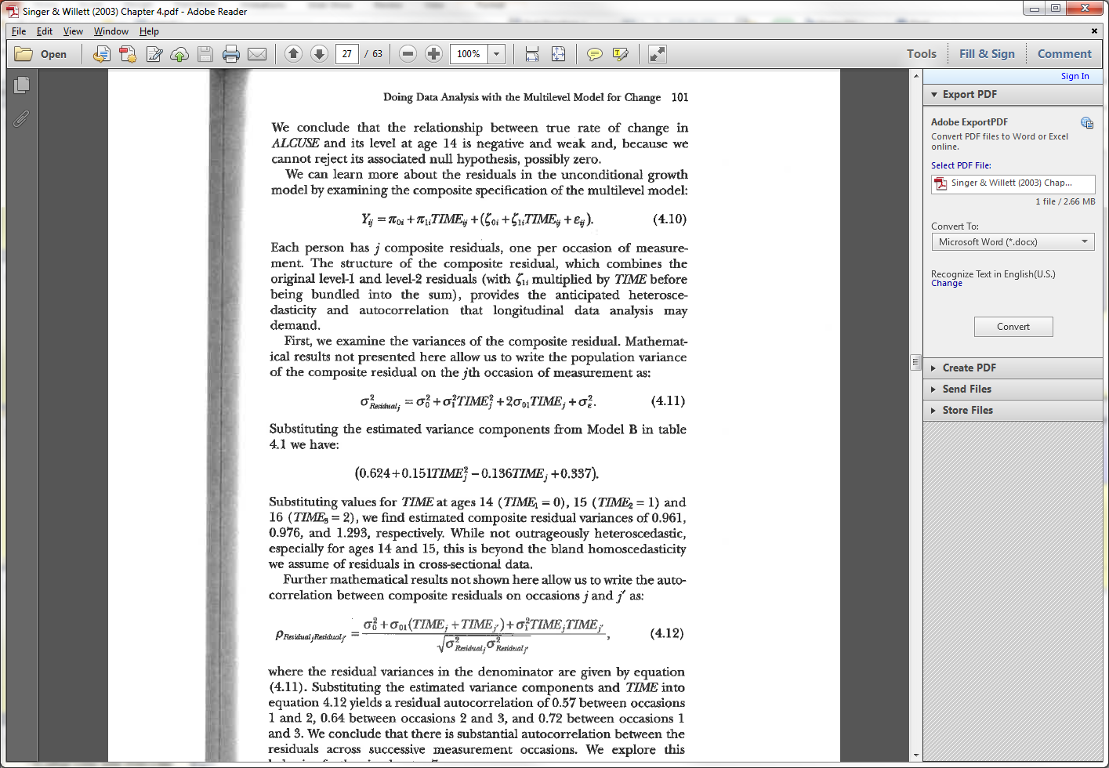
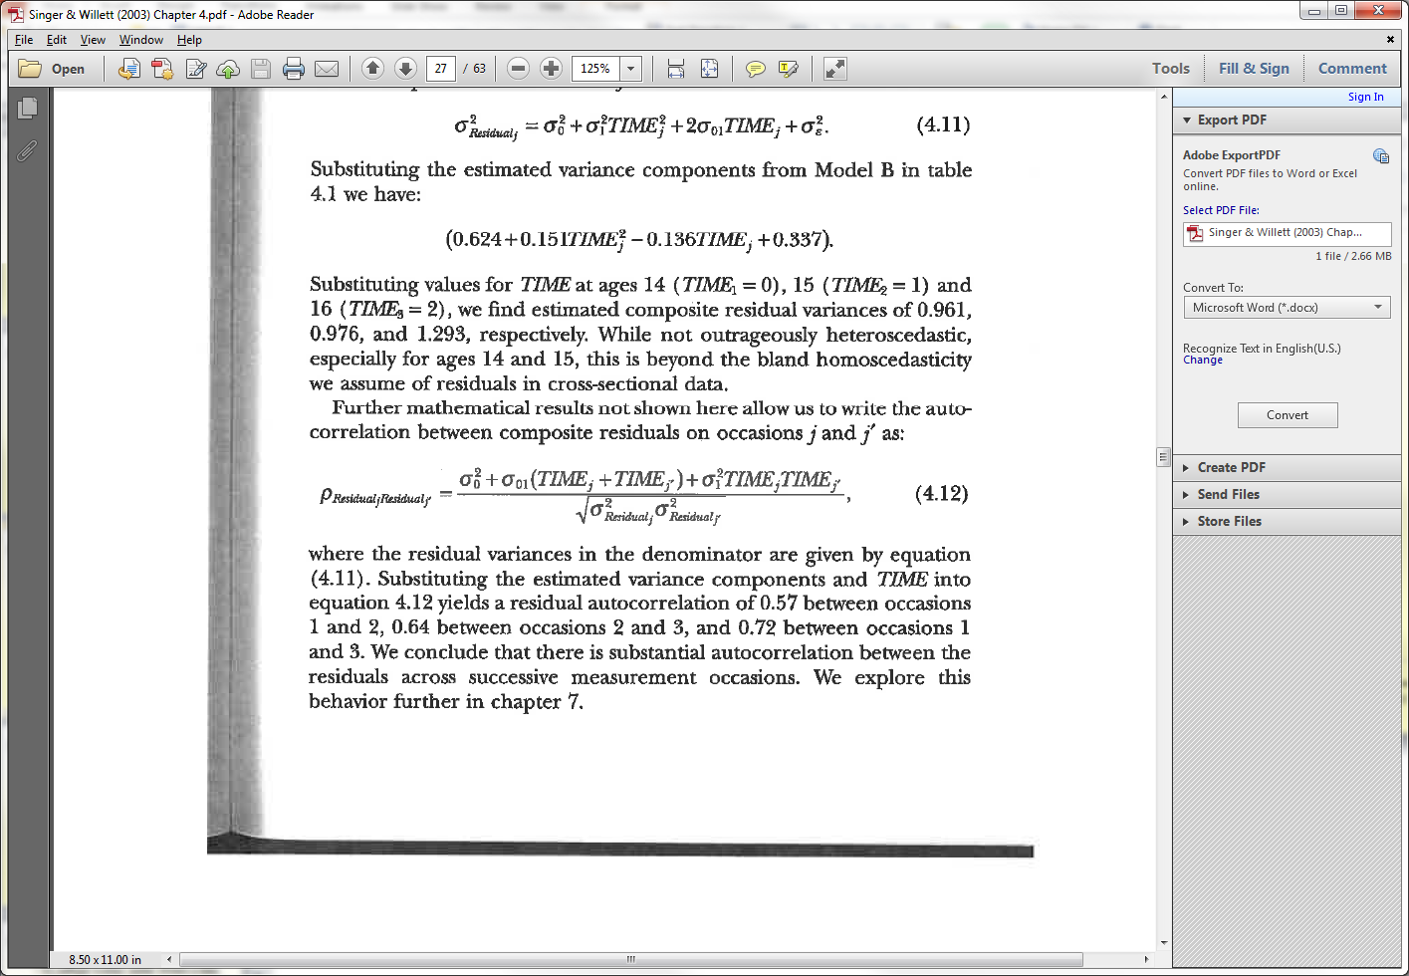
Step 4 in Modeling
Examining autocorrelation using the formulas from Singer and Willett (2003)
Estimate residual variances
Use residual variance estimates to estimate autocorrelation

Slide 75
Step 4 in Modeling
Example estimating residual variances
> VarCorr(tmod)
SUBNUM = pdLogChol(TIME)
Variance StdDev Corr
(Intercept) 0.6492751 0.8057761 (Intr)
TIME 0.1071334 0.3273124 -0.564
Residual 0.3116466 0.5582532
> -0.564*(0.806*0.327) #convert Corr to Cov
[1] -0.148649
> .649+(.107*0^2)+(2*-.149)*0+.312 #composite resid var T0
[1] 0.961
> .649+(.107*1^2)+(2*-.149)*1+.312 #composite resid var T1
[1] 0.77
> .649+(.107*2^2)+(2*-.149)*2+.312 #composite resid var T2
[1] 0.793

Slide 76
Step 4 in Modeling
Formula based methods of autocorrelation
> .649+(.107*0^2)+(2*-.149)*0+.312 #composite resid var T0
[1] 0.961
> .649+(.107*1^2)+(2*-.149)*1+.312 #composite resid var T1
[1] 0.77
> .649+(.107*2^2)+(2*-.149)*2+.312 #composite resid var T2
[1] 0.793
> (.649+-.149*(0+1)+.107*0*1)/sqrt(.961*.77) #T0 T1
[1] 0.58125
> (.649+-.149*(1+2)+.107*1*2)/sqrt(.77*.793) #T1 T2
[1] 0.5323673
> (.649+-.149*(0+2)+.107*0*2)/sqrt(.961*.793) #T0 T2
[1] 0.4020766

Slide 77
Step 4 in Modeling
A quick check for Heteroscedasticity
Problem is this is based on raw data and not residuals
> tapply(GROWSAT.UNIV$MULTDV,
GROWSAT.UNIV$TIME,var,na.rm=T)
0 1 2
0.9681912 0.8831397 0.7313358

Slide 78
Step 4 in Modeling
Arrange residuals into matrix: one row per person
Examine the Variance Pattern across residuals
> matrix(TEMP.RESID,ncol=3,byrow=T)[1:2,]
[,1] [,2] [,3]
[1,] -0.10488073 -1.1297697 0.5120083
[2,] -0.03508496 0.2290748 0.1599016
> apply(matrix(TEMP.RESID,ncol=3,byrow=T),2,var)
[1] 0.1645846 0.2404384 0.1520188

Slide 79
Step 4 in Modeling
Formal check for heteroscedasticity
The way to easily test using lme
> tmod4b<-update(tmod4a,weights=varExp(form=~TIME))
# Warning Message
> anova(tmod4a,tmod4b)
Model df logLik Test L.Ratio p-value
tmod4a 1 7 -1707.861
tmod4b 2 8 -1706.199 1 vs 2 3.323143 0.0683

Slide 80
Step 4 in Modeling
Get estimate of the degree of autocorrelation and heteroscedasticity
> summary(tmod4b)
....
Correlation Structure: AR(1)
Formula: ~1 | SUBNUM
Parameter estimate(s):
Phi
0.4019757
Variance function:
Structure: Exponential of variance covariate
Formula: ~TIME
Parameter estimates:
expon
-0.08626299

Slide 81
Step 4 in Modeling
Details on specifying the form of variance can be found in Bates & Pinheiro (2000)
Our example is odd because variance typically increases in growth modeling (ours decreased)
Increased variance uses the varFixed option as in
Given the low estimate of heteroscedasticity (and the fact that subsequent models turned out to be hard to estimate with this parameter) we settle on the AR1 model.
weights=varFixed(~TIME)

Slide 82
Final Level-1 Model
Final Level-1 model is:
> finlev1<-lme(MULTDV~TIME,random=~TIME|SUBNUM,
data=GROWSAT.UNIV,correlation=corAR1(),
na.action=na.omit, control=list(opt="optim"))
> round(summary(finlev1)$tTable,dig=3)
Value Std.Error DF t-value p-value
(Intercept) 3.219 0.044 903 72.398 0.000
TIME 0.053 0.024 903 2.213 0.027
Average level of
Satisfaction at
Time 0 (first data
collection time)
Amount Satisfaction
increases with each
increment of TIME

Slide 83
Level-2 Model
In Level-2 (Individual) we can now predict
Intercept Differences (why mean satisfaction differs)
Slope Differences (why growth patterns differ)
Intercept Differences
> lev2mod1<-lme(MULTDV~TIME+AGE,
random=~TIME|SUBNUM,data=GROWSAT.UNIV,
correlation=corAR1(),na.action=na.omit, control=list(opt="optim"))
> round(summary(lev2mod1)$tTable,dig=3)
Value Std.Error DF t-value p-value
(Intercept) 2.347 0.146 897 16.086 0.000
TIME 0.053 0.024 897 2.205 0.028
AGE 0.034 0.005 486 6.241 0.000

Slide 84
Level-2 Model
Slope Differences
> lev2mod2<-update(lev2mod1,MULTDV~TIME*AGE)
> round(summary(lev2mod2)$tTable,dig=3)
Value Std.Error DF t-value p-value
(Intercept) 2.098 0.186 896 11.264 0.000
TIME 0.271 0.104 896 2.608 0.009
AGE 0.043 0.007 486 6.180 0.000
TIME:AGE -0.008 0.004 896 -2.153 0.032

Slide 85
Level-2 Model
Plotting the Interaction by predicting four values
> TDAT<-data.frame(TIME=c(0,0,2,2),AGE=c(21,31,21,31))
> TDAT
TIME AGE
1 0 21
2 0 31
3 2 21
4 2 31
> predict(lev2mod2,TDAT,level=0)
[1] 3.010151 3.444641 3.198073 3.463921
attr(,"label")
[1] "Predicted values"

Slide 86
Level-2 Model
Plotting the Total Sample Interaction
> predict(lev2mod2,TDAT,level=0)
[1] 3.010151 3.444641 3.198073 3.463921

Slide 87
Level-2 Model
Plotting in R for quick visualization
> TDAT<-data.frame(TIME=c(0,0,2,2),AGE=c(21,31,21,31))
> TDAT$JSAT<-predict(lev2mod2,TDAT,level=0)
> with(TDAT,interaction.plot(TIME,AGE,JSAT,ylim=c(2,4)))

Slide 88
Step Summary (part 1)

Slide 89
Step Summary (part 2)

Slide 90
Growth Modeling
Exercise 3: Conduct a growth modeling analysis.
If time permits, show how to combine two DVs into one analysis (see notes below)
Notes:
TDAT<-univbct[,c("SUBNUM","AGE","TIME","JSAT")]
TDAT$JS.COM<-1
names(TDAT)<-c("SUBNUM","AGE","TIME","DV","JS.COM")
TDAT2<-univbct[,c("SUBNUM","AGE","TIME","COMMIT")]
TDAT2$JS.COM<-0
names(TDAT2)<-c("SUBNUM","AGE","TIME","DV","JS.COM")
ALLDAT<-rbind(TDAT,TDAT2)
names(ALLDAT)
tmod<-lme(DV~poly(TIME,2),random=~1|SUBNUM,ALLDAT,na.action=na.omit)
tmod2<-update(tmod,random=~poly(TIME,1)|SUBNUM)
tmod3<-update(tmod,random=~poly(TIME,2)|SUBNUM)
anova(tmod,tmod2,tmod3)
# JobSat scores significantly lower than commitment scores.
# Older individuals higher average scores (total)
tmod<-lme(DV~poly(TIME,2)+JS.COM+AGE,random=~poly(TIME,2)|SUBNUM,ALLDAT,na.action=na.omit)
summary(tmod)$tTable
#Age is not differentially related to average levels of Job Sat vs Commitment
tmod<-lme(DV~poly(TIME,2)+JS.COM*AGE,random=~poly(TIME,2)|SUBNUM,ALLDAT,na.action=na.omit)
summary(tmod)$tTable
# The linear slope for Job Sat significantly differs from the linear slope for commitment
tmod<-lme(DV~poly(TIME,2)*JS.COM+AGE,random=~poly(TIME,2)|SUBNUM,ALLDAT,na.action=na.omit)
summary(tmod)$tTable
# The linear and quadratic slopes (combined) do not vary by age (close though for linear)
tmod<-lme(DV~poly(TIME,2)*AGE+JS.COM,random=~poly(TIME,2)|SUBNUM,ALLDAT,na.action=na.omit)
summary(tmod)$tTable
# The linear and quadratic slopes for the two scales do not differentially interact with age
tmod<-lme(DV~poly(TIME,2)*AGE*JS.COM,random=~poly(TIME,2)|SUBNUM,ALLDAT,na.action=na.omit)
summary(tmod)$tTable

Slide 91
Part III
Discontinuous Growth Models

Slide 92
Discontinuous Growth Models
Allows one to build upon traditional growth models to incorporate events associated with abrupt changes
Unanticipated events such as financial shocks (State-level GDP and the Great Recession)
Anticipated events in field data collections (measuring sleep in different settings)
Anticipated events in laboratory experiments (adaptability and the task-change paradigm)

Slide 93
State-Level GDP Change
Notes:
library(lattice)
xyplot(gdp1k~I(TIME+1997)|as.factor(Area),
data=gdp.univ[1:240,],
layout = c(4,4),
type=c("p","g"),cex=1.2,pch=20,
col="black",
xlab=list("YEAR",cex=1.5),
ylab=list("GDP / 100K",cex=1.5))

Slide 94
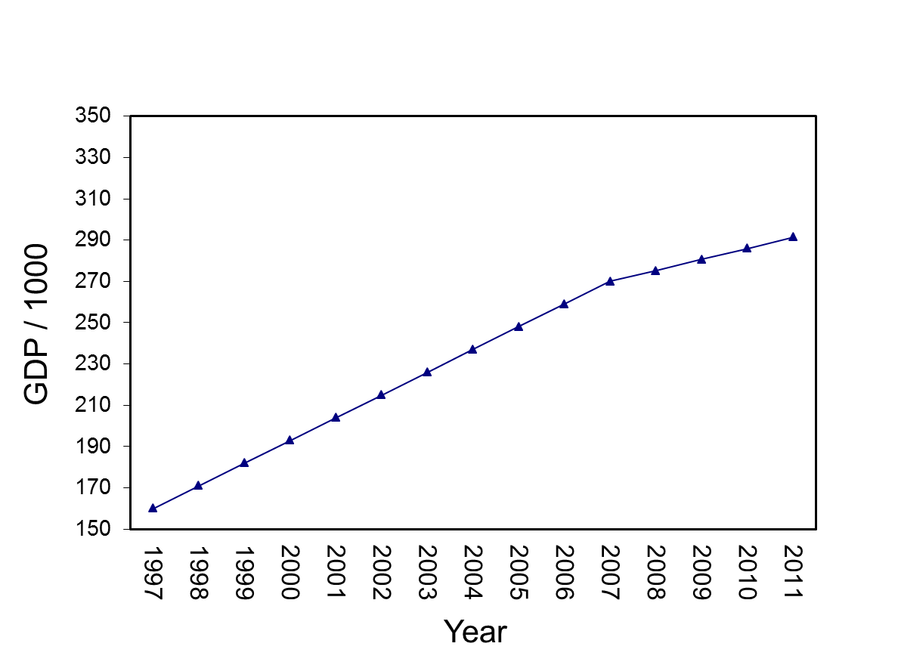
State-Level GDP Change
Notes:
TDAT<-gdp.univ[1:15,c("TIME","Trans","Recov")]
quantile(pinc[,2],c(.33,.66))/1000
median(pinc[,2])/1000
TDAT$Pinc20081k=149324.7
write.table(t(predict(mod4,TDAT,level=0)),file="clipboard", sep="\t",col.names=F,row.names=F)

Slide 95
State-Level GDP Change
Notes:
TDAT<-gdp.univ[1:15,c("TIME","Trans","Recov")]
quantile(pinc[,2],c(.33,.66))/1000
median(pinc[,2])/1000
TDAT$Pinc20081k=149324.7
write.table(t(predict(mod4,TDAT,level=0)),file="clipboard", sep="\t",col.names=F,row.names=F)

Slide 96
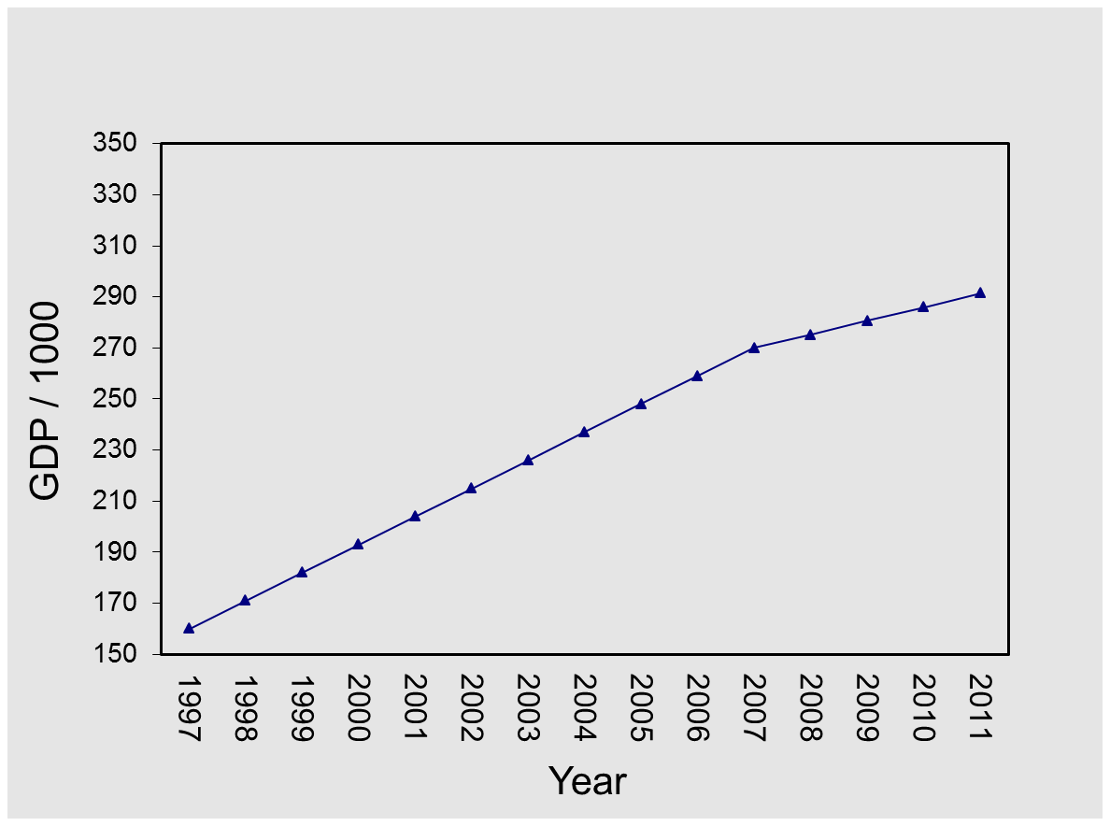
State-Level GDP Change
Questions we can ask
1. What is the overall pattern (pre-transition slope, transition change, post-transition slope) over time?
2. Are there differences in overall levels of GDP (intercept)?
3. Do States differ on pre-transition slopes, transition change, post-transition slopes?
4. What State-level variables predict pre-transition slope, transition change, post-transition slope?
Notes:
TDAT<-gdp.univ[1:15,c("TIME","Trans","Recov")]
quantile(pinc[,2],c(.33,.66))/1000
median(pinc[,2])/1000
TDAT$Pinc20081k=149324.7
write.table(t(predict(mod4,TDAT,level=0)),file="clipboard", sep="\t",col.names=F,row.names=F)

Slide 97
Sleep Example
Bliese, McGurk, Thomas, Balkin & Wesensten (2007)

Slide 98
Adaptability & Task-Change Paradigm
Lang & Bliese (2009)
Notes:
######### using 5,5,5,5,5,5 instead of zeros for PERIOD1XC
soardata[1:12,c("PERIOD1C","TRANSC","PERIOD2C","PERIOD1XC")]
tmod3<-lme(score~PERIOD1C+TRANSC+PERIOD2C+I(PERIOD1XC^2)+I(PERIOD2C^2)+GMF+
PERIOD1C:GMF+TRANSC:GMF+PERIOD2C:GMF+I(PERIOD1XC^2):GMF+
I(PERIOD2C^2):GMF,random=~1|ID,data=soardata)
summary(tmod3)$tTable
#Low
TDAT<-data.frame(GMF=-1,soardata[1:12,c("PERIOD1C","TRANSC","PERIOD2C","PERIOD1XC")])
VALS<-predict(tmod3,TDAT,level=0)
write.table(t(VALS),file="clipboard",sep="\t",row.names=F,col.names=F)
#Average
TDAT<-data.frame(GMF=0,soardata[1:12,c("PERIOD1C","TRANSC","PERIOD2C","PERIOD1XC")])
VALS<-predict(tmod3,TDAT,level=0)
write.table(t(VALS),file="clipboard",sep="\t",row.names=F,col.names=F)
#High
TDAT<-data.frame(GMF=1,soardata[1:12,c("PERIOD1C","TRANSC","PERIOD2C","PERIOD1XC")])
VALS<-predict(tmod3,TDAT,level=0)
write.table(t(VALS),file="clipboard",sep="\t",row.names=F,col.names=F)

Slide 99
Banking Sleep
Rupp, Wesensten, Bliese & Balkin (2009)

Slide 100

Firm Productivity: Great Recession

Slide 101
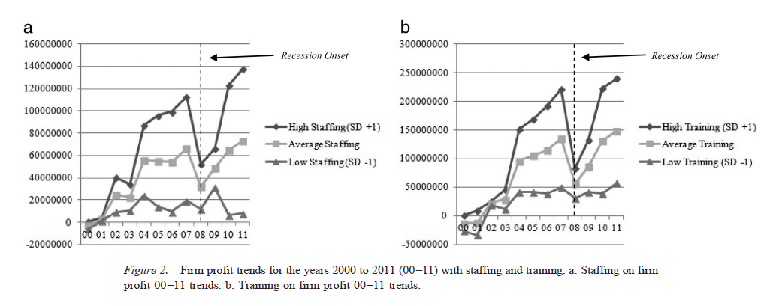
Firm Productivity: Great Recession

Slide 102
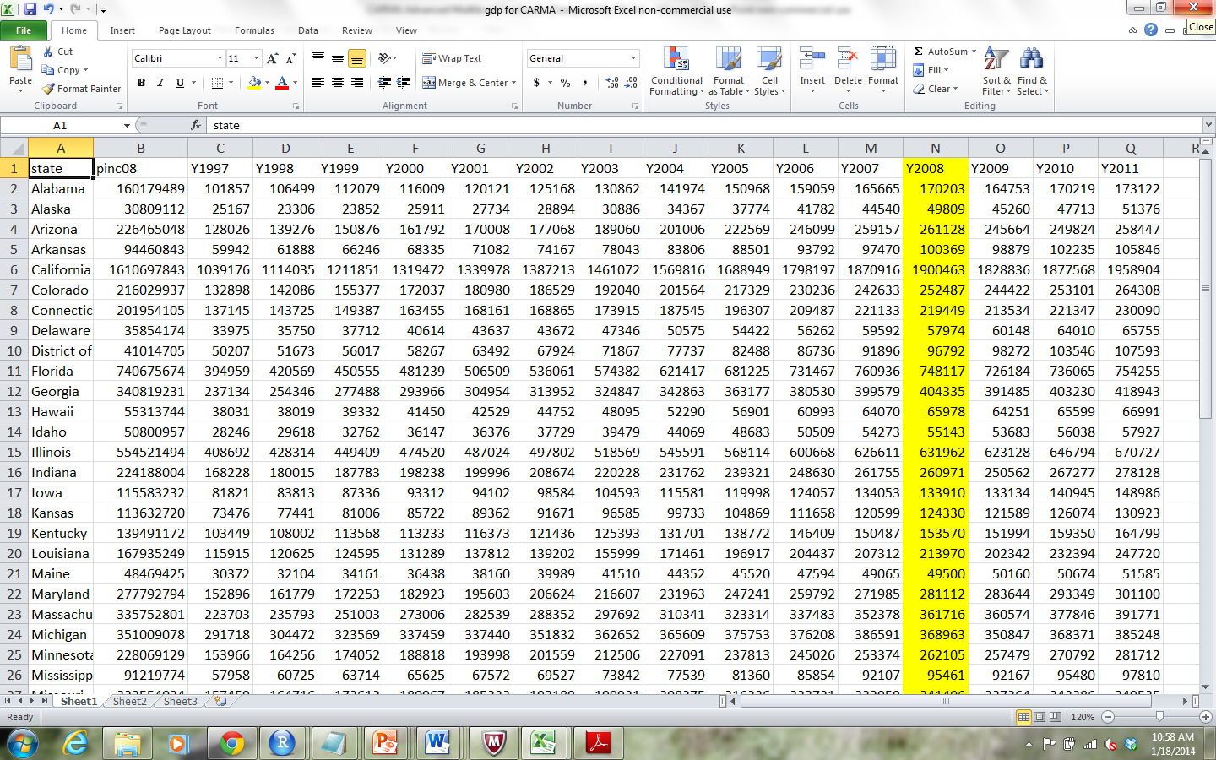
GDP Example
State-level GDP for 15 years (1997-2011)
In 1998, “Great Recession”

Slide 103
Growth Modeling Setup
Read data into R:
Copy data in EXCEL (Ctrl-C) “Discontinuous Growth State GDP 1997 to 2011.xlsx”
Paste into R with commands below
> gdpdata<-read.table(file="clipboard",sep="\t",header=T)
> names(gdpdata)
[1] "state" "pinc08" "Y1997" "Y1998" "Y1999" "Y2000"
[7] "Y2001" "Y2002" "Y2003" "Y2004" "Y2005" "Y2006"
[13] "Y2007" "Y2008" "Y2009" "Y2010" "Y2011"
> #For MAC users
> gdpdata<-read.table(pipe("pbpaste"),sep="\t",header=T)

Slide 104
Convert Data to Univariate Form
> names(gdpdata)
[1] "state" "pinc08" "Y1997" "Y1998" "Y1999" "Y2000"
[7] "Y2001" "Y2002" "Y2003" "Y2004" "Y2005" "Y2006"
[13] "Y2007" "Y2008" "Y2009" "Y2010" "Y2011"
> library(multilevel)
> gdpdata.univ<-make.univ(gdpdata,gdpdata[,3:17],
outname="gdp")

Slide 105
gdp 1997-2011: Alabama
> gdpdata.univ[1:15,c(1:5,18:19)]
state pinc08 Y1997 Y1998 Y1999 TIME gdp
1 Alabama 160179489 101857 106499 112079 0 101857
1.1 Alabama 160179489 101857 106499 112079 1 106499
1.2 Alabama 160179489 101857 106499 112079 2 112079
1.3 Alabama 160179489 101857 106499 112079 3 116009
1.4 Alabama 160179489 101857 106499 112079 4 120121
1.5 Alabama 160179489 101857 106499 112079 5 125168
1.6 Alabama 160179489 101857 106499 112079 6 130862
1.7 Alabama 160179489 101857 106499 112079 7 141974
1.8 Alabama 160179489 101857 106499 112079 8 150968
1.9 Alabama 160179489 101857 106499 112079 9 159059
1.10 Alabama 160179489 101857 106499 112079 10 165665
1.11 Alabama 160179489 101857 106499 112079 11 170203
1.12 Alabama 160179489 101857 106499 112079 12 164753
1.13 Alabama 160179489 101857 106499 112079 13 170219
1.14 Alabama 160179489 101857 106499 112079 14 173122

Slide 106
Growth Modeling Setup
“Advanced Discontinuous Growth Exercises”
Exercise 4: Growth Modeling Data Setup. Transform sleep data from “flat” to “stacked” format (Sleep actigraph 26 day.xls).

Slide 107
Coding for discontinuity
Discontinuous Growth Models

Slide 108
Coding for Discontinuity
Purpose
Detail how to add additional TIME variables to code for discontinuity
Use the State GDP data to illustrate setting up the specific variables

Slide 109
Make GDP more Manageable by Dividing by 1000
> gdpdata.univ[1:16,
c("state","TIME","gdp")]
state TIME gdp
1 Alabama 0 101857
1.1 Alabama 1 106499
1.2 Alabama 2 112079
1.3 Alabama 3 116009
1.4 Alabama 4 120121
1.5 Alabama 5 125168
1.6 Alabama 6 130862
1.7 Alabama 7 141974
1.8 Alabama 8 150968
1.9 Alabama 9 159059
1.10 Alabama 10 165665
1.11 Alabama 11 170203
1.12 Alabama 12 164753
1.13 Alabama 13 170219
1.14 Alabama 14 173122
2 Alaska 0 25167
> gdpdata.univ$gdp1k<-
gdpdata.univ$gdp/1000
> gdpdata.univ[1:10,
c("state","TIME","gdp","gdp1k")]
state TIME gdp gdp1k
1 Alabama 0 101857 101.857
1.1 Alabama 1 106499 106.499
1.2 Alabama 2 112079 112.079
1.3 Alabama 3 116009 116.009
1.4 Alabama 4 120121 120.121
1.5 Alabama 5 125168 125.168
1.6 Alabama 6 130862 130.862
1.7 Alabama 7 141974 141.974
1.8 Alabama 8 150968 150.968
1.9 Alabama 9 159059 159.059

Slide 110
State-Level GDP Change
Notes:
library(lattice)
xyplot(gdp1k~I(TIME+1997)|as.factor(Area),
data=gdp.univ[1:240,],
layout = c(4,4),
type=c("p","g"),cex=1.2,pch=20,
col="black",
xlab=list("YEAR",cex=1.5),
ylab=list("GDP / 100K",cex=1.5))

Slide 111
Create Time-Related Covariates
The basic linear growth model includes TIME
Additional TIME-based covariates describe other forms of continuous change (e.g., quadratic)
> tmod<-lme(gdp1k~TIME,random=~1|state,gdpdata.univ, control=list(opt="optim"))
> round(summary(tmod)$tTable,dig=3)
Value Std.Error DF t-value p-value
(Intercept) 163.152 39.078 713 4.175 0
TIME 9.744 0.477 713 20.436 0
> tmod<-lme(gdp1k~TIME+I(TIME^2),random=~1|state,gdpdata.univ, control=list(opt="optim"))
> round(summary(tmod)$tTable,dig=3)
Value Std.Error DF t-value p-value
(Intercept) 158.593 39.259 712 4.040 0.000
TIME 11.848 1.803 712 6.573 0.000
I(TIME^2) -0.150 0.124 712 -1.210 0.227

Slide 112
16 States: Linear

Slide 113
Create Time-Related Covariates
Discontinuity is captured by adding additional TIME-based covariates
Break time into segments
The discontinuous growth model we consider uses three TIME-based covariates to capture
Pre-discontinuity slope (TIME)
Change at the transition (TRANS)
Post-discontinuity transition slope (RECOV)

Slide 114
Create Time-Related Covariates
TRANS
RECOV
TIME
Notes:
TDAT<-gdp.univ[1:15,c("TIME","Trans","Recov")]
quantile(pinc[,2],c(.33,.66))/1000
median(pinc[,2])/1000
TDAT$Pinc20081k=149324.7
write.table(t(predict(mod4,TDAT,level=0)),file="clipboard", sep="\t",col.names=F,row.names=F)

Slide 115
Create Time-Related Covariates
The TIME-based covariate for the Transition (TRANS) is a dummy-coded variable
Pre-transition coded as 0
Post-transition coded as 1
In our example, 2008 is the year of discontinuity
TIME 0 to 10 (1997 to 2007) is pre-recession
TIME 11 to 14 (2008 to 2011) is post-recession
The ifelse function in R can be used to efficiently create the TRANS variable
gdpdata.univ$TRANS<-ifelse(gdpdata.univ$TIME>10,1,0)

Slide 116
Create Time-Related Covariates
The TIME-based covariate for the recovery slope (RECOV) is a combination of dummy and continuous
Pre-transition coded as 0
Post-transition slope coded 0 to n-1 post transition observations
In our example
TIME 0 to 10 (1997 to 2007) coded as 0
TIME 11 to 14 (2008 to 2011) coded 0,1,2,3
R code subtracts 11 from TIME (step1) and then changes negative numbers to 0 (step 2)
> gdpdata.univ$RECOV<-gdpdata.univ$TIME-11
> gdpdata.univ$RECOV[gdpdata.univ$RECOV<0]<-0

Slide 117
Create Time-Related Covariates
> gdpdata.univ[1:15,c("state","TIME","TRANS","RECOV")]
state TIME TRANS RECOV
1 Alabama 0 0 0
1.1 Alabama 1 0 0
1.2 Alabama 2 0 0
1.3 Alabama 3 0 0
1.4 Alabama 4 0 0
1.5 Alabama 5 0 0
1.6 Alabama 6 0 0
1.7 Alabama 7 0 0
1.8 Alabama 8 0 0
1.9 Alabama 9 0 0
1.10 Alabama 10 0 0
1.11 Alabama 11 1 0
1.12 Alabama 12 1 1
1.13 Alabama 13 1 2
1.14 Alabama 14 1 3

Slide 118
Creating Time-Related Covariates
“Advanced Discontinuous Growth Exercises”
Exercise 5: Create Time-Related Covariates in the sleep data

Slide 119
Analyzing and interpreting models
Discontinuous Growth Models

Slide 120
Analyzing and Interpreting Models
Purpose
Identify Model Building Steps
Interpreting Model Parameters
Examining Alternative Specifications

Slide 121
Model Building Steps
Notes on optimization in lme function
Build Level-1 Model (Bliese & Ployhart, 2002)
Step 1: Estimate the ICC
Step 2: Examine Fixed Effects for:
TIME
TRANS
RECOV
Step 3: Examine Variability in Growth Parameters
Step 4: Model autocorrelation
Step 5: Contrast Alternative Models
Build Level-2 Model (step 6)
Add level-2 predictors (Level-2)

Slide 122
Optimization
The lme function uses two different routines in the stats package for optimization
The function optim
The function nlmimb
The default after versions 2.2 of R has been nlmimb
Very precise
Less robust than optim
Complex models sometimes fail to converge with the default nlmimb so we will use the optim function
> My.Model<-lme(DV~IV, random=~IV|GRP,
data=MYDATA, control=list(opt="optim"))

Slide 123
Step 1: ICC estimate
ICC values are important to estimate
In this example, the ICC value is extremely high (0.94) working against finding discontinuous effects
Large differences across States
Low within-State variability
> null.mod<-lme(gdp1k~1,random=~1|state,gdpdata.univ, control=list(opt="optim"))
> VarCorr(null.mod)
state = pdLogChol(1)
Variance StdDev
(Intercept) 76969.042 277.43295
Residual 5140.942 71.70036
> 76969.042/(76969.042+5140.942)
[1] 0.9373896

Slide 124
Step 2 in Modeling
In one block examine fixed effects associated with
TIME
TRANS
RECOV
Only TIME is significant (but we will continue to examine data)
> mod2<-lme(gdp1k~TIME+TRANS+RECOV,random=~1|state,
gdpdata.univ,control=list(opt="optim"))
> round(summary(mod2)$tTable,dig=4)
Value Std.Error DF t-value p-value
(Intercept) 158.7940 39.1391 711 4.0572 0.0001
TIME 10.8671 0.7594 711 14.3098 0.0000
TRANS -5.4987 8.4224 711 -0.6529 0.5141
RECOV -5.0914 3.6421 711 -1.3980 0.1626

Slide 125
Interpreting Step 2
In 1997 (TIME 0), the average level of GDP across the 51 States was 158794 (158.794*1000)
GDP increased by 10867.129 each year
GDP dropped by 5498.661 in 2008 (relative to expected increase)
Recovery slope of -5091.427 indicates the recovery slope is weaker than the slope associated with the period before 2008 (but still positive)
> mod2<-lme(gdp1k~TIME+TRANS+RECOV,random=~1|state,
gdpdata.univ,control=list(opt="optim"))
> round(summary(mod2)$tTable,dig=4)
Value Std.Error DF t-value p-value
(Intercept) 158.7940 39.1391 711 4.0572 0.0001
TIME 10.8671 0.7594 711 14.3098 0.0000
TRANS -5.4987 8.4224 711 -0.6529 0.5141
RECOV -5.0914 3.6421 711 -1.3980 0.1626

Slide 126
Create Time-Related Covariates
Recovery slope 5091.427
Less than original slope
TRANS
RECOV
Drop of 5498.661
TIME
10867.129 yearly increase
GDP at Time 0
equals 158794
Notes:
TDAT<-gdp.univ[1:15,c("TIME","Trans","Recov")]
quantile(pinc[,2],c(.33,.66))/1000
median(pinc[,2])/1000
TDAT$Pinc20081k=149324.7
write.table(t(predict(mod4,TDAT,level=0)),file="clipboard", sep="\t",col.names=F,row.names=F)

Slide 127
Step 3: Modeling State Variability
Examine potential variability in time-based parameters
Add random slopes one at a time and contrast models
Best fit for model with random slopes for TIME, TRANS and RECOV
Suggests significant variability in all Time related parameters across States
> mod3.a<-update(mod2,random=~TIME|state)
> mod3.b<-update(mod3.a,random=~TIME+TRANS|state)
> mod3.c<-update(mod3.b,random=~TIME+TRANS+RECOV|state)
> anova(mod2,mod3.a,mod3.b,mod3.c)
Model df AIC BIC logLik Test L.Ratio p-value
mod2 1 6 8641.864 8669.671 -4314.932
mod3.a 2 8 6683.111 6720.189 -3333.556 1 vs 2 1962.7521 <.0001
mod3.b 3 11 6540.190 6591.171 -3259.095 2 vs 3 148.9212 <.0001
mod3.c 4 15 6379.728 6449.247 -3174.864 3 vs 4 168.4627 <.0001

Slide 128
State-Level GDP Change
Notes:
library(lattice)
xyplot(gdp1k~I(TIME+1997)|as.factor(Area),
data=gdp.univ[1:240,],
layout = c(4,4),
type=c("p","g"),cex=1.2,pch=20,
col="black",
xlab=list("YEAR",cex=1.5),
ylab=list("GDP / 100K",cex=1.5))

Slide 129
Step 3: Modeling State Variability
Contrast models with fixed slopes vs random slopes
Both models convey that parameters are variable
one through large SE’s
one showing significant variability among States
> round(summary(mod2)$tTable,dig=4)
Value Std.Error DF t-value p-value
(Intercept) 158.7940 39.1391 711 4.0572 0.0001
TIME 10.8671 0.7594 711 14.3098 0.0000
TRANS -5.4987 8.4224 711 -0.6529 0.5141
RECOV -5.0914 3.6421 711 -1.3980 0.1626
> round(summary(mod3.c)$tTable,dig=4)
Value Std.Error DF t-value p-value
(Intercept) 158.7940 26.1591 711 6.0703 0.0000
TIME 10.8671 1.9922 711 5.4550 0.0000
TRANS -5.4987 2.2932 711 -2.3978 0.0168
RECOV -5.0914 1.4221 711 -3.5803 0.0004

Slide 130
Step 4: Testing for Autocorrelation
Up to now, models assume independent errors in the covariance structure of the data.
No pattern to level-1 model residuals
Assumption of independent errors is rarely supported when dealing with repeated measures over time.
As Littell, Milliken, Stroup, and Wolfinger (1996) note, “measurements taken at adjacent times are typically more highly correlated than two measurements taken several time points apart” (p. 88).

Slide 131
Step 4: Testing for Autocorrelation
The correlation option in lme specifies alternative within-group correlation structures.
A common structure is corAR1() or first-order autoregressive
Update mod3.c and contrasting the -2 log likelihood values between the two models
Notice 1 df difference for the estimate of phi in mod4
> mod4<-update(mod3.c,correlation=corAR1(form=~TIME|state))
> anova(mod3.c,mod4)
Model df AIC BIC logLik Test L.Ratio p-value
mod3.c 1 15 6379.728 6449.247 -3174.864
mod4 2 16 6095.525 6169.679 -3031.762 1 vs 2 286.2027 <.0001

Slide 132
Step 4: Testing for Autocorrelation
> summary(mod4)
Linear mixed-effects model fit by REML
Data: gdpdata.univ
AIC BIC logLik
6095.525 6169.679 -3031.762
Random effects:
Formula: ~TIME + TRANS + RECOV | state
Structure: General positive-definite, Log-Cholesky parametrization
StdDev Corr
(Intercept) 186.470614 (Intr) TIME TRANS
TIME 14.288536 0.986
TRANS 9.254378 -0.948 -0.898
RECOV 8.739618 -0.989 -0.988 0.931
Residual 19.332704
Correlation Structure: AR(1)
Formula: ~TIME | state
Parameter estimate(s):
Phi
0.8617861

Slide 133
Step 4: Testing for Autocorrelation
Contrast models with and without adjustment of lag-1 autocorrelation
Changes in both parameter estimates and SEs
> round(summary(mod3.c)$tTable,dig=4)
Value Std.Error DF t-value p-value
(Intercept) 158.7940 26.1591 711 6.0703 0.0000
TIME 10.8671 1.9922 711 5.4550 0.0000
TRANS -5.4987 2.2932 711 -2.3978 0.0168
RECOV -5.0914 1.4221 711 -3.5803 0.0004
> round(summary(mod4)$tTable,dig=4)
Value Std.Error DF t-value p-value
(Intercept) 159.9887 26.2454 711 6.0959 0.0000
TIME 11.0041 2.0288 711 5.4238 0.0000
TRANS -5.8089 1.9922 711 -2.9159 0.0037
RECOV -5.6020 1.5201 711 -3.6853 0.0002

Slide 134
Steps 1 to 4
“Advanced Discontinuous Growth Exercises”
Exercise 6:
Estimate ICC
Model TIME-related Fixed Effects
Model variability across level-2 units
Estimate lag-1 autocorrelation

Slide 135
Step 5: Contrasting Alternative Models
The parameters TIME, TRANS and RECOV represent a flexible discontinuous model
In some cases, however, discontinuity might be captured with two of the three parameters
TIME and TRANS
TIME and RECOV
The form of the discontinuity differs depending upon which parameters are included

Slide 136
Step 5: Contrasting Alternative Models
The model with TIME and TRANS has identical slopes pre and post-discontinuity:
> mod5.a<-lme(gdp1k~TIME+TRANS,
random=~TIME+TRANS|state, gdpdata.univ,
correlation=corAR1(form=~TIME|state),
control=list(opt="optim"))
> round(summary(mod5.a)$tTable,dig=4)
Value Std.Error DF t-value p-value
(Intercept) 162.9069 26.9315 712 6.0489 0.0000
TIME 9.8017 1.7721 712 5.5310 0.0000
TRANS -4.8805 1.9446 712 -2.5097 0.0123

Slide 137
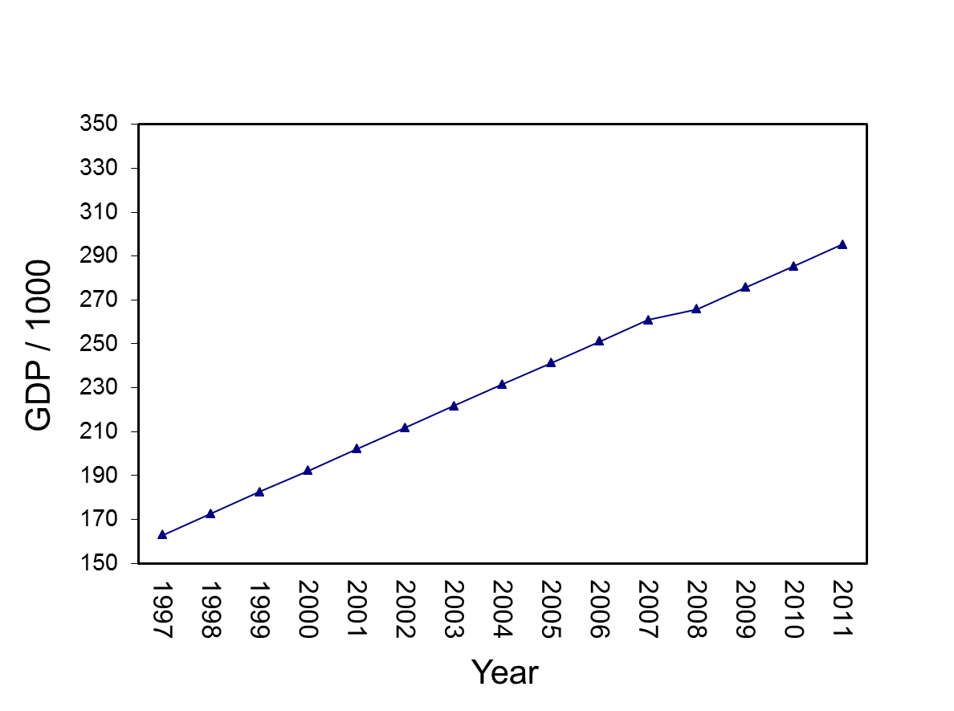
State-Level GDP Change
TRANS
Drop of 4880.5
Slopes are equal
Notes:
TDAT<-gdpdata.univ[1:15,c("TIME","TRANS","RECOV")]
write.table(t(predict(mod5.a,TDAT,level=0)),file="clipboard", sep="\t",col.names=F,row.names=F)

Slide 138
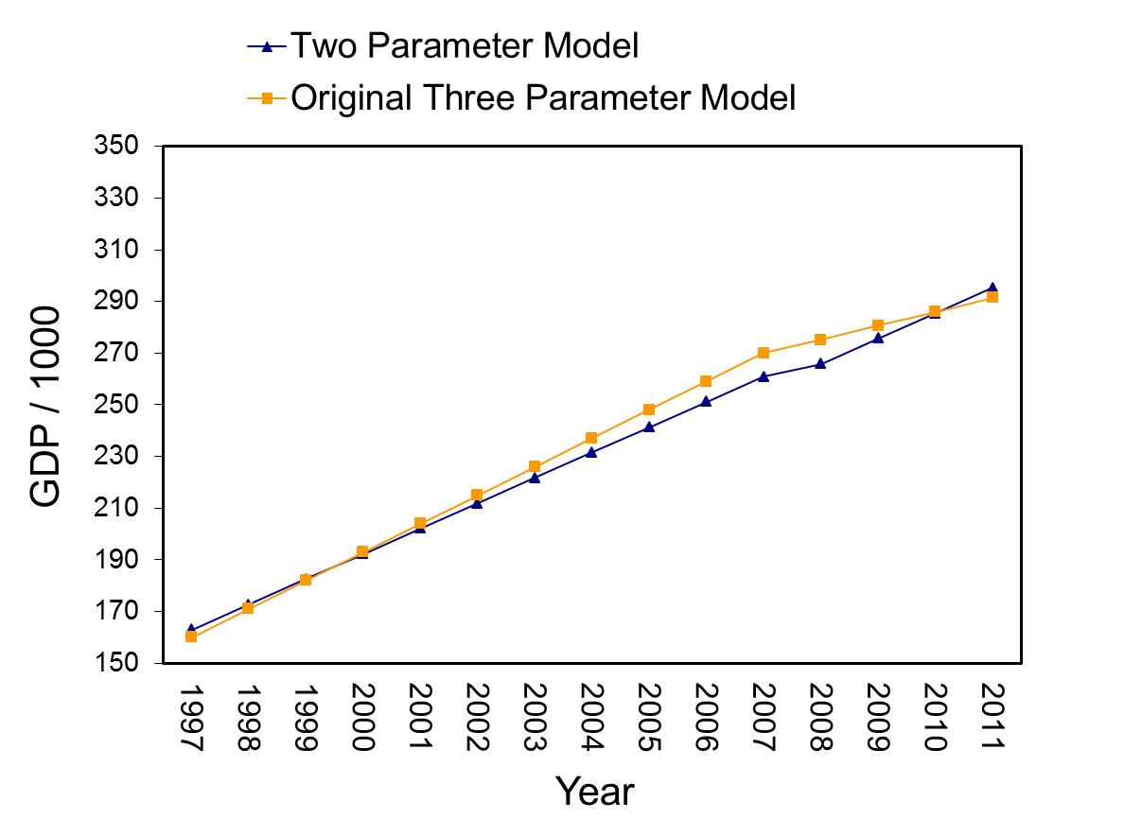
State-Level GDP Change
Notes:
TDAT<-gdpdata.univ[1:15,c("TIME","TRANS","RECOV")]
write.table(t(predict(mod5.a,TDAT,level=0)),file="clipboard", sep="\t",col.names=F,row.names=F)

Slide 139
Step 5: Contrasting Alternative Models
The model with TIME and RECOV has a change in slope pre and post-discontinuity
Excludes a parameter for a drop or increase at a specific time (2008):
> mod5.b<-lme(gdp1k~TIME+RECOV,
random=~TIME+RECOV|state, gdpdata.univ,
correlation=corAR1(form=~TIME|state),
control=list(opt="optim"))
> round(summary(mod5.b)$tTable,dig=4)
Value Std.Error DF t-value p-value
(Intercept) 161.1470 26.4624 712 6.0897 0e+00
TIME 10.5338 1.9364 712 5.4399 0e+00
RECOV -5.3337 1.5104 712 -3.5314 4e-04

Slide 140
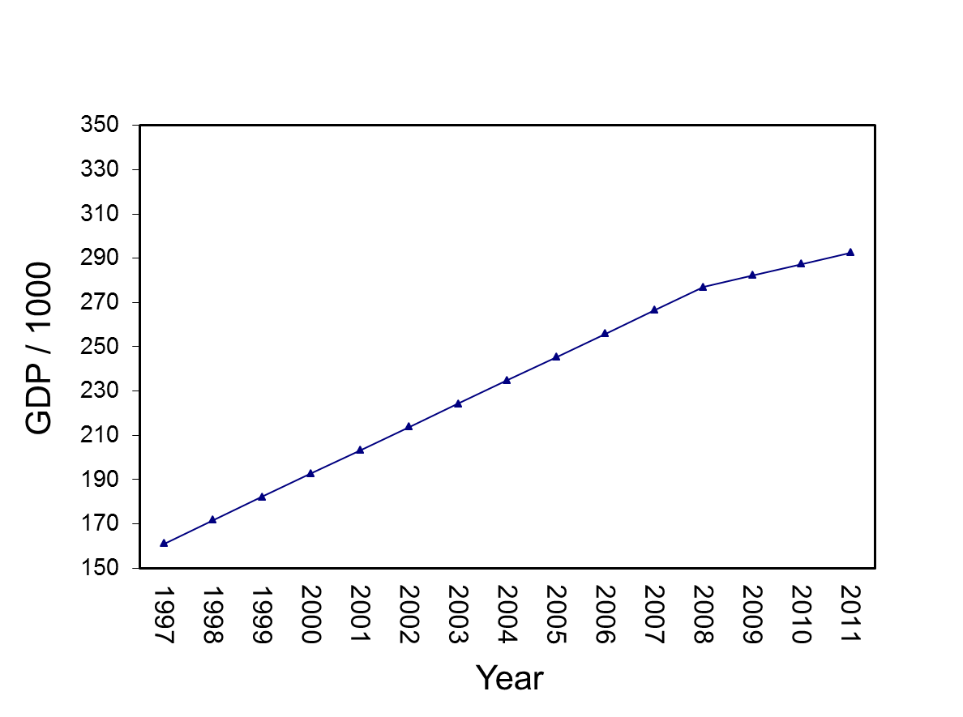
State-Level GDP Change
Change in Slope:
No drop/increase
Slopes are unequal
Notes:
TDAT<-gdpdata.univ[1:15,c("TIME","TRANS","RECOV")]
write.table(t(predict(mod5.b,TDAT,level=0)),file="clipboard", sep="\t",col.names=F,row.names=F)

Slide 141

State-Level GDP Change
Notes:
TDAT<-gdpdata.univ[1:15,c("TIME","TRANS","RECOV")]
write.table(t(predict(mod5.a,TDAT,level=0)),file="clipboard", sep="\t",col.names=F,row.names=F)

Slide 142
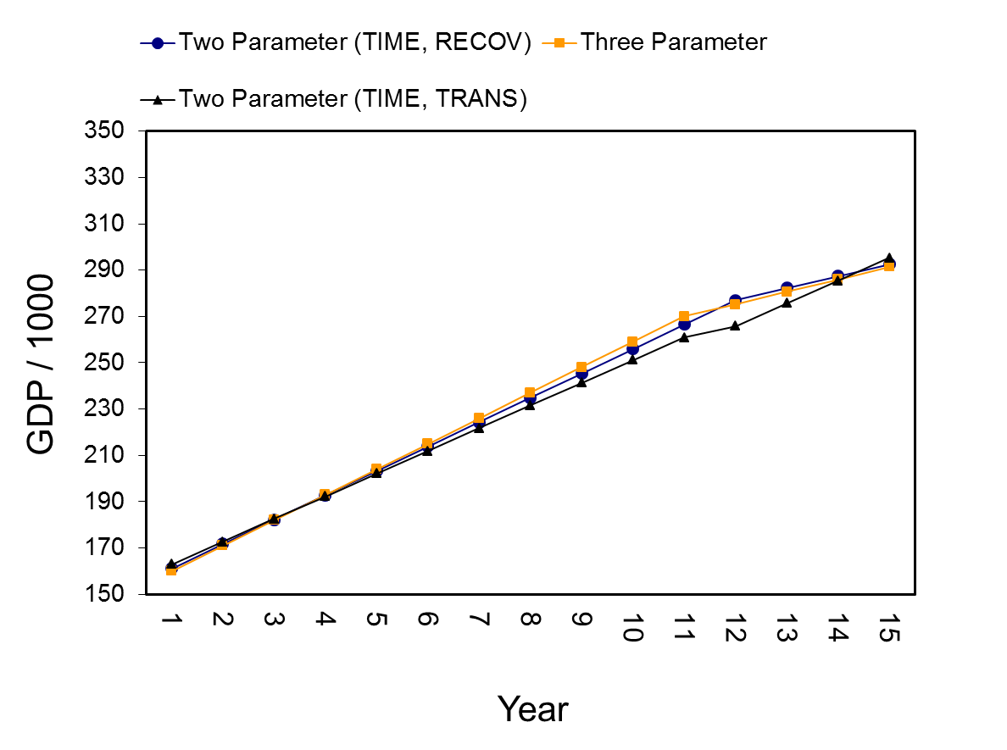
State-Level GDP Change
Notes:
TDAT<-gdpdata.univ[1:15,c("TIME","TRANS","RECOV")]
write.table(t(predict(mod5.a,TDAT,level=0)),file="clipboard", sep="\t",col.names=F,row.names=F)

Slide 143
Step 5: Picking Alternative Models
Alternative models have different predictors so comparisons of -2 log likelihood values is not appropriate
Default is Restricted-Maximum Likelihood (REML)
With REML, -2 log likelihood contrasts should be used only on random effects
May to useful to examine:
Akaike’s Information Criterion (AIC)
Bayesian Information Criterion (BIC)
Smaller is better
Can contrast values across non-nested models

Slide 144
Step 5: Picking Alternative Models
Akaike’s Information Criterion (AIC)
Formula: 2k – (2 * (logLik))
Bayesian Information Criterion (BIC)
Formula (large n approx): -2 * logLik + k * log(n)
> logLik(mod5.a)
'log Lik.' -3091.293 (df=11)
> AIC(mod5.a)
[1] 6204.586
> (2*11)-(2*(-3091.293))
[1] 6204.586
> BIC(mod5.a)
[1] 6255.581
> -2*-3091.293+11*log(765)
[1] 6255.625

Slide 145
Step 5: Picking Alternative Models
The BIC carries more of a penalty for additional parameters (k) than does the AIC
Practically speaking, this means that the BIC will favor simpler models

Slide 146
Step 5: Picking Alternative Models
Models:
Three parameter model (mod4)
TIME, TRANS (mod5.a)
TIME, RECOV (mod5.b)
Three parameter model (mod4) is best choice:
Lowest AIC
Lowest BIC
BIC for mod4 and mod5.b similar
> AIC(mod4)
[1] 6095.525
> BIC(mod4)
[1] 6169.679
>
> AIC(mod5.a)
[1] 6204.586
> BIC(mod5.a)
[1] 6255.581
>
> AIC(mod5.b)
[1] 6133.767
> BIC(mod5.b)
[1] 6184.763

Slide 147
Step 5 Exercise
“Advanced Discontinuous Growth Exercises”
Exercise 7:
Model Alternative Model 1 (TIME and TRANS)
Model Alternative Model 2 (TIME and RECOV)
Contrast
Three parameter models with two parameter models

Slide 148
Step 6: Adding Level-2 Predictors
The final step in discontinuous growth modeling is to add level-2 predictors of all the parameters found to randomly vary
In the GDP example, there are State-level differences in:
Intercepts (e.g., mean levels of GDP)
Pre-transition slope (TIME)
Change at the transition point (TRANS)
Post-transition slope (RECOV)

Slide 149
Step 6: Modeling State Variability
States vary on every parameter
> null.mod<-lme(gdp1k~1,random=~1|state,gdpdata.univ, control=list(opt="optim"))
> VarCorr(null.mod)
state = pdLogChol(1)
Variance StdDev
(Intercept) 76969.042 277.43295
Residual 5140.942 71.70036
> 76969.04/(76969.04+5140.942)
[1] 0.9373896
> mod3.a<-update(mod2,random=~TIME|state)
> mod3.b<-update(mod3.a,random=~TIME+TRANS|state)
> mod3.c<-update(mod3.b,random=~TIME+TRANS+RECOV|state)
> anova(mod2,mod3.a,mod3.b,mod3.c)
Model df AIC BIC logLik Test L.Ratio p-value
mod2 1 6 8641.864 8669.671 -4314.932
mod3.a 2 8 6683.111 6720.189 -3333.556 1 vs 2 1962.7521 <.0001
mod3.b 3 11 6540.190 6591.171 -3259.095 2 vs 3 148.9212 <.0001
mod3.c 4 15 6379.728 6449.247 -3174.864 3 vs 4 168.4627 <.0001

Slide 150
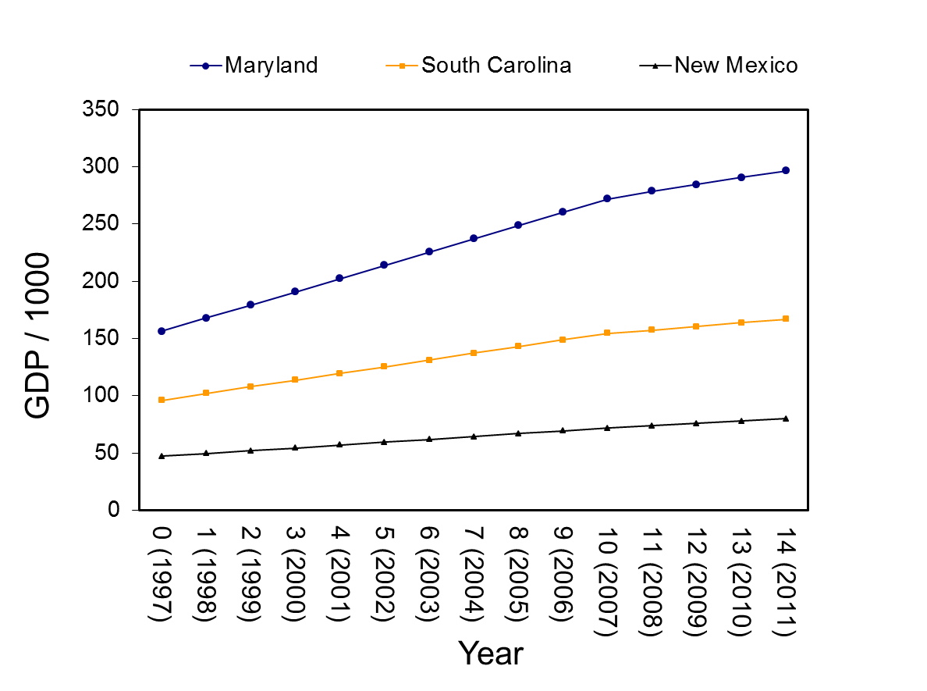
Visualizing State-Level Variability
Notes:
TDAT<-gdpdata.univ[1:15,c("TIME","TRANS","RECOV")]
TDAT$state="Maryland"
write.table(t(predict(mod4,TDAT,level=1)),file="clipboard", sep="\t",col.names=F,row.names=F)
####
TDAT<-gdpdata.univ[1:15,c("TIME","TRANS","RECOV")]
TDAT$state="South Carolina"
write.table(t(predict(mod4,TDAT,level=1)),file="clipboard", sep="\t",col.names=F,row.names=F)
####
TDAT<-gdpdata.univ[1:15,c("TIME","TRANS","RECOV")]
TDAT$state="New Mexico"
write.table(t(predict(mod4,TDAT,level=1)),file="clipboard", sep="\t",col.names=F,row.names=F)

Slide 151
Step 6: Modeling State Variability
Predicting Intercept Variability
State-Level Average Personal Income in 2008 (pinc08)
Average Personal Income related to State GDP
> mod6.a<-lme(gdp1k~TIME+TRANS+RECOV+pinc08,
random=~TIME+TRANS+RECOV|state, gdpdata.univ,
correlation=corAR1(form=~TIME|state),
control=list(opt="optim"))
> round(summary(mod6.a)$tTable,dig=4)
Value Std.Error DF t-value p-value
(Intercept) -59.1073 11.2495 711 -5.2542 0.0000
TIME 10.9638 2.0116 711 5.4503 0.0000
TRANS -5.7022 1.8716 711 -3.0468 0.0024
RECOV -5.4556 1.5095 711 -3.6142 0.0003
pinc08 0.0000 0.0000 49 99.1366 0.0000

Slide 152
Step 6: Modeling State Variability
Parameters and SE are all zero, so rescale pinc08 by dividing by 100,000 (pinc08.100k)
Average Personal Income in a State is a strong predictor of State GDP
> gdpdata.univ$pinc08.100k<-gdpdata.univ$pinc08/100000
> mod6.a<-lme(gdp1k~TIME+TRANS+RECOV+pinc08.100k,
random=~TIME+TRANS+RECOV|state, gdpdata.univ,
correlation=corAR1(form=~TIME|state),
control=list(opt="optim"))
> round(summary(mod6.a)$tTable,dig=4)
Value Std.Error DF t-value p-value
(Intercept) -59.1073 11.2495 711 -5.2542 0.0000
TIME 10.9638 2.0116 711 5.4503 0.0000
TRANS -5.7022 1.8716 711 -3.0468 0.0024
RECOV -5.4556 1.5095 711 -3.6142 0.0003
pinc08.100k 0.0897 0.0009 49 99.1366 0.0000

Slide 153
Step 6: Modeling State Variability
Notice huge change in Intercept Variance
> VarCorr(mod4)
state = pdLogChol(TIME + TRANS + RECOV)
Variance StdDev Corr
(Intercept) 34771.28998 186.470614 (Intr) TIME TRANS
TIME 204.16225 14.288536 0.986
TRANS 85.64351 9.254378 -0.948 -0.898
RECOV 76.38092 8.739618 -0.989 -0.988 0.931
Residual 373.75345 19.332704
> VarCorr(mod6.a)
state = pdLogChol(TIME + TRANS + RECOV)
Variance StdDev Corr
(Intercept) 5939.46580 77.067930 (Intr) TIME TRANS
TIME 201.47367 14.194142 -0.982
TRANS 61.91886 7.868854 0.989 -0.961
RECOV 76.91601 8.770177 0.997 -0.970 0.991
Residual 286.09112 16.914228

Slide 154
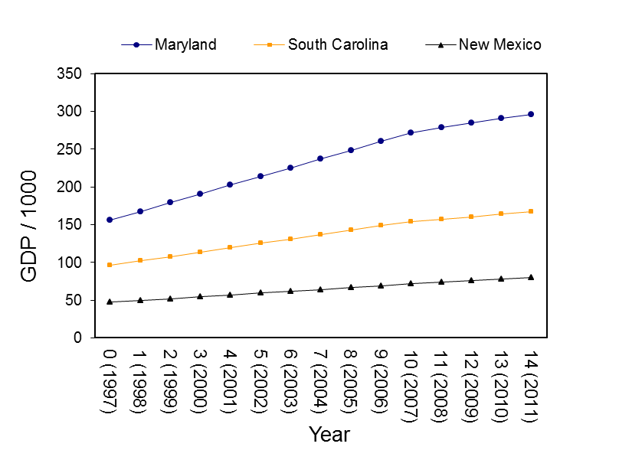
Step 6: Modeling Variability in Time-Based Parameters
Personal Income and State-Level variability in:
Pre-discontinuity slope (TIME)
Discontinuity (TRANS)
Post-discontinuity slope (RECOV)

Slide 155
Step 6: Modeling Variability in Time-Based Parameters
> mod6.b<-lme(gdp1k~TIME*pinc08.100k+
TRANS*pinc08.100k+RECOV*pinc08.100k,
random=~TIME+TRANS+RECOV|state, gdpdata.univ,
correlation=corAR1(form=~TIME|state),
control=list(opt="optim"))
> round(summary(mod6.b)$tTable,dig=4)
Value Std.Error DF t-value p-value
(Intercept) 4.0122 4.3978 708 0.9123 0.3619
TIME -0.8922 0.5077 708 -1.7574 0.0793
pinc08.100k 0.0638 0.0012 49 54.8118 0.0000
TRANS 1.5105 2.1745 708 0.6946 0.4875
RECOV 1.8000 1.1817 708 1.5232 0.1281
TIME:pinc08.100k 0.0048 0.0001 708 36.0762 0.0000
pinc08.100k:TRANS -0.0029 0.0006 708 -5.0823 0.0000
pinc08.100k:RECOV -0.0029 0.0003 708 -9.3703 0.0000

Slide 156
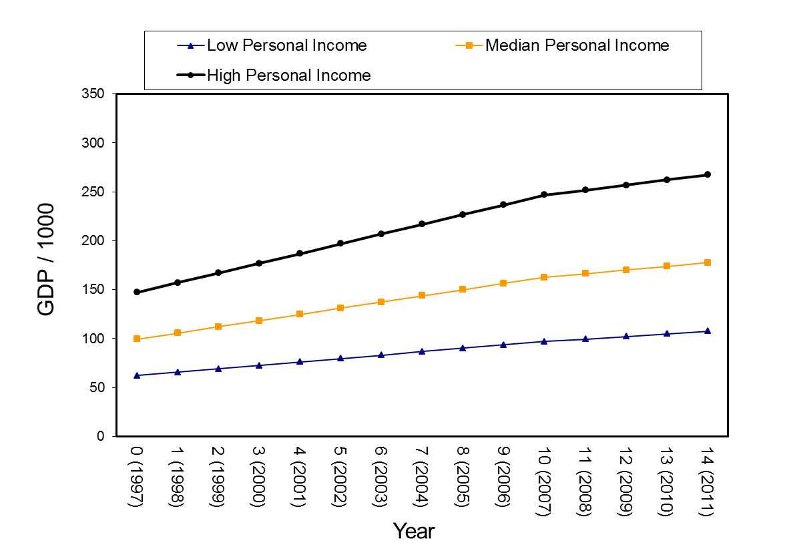
Step 6: Modeling Variability in Time-Based Parameters

Slide 157
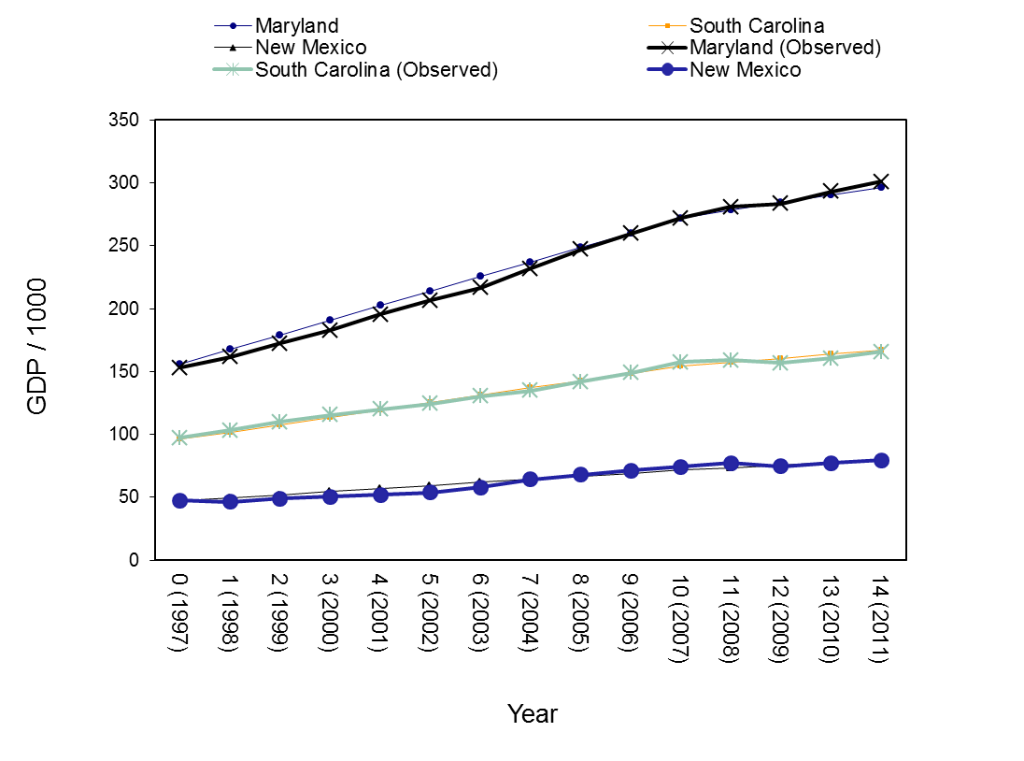
Step 6: Predicted Versus Observed

Slide 158
Step 6 Exercise
“Advanced Discontinuous Growth Exercises”
Exercise 8:
Model the Level-2 variable of AGE as a predictor of
Intercept variance
Time-varying parameter variances

Slide 159
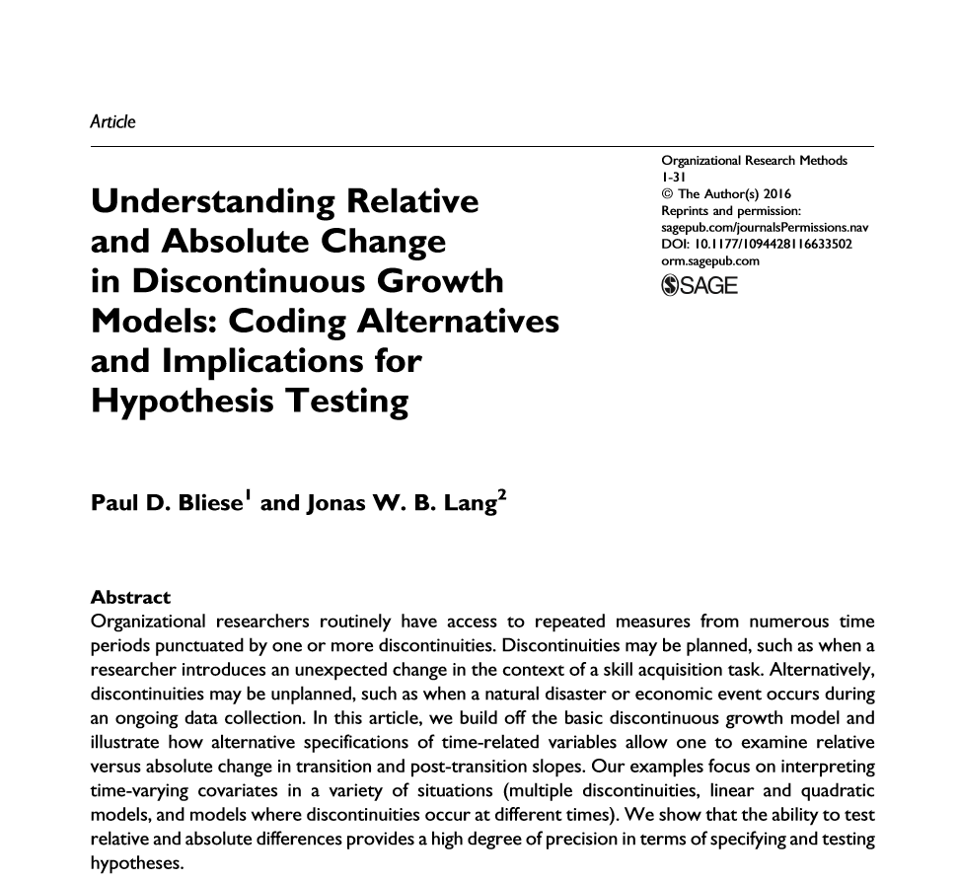
Some Extensions

Slide 160
Create Time-Related Covariates
> gdpdata.univ[1:15,c("state","TIME","TRANS","RECOV")]
state TIME TRANS RECOV
1 Alabama 0 0 0
1.1 Alabama 1 0 0
1.2 Alabama 2 0 0
1.3 Alabama 3 0 0
1.4 Alabama 4 0 0
1.5 Alabama 5 0 0
1.6 Alabama 6 0 0
1.7 Alabama 7 0 0
1.8 Alabama 8 0 0
1.9 Alabama 9 0 0
1.10 Alabama 10 0 0
1.11 Alabama 11 1 0
1.12 Alabama 12 1 1
1.13 Alabama 13 1 2
1.14 Alabama 14 1 3

Slide 161
Interpreting Step 2
In 1997 (TIME 0), the average level of GDP across the 51 States was 158794 (158.794*1000)
GDP increased by 10867.129 each year
GDP dropped by 5498.661 in 2008 (relative to expected increase)
Recovery slope of -5091.427 indicates the recovery slope is weaker than the slope associated with the period before 2008 (but still positive)
> mod.rel<-lme(gdp1k~TIME+TRANS+RECOV,
random=~TIME+TRANS+RECOV|state,
gdpdata.univ,control=list(opt="optim"))
> round(summary(mod.rel)$tTable,dig=3)
Value Std.Error DF t-value p-value
(Intercept) 158.794 26.159 711 6.070 0.000
TIME 10.867 1.992 711 5.455 0.000
TRANS -5.499 2.293 711 -2.398 0.017
RECOV -5.091 1.422 711 -3.580 0.000

Slide 162
Create Time-Related Covariates
Recovery slope 5091.427
Less than original slope
TRANS
RECOV
Drop of 5498.661
TIME
10867.129 yearly increase
GDP at Time 0
equals 158794
Notes:
TDAT<-gdp.univ[1:15,c("TIME","Trans","Recov")]
quantile(pinc[,2],c(.33,.66))/1000
median(pinc[,2])/1000
TDAT$Pinc20081k=149324.7
write.table(t(predict(mod4,TDAT,level=0)),file="clipboard", sep="\t",col.names=F,row.names=F)

Slide 163
Examining Absolute Change
The t-tests in the current models provide tests of relative change:
Is the drop at the transition point significant relative to what would be expected
Is the recovery slope different than the pre-change slope
What if our theory expected absolute change
The transition will lead to a significant absolute decline
The post-transition slope will be negative

Slide 164
Create Time-Related Covariates
> gdpdata.univ$TIME.A<-ifelse(gdpdata.univ$TIME>=10,10,gdpdata.univ$TIME)
> gdpdata.univ[1:15,c("state","TIME","TIME.A","TRANS","RECOV")]
state TIME TIME.A TRANS RECOV
1 Alabama 0 0 0 0
1.1 Alabama 1 1 0 0
1.2 Alabama 2 2 0 0
1.3 Alabama 3 3 0 0
1.4 Alabama 4 4 0 0
1.5 Alabama 5 5 0 0
1.6 Alabama 6 6 0 0
1.7 Alabama 7 7 0 0
1.8 Alabama 8 8 0 0
1.9 Alabama 9 9 0 0
1.10 Alabama 10 10 0 0
1.11 Alabama 11 10 1 0
1.12 Alabama 12 10 1 1
1.13 Alabama 13 10 1 2
1.14 Alabama 14 10 1 3

Slide 165
Interpreting Step 2
> mod.abs<-lme(gdp1k~TIME.A+TRANS+RECOV,
random=~TIME+TRANS+RECOV|state,
gdpdata.univ,control=list(opt="optim"))
> round(summary(mod.abs)$tTable,dig=3)
Value Std.Error DF t-value p-value
(Intercept) 158.794 26.159 711 6.070 0.000
TIME.A 10.867 1.992 711 5.455 0.000
TRANS 5.368 2.130 711 2.520 0.012
RECOV 5.776 1.145 711 5.046 0.000
> mod.abs<-lme(gdp1k~TIME+TRANS+RECOV,
random=~TIME+TRANS+RECOV|state,
gdpdata.univ,control=list(opt="optim"))
> round(summary(mod.rel)$tTable,dig=3)
Value Std.Error DF t-value p-value
(Intercept) 158.794 26.159 711 6.070 0.000
TIME 10.867 1.992 711 5.455 0.000
TRANS -5.499 2.293 711 -2.398 0.017
RECOV -5.091 1.422 711 -3.580 0.000

Slide 166
Some Extensions
Other models covered
Bliese & Lang (in press). Modeling Relative and Absolute Change in Discontinuous Growth Models

Slide 167
Part IV
Mediation Models
Borrowing ideas from Malhotra, Singhal, Shang & Ployhart (2014) and others

Slide 168
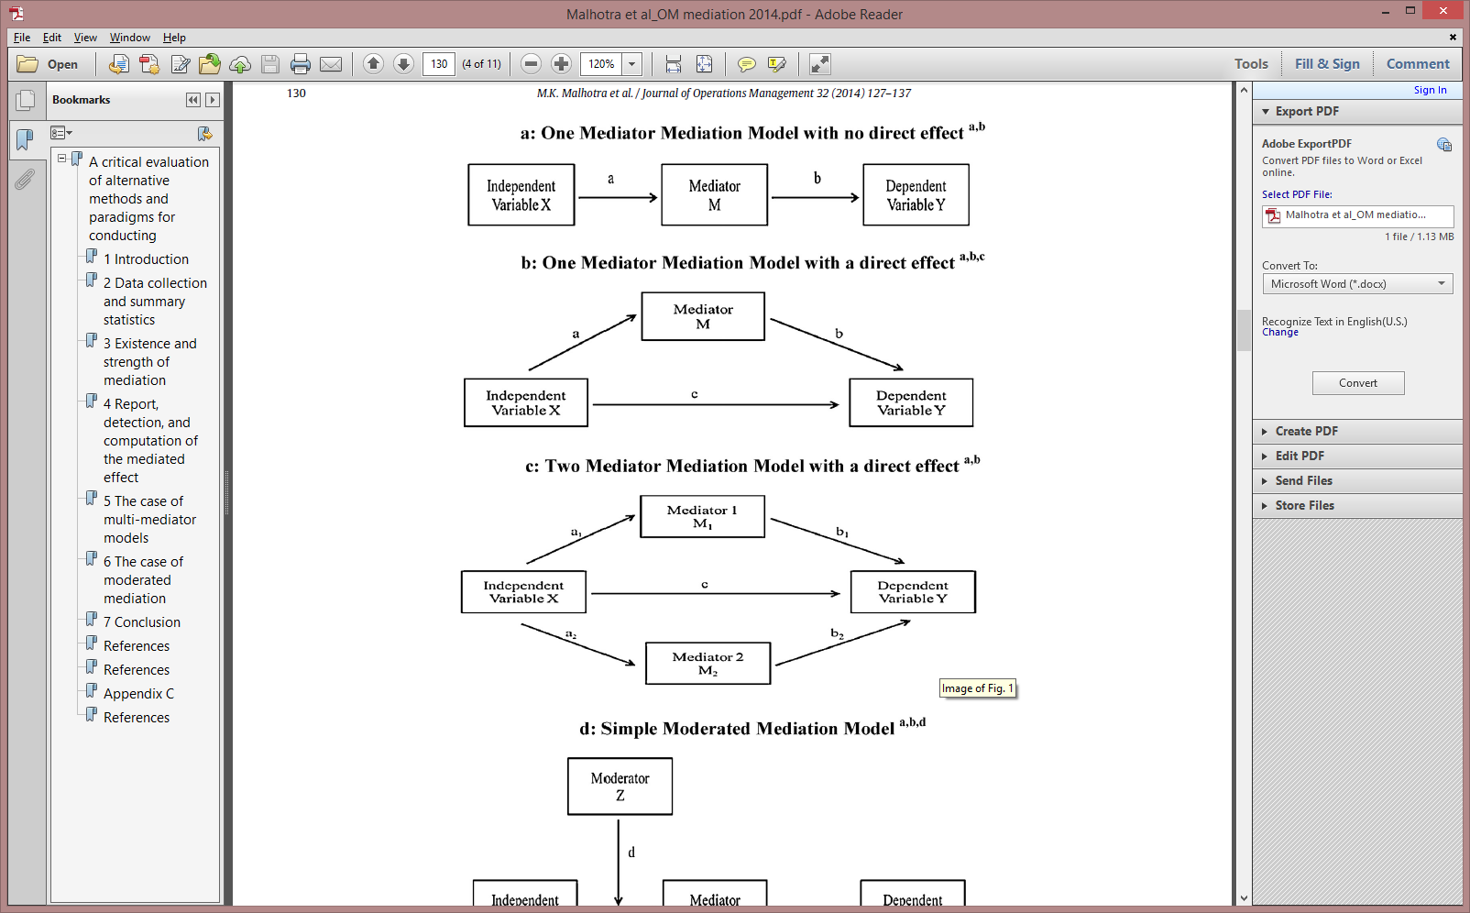
Basic Mediation Model

Slide 169
Baron and Kenny (1986)
http://davidakenny.net/cm/mediate.htm
Step 1: Show that the causal variable is correlated with the outcome (c).
Step 2: Show that the causal variable is correlated with the mediator (a).
Step 3: Show that the mediator affects the outcome variable (b). Use Y as the criterion variable in a regression equation and X and M as predictors.
Step 4: To establish that M completely mediates the X-Y relationship, the effect of X on Y controlling for M (path c') should be zero. The effects in both Steps 3 and 4 are estimated in the same equation.

Slide 170
Baron and Kenny (1986) Alternatives
Requiring c to be significant is overly restrictive and assumes that both a and b have the same sign
Take-home message: Methodologists generally agree that step 1 is too restrictive
Mediation now focuses on estimating the "Indirect Effect"
Whether the product of path a and b is significant (a*b)
Interestingly a*b also equals the reduction in c (c – c') when M is in the model with X

Slide 171
Indirect Effect Tests
A example in R: Work Hours (pred) -> Leadership (med) -> Wellbeing
$`Mod3: M~X` lm(LEAD~HRS)
Estimate
(Intercept) 3.40718349
pred -0.04571488
> -0.04571488*0.48386196
[1] -0.02211969
$`Mod1: Y~X` lm(WBEING~HRS)
Estimate Std. Error t value Pr(>|t|)
(Intercept) 3.51693620 0.052902697 66.47934 0.000000e+00
pred -0.06523285 0.004590274 -14.21110 3.078129e-45
> -0.06523285-(-0.04311316)
[1] -0.02211969
$`Mod2: Y~X+M` lm(WBEING~HRS+LEAD)
Estimate Std. Error t value Pr(>|t|)
(Intercept) 1.86832973 0.06413083 29.13310 1.024201e-176
pred -0.04311316 0.00421918 -10.21837 2.382257e-24
med 0.48386196 0.01242129 38.95426 4.967825e-302

Slide 172
Indirect Tests
How do we know if a*b (i.e., c-c') is significant?
Sobel test (in multilevel library)
> sobel(pred=bh1996$HRS,med=bh1996$LEAD,out=bh1996$WBEING)
$`Mod1: Y~X`
Estimate Std. Error t value Pr(>|t|)
(Intercept) 3.51693620 0.052902697 66.47934 0.000000e+00
pred -0.06523285 0.004590274 -14.21110 3.078129e-45
$`Mod2: Y~X+M`
Estimate Std. Error t value Pr(>|t|)
(Intercept) 1.86832973 0.06413083 29.13310 1.024201e-176
pred -0.04311316 0.00421918 -10.21837 2.382257e-24
med 0.48386196 0.01242129 38.95426 4.967825e-302
$`Mod3: M~X`
Estimate Std. Error t value Pr(>|t|)
(Intercept) 3.40718349 0.045154735 75.45573 0.000000e+00
pred -0.04571488 0.003917997 -11.66792 3.488366e-31
$Indirect.Effect
[1] -0.02211969
$SE
[1] 0.001978985
$z.value
[1] -11.17729
$N
[1] 7382

Slide 173
Indirect Tests
Sobel test limitations (from Preacher)
http://quantpsy.org/sobel/sobel.htm
A word to the wise
The Sobel test works well only in large samples. We recommend using this test only if the user has no access to raw data. If you have the raw data, bootstrapping offers a much better alternative that imposes no distributional assumptions. Consult Preacher and Hayes (2004, 2008) for details and easy-to-use macros that run the necessary regression analyses for you:

Slide 174
Indirect Tests
Bootstrapping (non-parametric)
Sample with replacement
Makes no assumptions about distribution of indirect effect
Can use either the bias corrected CI estimates or percentile method
Fritz, Taylor, and MacKinnon (2012) have raised concerns that bias-corrected bootstrapping test is too liberal with alpha being around .07 (copied from http://davidakenny.net/cm/mediate.htm)

Slide 175
Indirect Test: The Bootstrap
The non-parametric bootstrap is a versatile analytic tool
Resample data (with replacement)
> TDAT
ID HRS
1 1 12
2 2 11
3 3 12
4 4 9
5 5 7
6 6 8
7 7 9
8 8 8
9 9 12
10 10 11
> TDAT[sample(1:10,
replace=T),]
ID HRS
5 5 7
6 6 8
9 9 12
3 3 12
1 1 12
7 7 9
5.1 5 7
4 4 9
1.1 1 12
3.1 3 12

Slide 176
Indirect Tests
Bootstrapping (non-parametric using percentile method)
library(bootstrap)
TDAT<-bh1996[,c("HRS","LEAD","WBEING")]
theta<-function(x,DATA){SOBEL.OUT<-sobel(pred=DATA[x,1],med=DATA[x,2],out=DATA[x,3])
OUT<-SOBEL.OUT$Indirect.Effect
return(OUT)}
bootmod<-bootstrap(1:nrow(TDAT),theta,TDAT,nboot=1000)
> quantile(bootmod$thetastar, c(.025,.975))
2.5% 97.5%
-0.02634509 -0.01800095

Slide 177
Indirect Tests
Monte Carlo Method (copied http://davidakenny.net/cm/mediate.htm)
MacKinnon, Lockwood, and Williams (2004) have proposed a computer simulation test of the indirect effect. One starts with a, b s_{a}, and s_{b} (not the raw data). Using this information, random normal variables for a and b are generated to create a distribution of ab values. With these values, confidence intervals and a p value can be created. Selig and Preacher have created a helpful website that will perform the necessary calculations using R. The test is useful in situations in which there is not easy to bootstrap (e.g., the raw data are unavailable). If a and b are correlated, then that correlation can be included in the Monte Carlo simulation of a and b values.

Slide 178
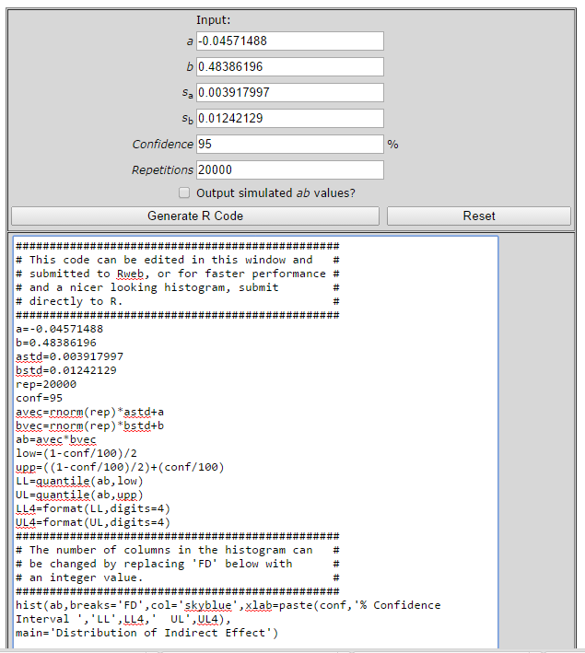
MonteCarlo Method: http://www.quantpsy.org/medmc/medmc.htm
Get these values from models 2 and
3 in the sobel function output
Interpret this
Copy this code right into R

Slide 179
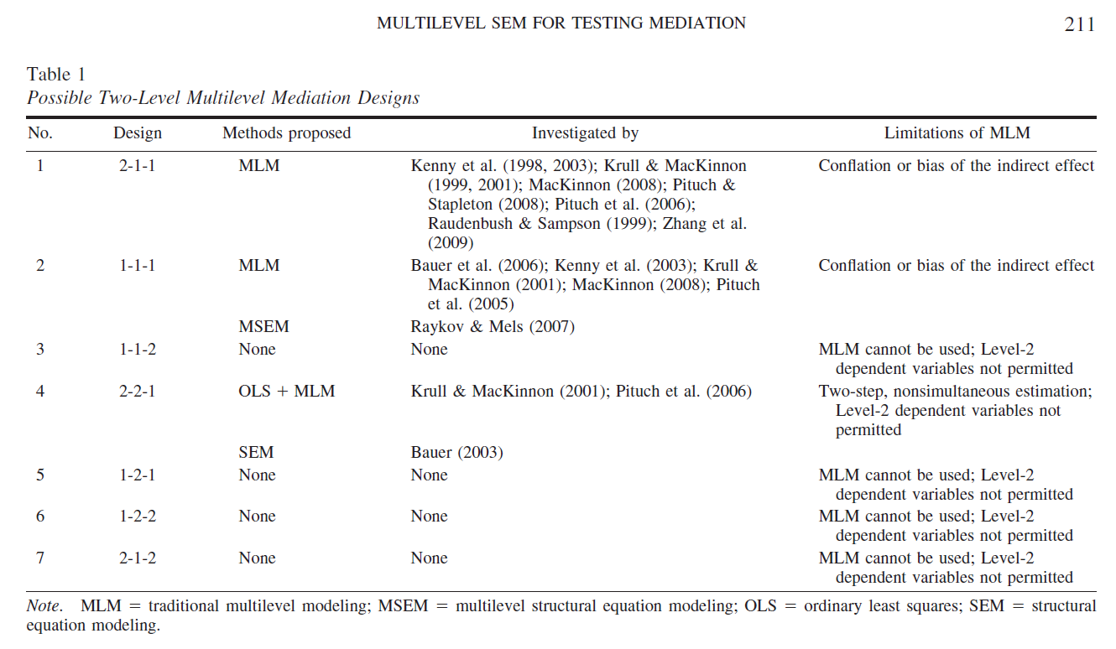
Background for Preacher, Zyphur & Zhang (2010)

Slide 180
What's the problem with our 1-1-1 example?
> round(summary(lm(WBEING~HRS+LEAD,bh1996))$coef,dig=4)
Estimate Std. Error t value Pr(>|t|)
(Intercept) 1.8683 0.0641 29.1331 0
HRS -0.0431 0.0042 -10.2184 0
LEAD 0.4839 0.0124 38.9543 0
> round(summary(lm(W.WBEING~W.HRS+W.LEAD,bh1996))$coef,dig=4)
Estimate Std. Error t value Pr(>|t|)
(Intercept) 0.0000 0.0093 0.0000 1
W.HRS -0.0278 0.0044 -6.2518 0
W.LEAD 0.5085 0.0130 38.9687 0
>
> round(summary(lm(LEAD~HRS,bh1996))$coef,dig=4)
Estimate Std. Error t value Pr(>|t|)
(Intercept) 3.4072 0.0452 75.4557 0
HRS -0.0457 0.0039 -11.6679 0
> round(summary(lm(W.LEAD~W.HRS,bh1996))$coef,dig=4)
Estimate Std. Error t value Pr(>|t|)
(Intercept) 0.0000 0.0083 0.0000 1
W.HRS -0.0367 0.0039 -9.2997 0
> with(bh1996,waba(HRS,LEAD,GRP))
$Cov.Theorem
RawCorr EtaBx EtaBy CorrB EtaWx EtaWy CorrW
1 -0.1345848 0.3787881 0.3708454 -0.2995793 0.9254834 0.9286946 -0.1076245

Slide 181
Some fixes to 1-1-1
Group-mean center all variables
Use the centered variables in the sobel test
> sobel(pred=bh1996$W.HRS,med=bh1996$W.LEAD,out=bh1996$W.WBEING)
$Indirect.Effect
[1] -0.01865382
$SE
[1] 0.002062178
$z.value
[1] -9.045691
$N
[1] 7382

Slide 182
Some fixes to 1-1-1
Group-mean center all variables
Use the centered variables in a bootstrap
library(bootstrap)
TDAT<-bh1996[,c("W.HRS","W.LEAD","W.WBEING")]
theta<-function(x,DATA){SOBEL.OUT<-sobel(pred=DATA[x,1],med=DATA[x,2],out=DATA[x,3])
OUT<-SOBEL.OUT$Indirect.Effect
return(OUT)}
bootmod<-bootstrap(1:nrow(TDAT),theta,TDAT,nboot=1000)
> quantile(bootmod$thetastar, c(.025,.975))
2.5% 97.5%
-0.02317276 -0.01397332

Slide 183
Some fixes to 1-1-1
Group-mean center all variables
Use the coefficients and standard errors in the montecarlo
################################################
# This code can be edited in this window and #
# submitted to Rweb, or for faster performance #
# and a nicer looking histogram, submit #
# directly to R. #
################################################
a=-0.03668403
b=0.5084997
astd=0.003944643
bstd=0.013048943
rep=20000
conf=95
avec=rnorm(rep)*astd+a
bvec=rnorm(rep)*bstd+b
ab=avec*bvec
low=(1-conf/100)/2
upp=((1-conf/100)/2)+(conf/100)
LL=quantile(ab,low)
UL=quantile(ab,upp)
LL4=format(LL,digits=4)
UL4=format(UL,digits=4)
################################################
# The number of columns in the histogram can #
# be changed by replacing 'FD' below with #
# an integer value. #
################################################
hist(ab,breaks='FD',col='skyblue',xlab=paste(conf,'% Confidence Interval ','LL',LL4,' UL',UL4),
main='Distribution of Indirect Effect')

Slide 184
What's the problem with any mediation containing a 2 (e.g., 2-1-1)
2-1 link is group-level which means that we are basically conducting a group mean analysis
…it is not generally recognized that—at an interpretational level—these are actually Between effects because X may affect only the Between components of M and Y. Preacher et al., 2010 page 210-211.

Slide 185
What's the problem with any mediation containing a 2 (e.g., 2-1-1)
Raudenbush and Bryk (2002) page 24 (Means as Outcome Regression): Notice the name and that Y_{ij} is a level-1 outcome.
Separate components where W_{j} is a Level-2 predictor constant across groups
Y_{ij} = β_{0j}+r_{ij}
β_{0j} = γ₀₀ + γ₀₁W_{j}+u_{0j}
Combined
Y_{ij} =γ₀₀+γ₀₁W_{j}+u_{0j}+r_{ij}.

Slide 186
What's the problem with any mediation containing a 2 (e.g., 2-1-1)
Page 212 argues that estimate of group-level relationships in mixed-effects models are biased because they do not adjust for reliability
Problem is that we rarely care about biased estimates; instead, we care about significant estimates
Correcting parameter estimates for un-reliability does make one more likely to detect a significant effect.
Hence, this concern may be a bit over-stated
Other concerns (page 213) may "involve an inconvenient degree of manual manipulation", but may actually be fine

Slide 187
Main Take-Away
Mediation is more complex in multilevel models
Pretty easy to specify 1-1-1 mediation models
Specifying mediation models where the mediator or predictor is a level-2 variable (2-1-1 or 1-2-1) fundamentally changes the model so that it is basically a group-mean model
Non-SEM approaches can handle these and may be adequate
In very complex models, multilevel SEM may be necessary

Slide 188
Part V
Empirical Bayes

Slide 189
Purpose
Introduce Empirical Bayes Estimates and discuss when these estimates might be useful in research
Demonstrate how R can be used to estimate Empirical Bayes Estimates
Non Linear Mixed Effects (nlme) package (Bates & Pinhiero, 2000)

Slide 190
Outline
Empirical Bayes and BLUPs
Reviewing the mixed-effects model
Visualizing shrunken estimates
Understanding the role of ICC(1)
A detailed example based on Chen et al., (2011)

Slide 191
Empirical Bayes Estimates
While there are some technical differences, Empirical Bayes Estimates highly similar to:
Best Linear Unbiased Predictions (BLUPs) (Pinheiro & Bates, 2000)
Empirical Best Linear Unbiased Predictions (eBLUPs)
Shrunken estimates
lme in R returns BLUPs

Slide 192
Empirical Bayes Estimates
In a two-level mixed-effects model, each significant random term allows for differences in the level-2 parameters
tmod<-lme(JSAT~TIME,random=~1+TIME|SUBNUM,data=univbct,
na.action=na.omit)
Random Slope:
Relationship between
TIME and Job Sat varies
across individuals
Random intercept:
Mean Differences
across individuals

Slide 193
Empirical Bayes Estimates
Raw data from 30 individuals suggests that intercepts and slopes vary
Mixed-effects models confirm variability
ICC(1) = 0.50
Likelihood test for TIME significant
Notes:
> data(univbct)
> TEMP<-univbct[3*1:495,c(22,1:17)] #convert to multivariate form
> TEMP<-na.exclude(TEMP[,c("SUBNUM","JOBSAT1","JOBSAT2","JOBSAT3")])
> TEMP.UNIV<-make.univ(TEMP,TEMP[,2:4],outname="JSAT")
> library(lattice)
> xyplot(JSAT~TIME|as.factor(SUBNUM),data=TEMP.UNIV[1:90,],
type=c("p","r","g"),col="blue",col.line="black",
xlab="Time",ylab="Job Satisfaction")

Slide 194
Empirical Bayes Estimates
The estimates produced from the mixed-effects models represent an interesting intersection between
Bayesian statistics
Traditional significance testing
(Empirical Bayes not considered true Bayes)
Deeley, J. and Lindley, D. (1981). Bayes Empirical Bayes. Journal of the American Statistical Association, 76, 833-841.
Empirical Bayes estimates are an excellent choice for estimating a highly probable value for a level-2 parameter.

Slide 195
Empirical Bayes Estimate Examples
Group-level slope and intercept values from 25 separate regression equations vs. empirical Bayes estimates from a mixed-effects model.

Slide 196
Empirical Bayes Estimate Examples
Individual slope and intercepts from 30 separate regression equations vs. empirical Bayes estimates from mixed-effects model
Notes:
> data(univbct)
> TEMP<-univbct[3*1:495,c(22,1:17)] #convert to multivariate form
> TEMP<-na.exclude(TEMP[,c("SUBNUM","JOBSAT1","JOBSAT2","JOBSAT3")])
> TEMP.UNIV<-make.univ(TEMP,TEMP[,2:4],outname="JSAT")
> library(lattice)
> xyplot(JSAT~TIME|as.factor(SUBNUM),data=TEMP.UNIV[1:90,],
type=c("p","r","g"),col="blue",col.line="black",
xlab="Time",ylab="Job Satisfaction")

Slide 197
Empirical Bayes Estimates
In both examples, the empirical Bayes estimates from the mixed-effects models are less extreme than the regression-based estimates
The “shrunken” estimates occur because information about the entire sample is used to estimate likely values for each group or individual
Notice that estimates are more variable with the growth modeling data
Strong ICC(1) value in growth modeling data reduces the shrinkage

Slide 198
Empirical Bayes Estimates
Empirical Bayes estimates are obtained from lme using the coef function
>tmod<-lme(JSAT~TIME,random=~TIME|SUBNUM, univbct,
na.action=na.omit,control=list(opt="optim"))
> coef(tmod)[1:7,]
(Intercept) TIME
1 1.777036 0.354812498
2 3.703704 0.062174256
3 3.867054 -0.005402035
4 3.359984 -0.031020722
5 3.647307 -0.049002555
6 2.639005 0.300867017
7 3.489300 -0.555292911

Slide 199
Empirical Bayes Estimates
Output varies by type of model (Random Intercept Only)
>tmod<-lme(JSAT~TIME,random=~1|SUBNUM, univbct,
na.action=na.omit,control=list(opt="optim"))
> coef(tmod)[1:7,]
(Intercept) TIME
1 2.179754 0.05176461
2 3.683815 0.05176461
3 3.767374 0.05176461
4 3.266020 0.05176461
5 3.516697 0.05176461
6 2.931784 0.05176461
7 2.848226 0.05176461

Slide 200
Empirical Bayes Calculations
Group estimate equals:
ω*sample estimate + (1- ω)*group estimate
Where ω equals:
1 - σ²/(σ² + τ₀₀)
1 - σ²/(σ² + τ₀₀) equals τ₀₀ / (τ₀₀ + σ²) or ICC(1)
If ω (ICC1) equals 1, the level-2 estimate is 1*sample estimate + 0*group estimate
Reference
Gelman, A. & Pardoe, I. (2006). Bayesian measures of explained variance and pooling in multilevel (hierarchical) models. Technometrics, 48, 241-251.

Slide 201
Working through Some Calculations
> tmod<-lme(HRS~1,random=~1|GRP,bh1996)
> VarCorr(tmod)
Variance StdDev
(Intercept) 0.665332 0.8156789
Residual 4.482825 2.1172682
> 0.665332/(0.665332+4.482825)
[1] 0.1292369
> coef(tmod)[1:4,]
[1] 11.00459 12.09511 10.49746 12.03350
> mean(bh1996$HRS)
[1] 11.2987
> with(bh1996,tapply(HRS,GRP,mean))[1:4]
1 2 3 4
10.972973 12.174603 10.437500 12.142857
> 0.1292369*11.2987+(1-0.1292369)*10.972973 # larger
[1] 11.01507
> 0.1292369*11.2987+(1-0.1292369)*12.174603 # smaller
[1] 12.0614

Slide 202
Detailed Calculations in lme
The lme coef function estimates “Best Linear Unbiased Predictors (BLUPS)” by adding the fixed effect and the random effect for each unit
> tmod$coefficients[[1]] #Estimate of Mean
(Intercept)
11.35179
> tmod$coefficients[[2]] #Random Effects
$GRP
(Intercept)
1 -0.347206536
2 0.743314382
3 -0.854331812
4 0.681704009
> 11.35179+(-0.347206536) #identical to coef
[1] 11.00458
> 11.35179+(0.743314382)
[1] 12.0951

Slide 203
Illustrating Chen et al., (2011)
Chen et al., (2011) examined job satisfaction change, and showed that change over time (improvement or decline) predicted variance in turnover intent over and above average levels of job satisfaction.
Indicate that turnover intentions are a dynamic process
Change over time was estimated using BLUPs from a growth model in lme.

Slide 204

Illustrating Chen et al., (2011)

Slide 205
Illustrating Chen et al., (2011)
Study 2 (n=85)
> chen2011<-read.delim(file="clipboard")
> names(chen2011)
[1] "id" "orgtenure" "t1jobsat" "t2jobsat"
[5] "t3jobsat" "t1toint" "t2toint" "t3toint"
[9] "t4toint"
> chen2011.univ<-make.univ(chen2011,chen2011[,3:5],
outname="jsat")
> tmod.null<-lme(jsat~1,random=~1|id,chen2011.univ)
> VarCorr(tmod.null)
id = pdLogChol(1)
Variance StdDev
(Intercept) 0.4613051 0.6791945
Residual 0.1731589 0.4161236
> 0.4613051/(0.4613051+0.1731589)
[1] 0.7270784

Slide 206
Illustrating Chen et al., (2011)
Slope test significant p<.10 (recall use one-tailed)
> tmod1<-lme(jsat~TIME,random=~1|id,chen2011.univ)
> tmod2<-lme(jsat~TIME,random=~TIME|id,chen2011.univ)
> anova(tmod1,tmod2)
Model df AIC BIC logLik Test
tmod1 1 4 477.4675 491.6011 -234.7337
tmod2 2 6 477.5104 498.7107 -232.7552 1 vs 2
L.Ratio p-value
tmod1
tmod2 3.957143 0.1383
> coef(tmod2)
(Intercept) TIME
1 3.996390 -0.029318486
2 4.824626 -0.047964850
3 3.168154 -0.010672122
4 4.422821 -0.147491948
5 3.582272 -0.019995304
6 3.996390 -0.029318486

Slide 207
Illustrating Chen et al., (2011)
Create a new data.frame called BLUPS
Rename Intercept and Slope estimates
Copy the row.names to the “id” variable to allow merging with “id” in original chen2011 data.frame
> BLUPS<-coef(tmod2)
> names(BLUPS)<-c("EB_Int","EB_Slope")
> BLUPS$id<-row.names(BLUPS)
> BLUPS[1:5,]
EB_Int EB_Slope id
1 3.996390 -0.02931849 1
2 4.824626 -0.04796485 2
3 3.168154 -0.01067212 3
4 4.422821 -0.14749195 4
5 3.582272 -0.01999530 5

Slide 208
Illustrating Chen et al., (2011)
Merge the BLUPS data.frame and the original chen2011 data.frame by “id”
> chen2011<-merge(chen2011,BLUPS,by="id")
> names(chen2011)
[1] "id" "orgtenure" "t1jobsat" "t2jobsat"
[5] "t3jobsat" "t1toint" "t2toint" "t3toint"
[9] "t4toint" "EB_Int" "EB_Slope"

Slide 209
Illustrating Chen et al., (2011)
Unstandardized Results from Model 2 in Table 5 of Chen et al. (2011)
Based on simple OLS regression (lm function)
#Replicating Model 2 in TABLE 5
> tmod<-lm(t4toint~t1toint+EB_Int+orgtenure+EB_Slope,
data=chen2011)
> round(summary(tmod)$coef,dig=4)
Estimate Std. Error t value Pr(>|t|)
(Intercept) -0.6449 0.7806 -0.8262 0.4111
t1toint 1.0056 0.0784 12.8305 0.0000
EB_Int 0.1338 0.1595 0.8386 0.4042
orgtenure 0.0001 0.0021 0.0583 0.9537
EB_Slope -2.5858 0.7053 -3.6665 0.0004

Slide 210
Illustrating Chen et al., (2011)
Standardized Results of Model 2
Use the scale function on the dataset
scale standardizes all variable
Wrap the scale function in the data.frame function
Model differs some from Table 5
May be due to non-EB estimates of average JobSat
> tmod<-lm(t4toint~t1toint+EB_Int+orgtenure+EB_Slope,
data=data.frame(scale(chen2011)))
> round(summary(tmod)$coef,dig=4)
Estimate Std. Error t value Pr(>|t|)
(Intercept) 0.0000 0.0506 0.0000 1.0000
t1toint 0.9729 0.0758 12.8305 0.0000
EB_Int 0.0651 0.0776 0.8386 0.4042
orgtenure 0.0030 0.0511 0.0583 0.9537
EB_Slope -0.2007 0.0548 -3.6665 0.0004

Slide 211
Illustrating Chen et al., (2011)
Calculate a new variable averaging Job Satisfaction across the three time points using rowMeans
Minor changes
#Replicating Model 2 in TABLE 5: Using non-EB estimates
#average Job Sat results in minor changes
> chen2011$av.jobsat<-rowMeans(chen2011[,3:5])
> tmod<-lm(t4toint~t1toint+av.jobsat+orgtenure+EB_Slope,
data=data.frame(scale(chen2011)))
> round(summary(tmod)$coef,dig=4)
Estimate Std. Error t value Pr(>|t|)
(Intercept) 0.0000 0.0506 0.0000 1.0000
t1toint 0.9729 0.0758 12.8305 0.0000
av.jobsat 0.0620 0.0739 0.8386 0.4042
orgtenure 0.0030 0.0511 0.0583 0.9537
EB_Slope -0.2116 0.0533 -3.9678 0.0002

Slide 212
Another Example: Individual Differences
Research with Yair Bar-Haim (Tel Aviv University) and (indirectly) with researchers at the National Institute of Mental Health
Threat-Related Attention Bias in Anxiety
Bar-Haim, Lamy, et al (2007) – Psychological Bulletin
Focused on emotional (anger) reactivity

Slide 213















Modeling Individual Differences
Looking for the point of change in interpretation – “balance point”
A
A
A
A
A
A
A
H
H
H
H
H
H
H
H
Balance point = percent of “angry” responses x 15
# “angry” responses
Face number

Slide 214
Modeling Individual Differences
(combined data from the first session in each of the 3 pilots, N=86)
p | r
0.005 | 0.300 | Anger Expression-In
n.s |  | Anger Expression-Out
0.027 | -0.238 | Anger Control-In
n.s |  | Anger Control-Out
0.021 | 0.249 | Anger Expression Index
Anger Expression In (AX-I)–angry feelings experienced.
Anger Control In (AC-I) – attempts to control anger by calming down
Anger Expression Index – provides a measure of total anger expression.

Slide 215
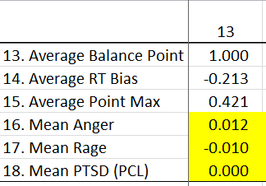
Modeling Individual Differences
Based on the pilot studies we administer the faces test to Soldiers in Alaska and are able to link up 278 computer-based tests to surveys.

Slide 216




Modeling Individual Differences
# “angry” responses
Session 1
Session 2
Set C:
Mean BP=8.2
Mean BP=8.5
Mean BP=7.9
Set D:
Mean BP=7.7

Slide 217
Modeling Individual Differences
In a “less controlled” field environment, errors and distractions are more likely
Can we improve upon just using “mean angry responses”
Originally proposed treating this as an IRT model and estimating the person-level attribute
Doran, H., Bates, D., Bliese, P. & Dowling, M. (2007). Estimating the multilevel Rasch Model: With the lme4 package. Journal of Statistical Software, 20 (2).

Slide 218
Modeling Individual Differences
NIMH researcher (Joel Stoddard) suggested fitting a non-linear model sigmoid curve characterized by three parameters: an upper asymptote, a growth rate and a time of maximum growth for each participant
Non-linear models are notoriously difficult to estimate
Built off of Joel’s idea by estimating the curves in nlme with random (individual) terms for the maximum growth rate
nlme can provide empirical Bayes estimates for maximum growth rate for each individual

Slide 219
Modeling Individual Differences
Looking for the point of change in interpretation – “balance point”
A
A
A
A
A
A
A
H
H
H
H
H
H
H
H
Red – Face B
Blue – Face C
Green – Face E
Magenta – Face H

Slide 220
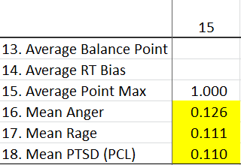
Modeling Individual Differences
All three correlations significant in anticipated direction

Slide 221
Empirical Bayes Summary
Empirical Bayes estimates or BLUPs can be an effective way to clean-up messy data
Obtain estimates of overall properties
Intercepts / Mean values
Obtain estimates of slopes
In cases where ICC values are very high, BLUPs will be similar to observed level-2 data

Slide 222
Empirical Bayes with ICC(1) of .94

Slide 223
Empirical Bayes Exercise
Use the univbct data.frame to estimate BLUPs for:
Average levels of job satisfaction (Intercept)
Job satisfaction slopes
Determine if BLUPs are related to changes in job commitment
HINTS
> data(univbct) #bring in the data from multilevel package
# Convert data from long (univariate) to wide format
# for final analyses examining changes in job commitment
> bct<-univbct[!duplicated(univbct$SUBNUM),c(1:17,22)]
> nrow(bct)
[1] 495
> nrow(univbct)
[1] 1485

Slide 224
Empirical Bayes Exercise
HINTS (continued)
#Start by estimating the ICC(1)on the univbct dataframe
> tmod.null<-lme(JSAT~1,random=~1|SUBNUM,data=univbct,
na.action=na.omit)
> VarCorr(tmod.null)
#Determine if TIME slope randomly varies

Slide 225
Empirical Bayes Exercise
> VarCorr(tmod.null)
SUBNUM = pdLogChol(1)
Variance StdDev
(Intercept) 0.4337713 0.6586132
Residual 0.4319061 0.6571956
> 0.4337713/(0.4337713+0.4319061)
[1] 0.5010773
>
> tmod1<-lme(JSAT~TIME,random=~1|SUBNUM,data=univbct,
na.action=na.omit)
> tmod2<-lme(JSAT~TIME,random=~TIME|SUBNUM,data=univbct,
na.action=na.omit)
> anova(tmod1,tmod2)
Model df AIC BIC logLik Test
tmod1 1 4 3461.234 3482.194 -1726.617
tmod2 2 6 3434.132 3465.571 -1711.066 1 vs 2
L.Ratio p-value
tmod1
tmod2 31.10262 <.0001

Slide 226
Empirical Bayes Exercise
> BLUPS<-coef(tmod2)
> names(BLUPS)
[1] "(Intercept)" "TIME"
> names(BLUPS)<-c("EB_Int","EB_Slope")
> BLUPS$SUBNUM<-row.names(BLUPS)
> bct<-merge(bct,BLUPS,by="SUBNUM")
> tmod<-lm(COMMIT3~COMMIT1+EB_Int+EB_Slope,bct)
> round(summary(tmod)$coef,dig=4)
Estimate Std. Error t value Pr(>|t|)
(Intercept) 0.3389 0.1715 1.9764 0.0487
COMMIT1 0.4454 0.0366 12.1656 0.0000
EB_Int 0.4608 0.0501 9.1982 0.0000
EB_Slope 1.9372 0.1661 11.6641 0.0000

Slide 227
Part VI
Generalized Linear Mixed Effects Models (GLMMs) and Dichotomous Outcomes

Slide 228
Purpose
Review the logistic regression model for dichotomous outcomes and show how a multilevel logistic regression model can be estimated in R.
Introduce the lme4 package in R

Slide 229
Outline
Introduction
Short refresher on logistic regression models
Estimating logistic regression models in R
Estimating ICC(1) in binomial GLMMs
Binomial GLMMs in lme4
Plotting results

Slide 230
Introduction: Dichotomous Outcomes
A number of variables of interest to organizations are dichotomous
Safety Accidents
Turnover
Health-Related Outcomes (e.g., Depression)
Dichotomous data can be converted into rates which are intrinsically easy to communicate
After the intervention, the sample was 2.75 points lower on a continuous depression measure vs
After the intervention, depression dropped from 15.7% to 11.3%.

Slide 231
Introduction: Dichotomous Outcomes
Combat Exposure and Depression: Two formats

Slide 232
Introduction: Dichotomous Outcomes
Dichotomous outcomes may cluster by unit membership
Non-independence due to groups
Non-independence due to pre-existing group membership raises the same issues and opens the same opportunities found with continuous outcomes.
Model contextual (level-2) influences
Potential bias in standard errors if non-independence is ignored

Slide 233
Introduction: Logistic Regression
As a starting point we use OLS regression (aka Linear Probability Model or LPM)
Perform a median split and create WB.DICHOT
Examine the relationship between work hours (HRS) and dichotomized well-being (WB.DICHOT) in the bh1996 dataframe
> library(multilevel)
> data(bh1996)
> summary(bh1996$WBEING)
Min. 1st Qu. Median Mean 3rd Qu. Max.
0.000 2.167 2.833 2.780 3.444 5.000
> bh1996$WB.DICHOT<-ifelse(bh1996$WBEING>2.833,1,0)

Slide 234
Introduction: Logistic Regression
Regress WB.DICHOT on HRS
Predict rates of Positive Well-Being
> tmod<-lm(WB.DICHOT~HRS,bh1996)
> round(summary(tmod)$coef, dig=4)
Estimate Std. Error t value Pr(>|t|)
(Intercept) 0.8275 0.0293 28.2745 0
HRS -0.0286 0.0025 -11.2678 0
> TDAT<-data.frame(HRS=6:16)
> (PREDS<-predict(tmod,TDAT))
1 2 3 4 5
0.6558141 0.6272005 0.5985870 0.5699734 0.5413598
6 7 8 9 10
0.5127463 0.4841327 0.4555191 0.4269056 0.3982920
11
0.3696784

Slide 235
Introduction: Logistic Regression
Plot of the predicted means from the OLS model
> TDAT<-data.frame(HRS=6:16)
> plot(PREDS,x=6:16,xlab="Hours", ylim=c(.3,.8),
ylab="Positive Well-Being Rate")

Slide 236
Introduction: Logistic Regression
Some issues with the OLS model:
Heteroscedasticity: Variance of the mean of a binary variable = mean*(1-mean)
> plot(PREDS*(1-PREDS),x=6:16,xlab="HRS",
ylab="Variance")

Slide 237
Introduction: Logistic Regression
Some issues with the OLS model (continued):
Heteroscedasticity “implies the variance of the errors depends on values of x” (Long, p. 38).
Known to produce incorrect standard errors and statistical tests
Nonsensical Predictions
In our example, the predictions are logical (bounded by 0 and 1); however, often predictions would fall outside of 0 and 1.
Illogical predictions also frequently occur at the extremes when the dependent variable is continuous
Notes:
summary(bh1996$WBEING)
bh1996$WB.DICHOT<-ifelse(bh1996$WBEING>2.833,1,0)
tmod<-lm(WB.DICHOT~HRS,bh1996)
summary(tmod)$coef
TDAT<-data.frame(HRS=6:16)
predict(tmod,TDAT)
tmod.glm<-glm(WB.DICHOT~HRS,family="binomial",bh1996)
summary(tmod.glm)$coef
################
bh1996$WB.DICHOT2<-ifelse(bh1996$WBEING>3.444,1,0)
tmod<-lm(WB.DICHOT2~HRS,bh1996)
summary(tmod)$coef
tmod.glm<-glm(WB.DICHOT2~HRS,family="binomial",bh1996)
summary(tmod.glm)$coef

Slide 238
Introduction: Logistic Regression
Some issues with the OLS model (continued):
Functional Form
Linear model predicts the same change in y for every level of x
> PREDS[1]-PREDS[2]; PREDS[2]-PREDS[3]; PREDS[9]-PREDS[10]
1
0.02861357
2
0.02861357
9
0.02861357
Notes:
summary(bh1996$WBEING)
bh1996$WB.DICHOT<-ifelse(bh1996$WBEING>2.833,1,0)
tmod<-lm(WB.DICHOT~HRS,bh1996)
summary(tmod)$coef
TDAT<-data.frame(HRS=6:16)
predict(tmod,TDAT)
tmod.glm<-glm(WB.DICHOT~HRS,family="binomial",bh1996)
summary(tmod.glm)$coef
################
bh1996$WB.DICHOT2<-ifelse(bh1996$WBEING>3.444,1,0)
tmod<-lm(WB.DICHOT2~HRS,bh1996)
summary(tmod)$coef
tmod.glm<-glm(WB.DICHOT2~HRS,family="binomial",bh1996)
summary(tmod.glm)$coef

Slide 239
Introduction: Logistic Regression
Some issues with the OLS model (continued):
Functional Form
Long (1997) notes that “When the outcome is a probability, it is often substantively reasonable that the effects of independent variables will have diminishing returns as the predicted probability approaches 0 or 1”
Long (1997) argues the constant functional form is “the most serious problem” with applying OLS regression to a dichotomous outcome
Notes:
summary(bh1996$WBEING)
bh1996$WB.DICHOT<-ifelse(bh1996$WBEING>2.833,1,0)
tmod<-lm(WB.DICHOT~HRS,bh1996)
summary(tmod)$coef
TDAT<-data.frame(HRS=6:16)
predict(tmod,TDAT)
tmod.glm<-glm(WB.DICHOT~HRS,family="binomial",bh1996)
summary(tmod.glm)$coef
################
bh1996$WB.DICHOT2<-ifelse(bh1996$WBEING>3.444,1,0)
tmod<-lm(WB.DICHOT2~HRS,bh1996)
summary(tmod)$coef
tmod.glm<-glm(WB.DICHOT2~HRS,family="binomial",bh1996)
summary(tmod.glm)$coef

Slide 240
Introduction: Logistic Regression
Functional Form
Predictions from 0 HRS to 24 HRS
S-shaped curve
Non-linear model
> TDAT<-data.frame(HRS=0:24)
> plot(predict(tmod,TDAT),x=0:24,xlab="Hours")
Notes:
summary(bh1996$WBEING)
bh1996$WB.DICHOT<-ifelse(bh1996$WBEING>2.833,1,0)
tmod<-lm(WB.DICHOT~HRS,bh1996)
summary(tmod)$coef
TDAT<-data.frame(HRS=6:16)
predict(tmod,TDAT)
tmod.glm<-glm(WB.DICHOT~HRS,family="binomial",bh1996)
summary(tmod.glm)$coef
################
bh1996$WB.DICHOT2<-ifelse(bh1996$WBEING>3.444,1,0)
tmod<-lm(WB.DICHOT2~HRS,bh1996)
summary(tmod)$coef
tmod.glm<-glm(WB.DICHOT2~HRS,family="binomial",bh1996)
summary(tmod.glm)$coef

Slide 241
Introduction: Logistic Regression
Basic logic underlying logistic regression:
A “latent” y variable (y*) regressed on predictors
y* can range from negative to positive infinity
y* is linked back to the original 0/1 by a threshold
1 if y* > threshold
0 if y* < or equal to threshold
Fundamentally, the model uses y* to estimate the probability that y = 1 for given values of the predictor(s)
Because y* is unobserved, we must use Maximum Likelihood (with some assumptions)
Notes:
summary(bh1996$WBEING)
bh1996$WB.DICHOT<-ifelse(bh1996$WBEING>2.833,1,0)
tmod<-lm(WB.DICHOT~HRS,bh1996)
summary(tmod)$coef
TDAT<-data.frame(HRS=6:16)
predict(tmod,TDAT)
tmod.glm<-glm(WB.DICHOT~HRS,family="binomial",bh1996)
summary(tmod.glm)$coef
################
bh1996$WB.DICHOT2<-ifelse(bh1996$WBEING>3.444,1,0)
tmod<-lm(WB.DICHOT2~HRS,bh1996)
summary(tmod)$coef
tmod.glm<-glm(WB.DICHOT2~HRS,family="binomial",bh1996)
summary(tmod.glm)$coef

Slide 242
Introduction: Logistic Regression
When using ML to regress y* on predictors we have to make assumptions about:
The distribution of the errors
The variance of the errors (since y* is unobserved, error variance cannot be calculated)
In lme, y is observed providing estimates of sigma-squared
In our examples, we consider the logit model
Logistic error distributions
Error variance assumed to be π²/3 ≈ 3.29
> pi^2/3
[1] 3.289868
Notes:
summary(bh1996$WBEING)
bh1996$WB.DICHOT<-ifelse(bh1996$WBEING>2.833,1,0)
tmod<-lm(WB.DICHOT~HRS,bh1996)
summary(tmod)$coef
TDAT<-data.frame(HRS=6:16)
predict(tmod,TDAT)
tmod.glm<-glm(WB.DICHOT~HRS,family="binomial",bh1996)
summary(tmod.glm)$coef
################
bh1996$WB.DICHOT2<-ifelse(bh1996$WBEING>3.444,1,0)
tmod<-lm(WB.DICHOT2~HRS,bh1996)
summary(tmod)$coef
tmod.glm<-glm(WB.DICHOT2~HRS,family="binomial",bh1996)
summary(tmod.glm)$coef

Slide 243
Introduction: Logistic Regression
Logistic regression makes assumptions about the errors
Conditional mean of error is zero
Conditional variance of error is π²/3
These assumptions are necessary to identify the model
Importantly, the probabilities associated with the parameter estimates are estimable functions
Probabilities can be interpreted even though the model is based on assumptions about error that cannot be tested.
Notes:
summary(bh1996$WBEING)
bh1996$WB.DICHOT<-ifelse(bh1996$WBEING>2.833,1,0)
tmod<-lm(WB.DICHOT~HRS,bh1996)
summary(tmod)$coef
TDAT<-data.frame(HRS=6:16)
predict(tmod,TDAT)
tmod.glm<-glm(WB.DICHOT~HRS,family="binomial",bh1996)
summary(tmod.glm)$coef
################
bh1996$WB.DICHOT2<-ifelse(bh1996$WBEING>3.444,1,0)
tmod<-lm(WB.DICHOT2~HRS,bh1996)
summary(tmod)$coef
tmod.glm<-glm(WB.DICHOT2~HRS,family="binomial",bh1996)
summary(tmod.glm)$coef

Slide 244
Introduction: Logistic Regression
Working with predicted probabilities is central to making sense of models with dichotomous outcomes.
In the examples, we focus on both:
Estimating parameters and examining the significance
Showing how to work with the models to get estimated probabilities
Notes:
summary(bh1996$WBEING)
bh1996$WB.DICHOT<-ifelse(bh1996$WBEING>2.833,1,0)
tmod<-lm(WB.DICHOT~HRS,bh1996)
summary(tmod)$coef
TDAT<-data.frame(HRS=6:16)
predict(tmod,TDAT)
tmod.glm<-glm(WB.DICHOT~HRS,family="binomial",bh1996)
summary(tmod.glm)$coef
################
bh1996$WB.DICHOT2<-ifelse(bh1996$WBEING>3.444,1,0)
tmod<-lm(WB.DICHOT2~HRS,bh1996)
summary(tmod)$coef
tmod.glm<-glm(WB.DICHOT2~HRS,family="binomial",bh1996)
summary(tmod.glm)$coef

Slide 245
Introduction: Logistic Regression
In R, logistic regression models can be estimated using the glm function with a binomial family.
binomial link function defaults to “logit” but can be changed to a variety of other links (probit, etc.).
Models are summarized to determine whether parameter estimates are significant
tmod<-glm(DICHOT.DV~IV1+IV2,family="binomial",mydata)
summary(tmod)
summary(tmod)$coef
Notes:
summary(bh1996$WBEING)
bh1996$WB.DICHOT<-ifelse(bh1996$WBEING>2.833,1,0)
tmod<-lm(WB.DICHOT~HRS,bh1996)
summary(tmod)$coef
TDAT<-data.frame(HRS=6:16)
predict(tmod,TDAT)
tmod.glm<-glm(WB.DICHOT~HRS,family="binomial",bh1996)
summary(tmod.glm)$coef
################
bh1996$WB.DICHOT2<-ifelse(bh1996$WBEING>3.444,1,0)
tmod<-lm(WB.DICHOT2~HRS,bh1996)
summary(tmod)$coef
tmod.glm<-glm(WB.DICHOT2~HRS,family="binomial",bh1996)
summary(tmod.glm)$coef

Slide 246
Introduction: Logistic Regression
Estimates can be converted into a predicted probability by using the formula
exp(parameter)/(1+exp(parameter))
> summary(bh1996$WB.DICHOT)
Min. 1st Qu. Median Mean 3rd Qu. Max.
0.0000 0.0000 1.0000 0.5042 1.0000 1.0000
> tmod<-glm(WB.DICHOT~1,family="binomial",bh1996)
> round(summary(tmod)$coef,dig=4)
Estimate Std. Error z value Pr(>|z|)
(Intercept) 0.0168 0.0233 0.7216 0.4705
> exp(0.0168)/(1+exp(0.0168))
[1] 0.5041999
Notes:
summary(bh1996$WBEING)
bh1996$WB.DICHOT<-ifelse(bh1996$WBEING>2.833,1,0)
tmod<-lm(WB.DICHOT~HRS,bh1996)
summary(tmod)$coef
TDAT<-data.frame(HRS=6:16)
predict(tmod,TDAT)
tmod.glm<-glm(WB.DICHOT~HRS,family="binomial",bh1996)
summary(tmod.glm)$coef
################
bh1996$WB.DICHOT2<-ifelse(bh1996$WBEING>3.444,1,0)
tmod<-lm(WB.DICHOT2~HRS,bh1996)
summary(tmod)$coef
tmod.glm<-glm(WB.DICHOT2~HRS,family="binomial",bh1996)
summary(tmod.glm)$coef

Slide 247
Introduction: Logistic Regression
The predict function is important in interpreting results because independent variables have a non-linear relationship to the predicted probability of the outcome.
The predict function can be used one of two ways
Used with the model alone, predict estimates a value for each observation
Used with the model and another dataframe, predict estimates the values for specific levels of the predictors
When predicting dichotomous outcomes, use the option type="response" to return probabilities
Notes:
summary(bh1996$WBEING)
bh1996$WB.DICHOT<-ifelse(bh1996$WBEING>2.833,1,0)
tmod<-lm(WB.DICHOT~HRS,bh1996)
summary(tmod)$coef
TDAT<-data.frame(HRS=6:16)
predict(tmod,TDAT)
tmod.glm<-glm(WB.DICHOT~HRS,family="binomial",bh1996)
summary(tmod.glm)$coef
################
bh1996$WB.DICHOT2<-ifelse(bh1996$WBEING>3.444,1,0)
tmod<-lm(WB.DICHOT2~HRS,bh1996)
summary(tmod)$coef
tmod.glm<-glm(WB.DICHOT2~HRS,family="binomial",bh1996)
summary(tmod.glm)$coef

Slide 248
Introduction: Logistic Regression
Using predict to estimate a value for each observation
> tmod<-glm(WB.DICHOT~1,family="binomial",bh1996)
> predict(tmod)[1:10]
1 2 3 4 5
0.01679801 0.01679801 0.01679801 0.01679801 0.01679801
6 7 8 9 10
0.01679801 0.01679801 0.01679801 0.01679801 0.01679801
> predict(tmod,type="response")[1:10]
1 2 3 4 5
0.5041994 0.5041994 0.5041994 0.5041994 0.5041994
6 7 8 9 10
0.5041994 0.5041994 0.5041994 0.5041994 0.5041994
Notes:
summary(bh1996$WBEING)
bh1996$WB.DICHOT<-ifelse(bh1996$WBEING>2.833,1,0)
tmod<-lm(WB.DICHOT~HRS,bh1996)
summary(tmod)$coef
TDAT<-data.frame(HRS=6:16)
predict(tmod,TDAT)
tmod.glm<-glm(WB.DICHOT~HRS,family="binomial",bh1996)
summary(tmod.glm)$coef
################
bh1996$WB.DICHOT2<-ifelse(bh1996$WBEING>3.444,1,0)
tmod<-lm(WB.DICHOT2~HRS,bh1996)
summary(tmod)$coef
tmod.glm<-glm(WB.DICHOT2~HRS,family="binomial",bh1996)
summary(tmod.glm)$coef

Slide 249
Introduction: Logistic Regression
Predicting values for specific levels of work hours
S-curve
Not pronounced
HRS is weak predictor
tmod.glm<-glm(WB.DICHOT~HRS,family="binomial",bh1996)
TDAT<-data.frame(HRS=0:24)
PREDS<-predict(tmod.glm,TDAT,type="response")
plot(PREDS,x=0:24,xlab="Hours", ylim=c(0,1),
ylab="Probability of Well-Being = 1")

Slide 250
Introduction: Logistic Regression
y* is linked back to the original 0/1 by a threshold
1 if y* > threshold
0 if y* < or equal to threshold
> bh1996$PRED.HRS<-predict(tmod.glm,type="response")
> mean(bh1996$WB.DICHOT)
[1] 0.5041994
> bh1996$PRED.HRS.DICHOT<-ifelse(bh1996$PRED.HRS>.5041994,1,0)
> with(bh1996,xtabs(~WB.DICHOT+PRED.HRS.DICHOT))
PRED.HRS.DICHOT
WB.DICHOT 0 1
0 2030 1630
1 1605 2117
> (1605+1630)/nrow(bh1996) #overall error rate
[1] 0.4382281
Notes:
summary(bh1996$WBEING)
bh1996$WB.DICHOT<-ifelse(bh1996$WBEING>2.833,1,0)
tmod<-lm(WB.DICHOT~HRS,bh1996)
summary(tmod)$coef
TDAT<-data.frame(HRS=6:16)
predict(tmod,TDAT)
tmod.glm<-glm(WB.DICHOT~HRS,family="binomial",bh1996)
summary(tmod.glm)$coef
################
bh1996$WB.DICHOT2<-ifelse(bh1996$WBEING>3.444,1,0)
tmod<-lm(WB.DICHOT2~HRS,bh1996)
summary(tmod)$coef
tmod.glm<-glm(WB.DICHOT2~HRS,family="binomial",bh1996)
summary(tmod.glm)$coef

Slide 251
Introduction: Logistic Regression
Another example involving leadership
S-curve
More pronounced
LEAD strong predictor
Bounded by 0 and 1
Even for out of range
> tmod.glm<-glm(WB.DICHOT~LEAD,family="binomial",bh1996)
> TDAT<-data.frame(LEAD=seq(0,6,by=.1))
> PREDS<-predict(tmod.glm,TDAT,type="response")
> plot(PREDS,x=seq(0,6,by=.1),xlab="Leadership Consideration",
ylim=c(0,1), ylab="Positive Well-Being Rate")

Slide 252
Introduction: Logistic Regression
y* is linked back to the original 0/1 by a threshold
1 if y* > threshold
0 if y* < or equal to threshold
> bh1996$PRED.LD<-predict(tmod.glm,type="response")
> mean(bh1996$WB.DICHOT)
[1] 0.5041994
> bh1996$PRED.LD.DICHOT<-ifelse(bh1996$PRED.LD>.5041994,1,0)
> with(bh1996,xtabs(~WB.DICHOT+PRED.LD.DICHOT))
PRED.LD.DICHOT
WB.DICHOT 0 1
0 2201 1459
1 1189 2533
>
> (1189+1459)/nrow(bh1996) #Error rate
[1] 0.3587104
Notes:
summary(bh1996$WBEING)
bh1996$WB.DICHOT<-ifelse(bh1996$WBEING>2.833,1,0)
tmod<-lm(WB.DICHOT~HRS,bh1996)
summary(tmod)$coef
TDAT<-data.frame(HRS=6:16)
predict(tmod,TDAT)
tmod.glm<-glm(WB.DICHOT~HRS,family="binomial",bh1996)
summary(tmod.glm)$coef
################
bh1996$WB.DICHOT2<-ifelse(bh1996$WBEING>3.444,1,0)
tmod<-lm(WB.DICHOT2~HRS,bh1996)
summary(tmod)$coef
tmod.glm<-glm(WB.DICHOT2~HRS,family="binomial",bh1996)
summary(tmod.glm)$coef

Slide 253
Introduction: Logistic Regression
GLMM Exercise 1:
Use the lq2002 dataset to estimate a logistic regression model
Create a new hostility score (DV) by converting any value greater than 1 to 1 and <=1 to 0
Regress HOST.DICHOT on Task Significance (TSIG)
Use predict to show the form of the relationship between TSIG and predicted levels of hostility.
First steps on next slide…

Slide 254
Introduction: Logistic Regression
> data(lq2002)
> names(lq2002)
[1] "COMPID" "SUB" "LEAD01" "LEAD02" "LEAD03"
[6] "LEAD04" "LEAD05" "LEAD06" "LEAD07" "LEAD08"
[11] "LEAD09" "LEAD10" "LEAD11" "TSIG01" "TSIG02"
[16] "TSIG03" "HOSTIL01" "HOSTIL02" "HOSTIL03" "HOSTIL04"
[21] "HOSTIL05" "LEAD" "TSIG" "HOSTILE" "GLEAD"
[26] "GTSIG" "GHOSTILE“
> lq2002$HOST.DICHOT<-ifelse(lq2002$HOSTILE>1,1,0)
> summary(lq2002$HOST.DICHOT)
Min. 1st Qu. Median Mean 3rd Qu. Max.
0.0000 0.0000 0.0000 0.3276 1.0000 1.0000

Slide 255
ICC(1) estimation and lme4
GLMMs and Dichotomous Outcomes

Slide 256
ICC(1) estimation and lme4
Generalized Linear Mixed Effects Models (GLMMs) provide a way to estimate logistic regression in mixed-effects model framework
GLMMs can be estimated using the lmer function in the lme4 package in R
GLMM estimation is an evolving area of statistical method development
Worth trying out alternative models to ensure consistency (Bolker et al., 2008)

Slide 257
ICC(1) estimation and lme4
As with linear mixed-effects models (lme), it is important to begin by estimating the degree of non-independence in the outcome via the ICC(1)
In this module we:
Estimate ICC(1) using ANOVA
glmer function in the lme4 library using a binomial link
We will also use the "bobyqa" optimizer

Slide 258
ICC(1) estimation and lme4
The ICC(1) estimates the degree to which individual responses are influenced by group membership
with(bh1996, graph.ran.mean(WB.DICHOT, GRP, nreps=1000,
limits=c(0,1), graph=TRUE, bootci=FALSE))
Are differences more than just random variation?
Appears to be some non-independence

Slide 259
ICC(1) estimation and lme4
Ridout, Demetrio & Firth (1999) describe several ways to estimate ICC(1), but we consider two:
ANOVA method: Ridout, et al. (1999) showed that estimates from the a one-way ANOVA performed well in a simulation
Variance estimates of tau from a GLMM model estimated using the lme4 package

Slide 260
ICC(1) estimation and lme4
ANOVA method
ICC(1)=(MSB-MSW)/[MSB+((Ng-1)*MSW)]
> tmod<-aov(WB.DICHOT~as.factor(GRP),data=bh1996)
> summary(tmod)
Df Sum Sq Mean Sq F value Pr(>F)
as.factor(GRP) 98 70.7 0.7212 2.96 <2e-16 ***
Residuals 7283 1774.7 0.2437
> nrow(bh1996)/length(unique(bh1996$GRP)) #Grp size
[1] 74.56566
> (0.7212-0.2437)/(0.7212+((75-1)*0.2437))
[1] 0.02545988
> ICC1(tmod) #ICC1 function in multilevel package
[1] 0.02560796

Slide 261
ICC(1) estimation and lme4
GLMM method with lmer from lme4 package
> library(lme4)
Loading required package: Matrix
Loading required package: Rcpp
Attaching package: ‘lme4’
The following object is masked from ‘package:nlme’:
lmList

Slide 262
ICC(1) estimation and lme4
In glmer, the random effects are specified differently than in lme
No "random=" term
Random elements of model captured within parentheses
Random intercept designated as (1|GRP) instead of as random=~1|GRP
In glmer, the family must also be specified
For dichotomous data, family="binomial"
> tmod.null<-glmer(WB.DICHOT~1+(1|GRP),
family="binomial",data=bh1996,
glmerControl(optimizer="bobyqa"))

Slide 263
ICC(1) estimation and lme4
> summary(tmod.null)
Generalized linear mixed model fit by maximum likelihood (Laplace Approximation) ['glmerMod']
Family: binomial ( logit )
Formula: WB.DICHOT ~ 1 + (1 | GRP)
Data: bh1996
Control: glmerControl(optimizer = "bobyqa")
...
Random effects:
Groups Name Variance Std.Dev.
GRP (Intercept) 0.1026 0.3203
Number of obs: 7382, groups: GRP, 99
Fixed effects:
Estimate Std. Error z value Pr(>|z|)
(Intercept) 0.002536 0.041187 0.062 0.951

Slide 264
ICC(1) estimation and lme4
Extracting glmer elements
> names(summary(tmod.null))
[1] "methTitle" "objClass" "devcomp" "isLmer"
[5] "useScale" "logLik" "family" "link"
[9] "ngrps" "coefficients" "sigma" "vcov"
[13] "varcor" "AICtab" "call" "residuals"
> summary(tmod.null)$varcor
Groups Name Std.Dev.
GRP (Intercept) 0.32029
> 0.32029^2 #Variance
[1] 0.1025857
> summary(tmod.null)$coef
Estimate Std. Error z value Pr(>|z|)
(Intercept) 0.002535822 0.04118671 0.06156894 0.9509061

Slide 265
ICC(1) estimation and lme4
ICC(1) calculation requires:
Estimate of tau₀₀ (group-level variance)
Estimate of sigma-squared (error variance)
Error variance assumed to be π²/3 ≈ 3.29
ICC(1) = tau₀₀ /(tau₀₀ + sigma-squared)
Larger than ANOVA-based estimate
> summary(tmod.null)$varcor
Groups Name Std.Dev.
GRP (Intercept) 0.32029
> 0.32029^2 #Variance
[1] 0.1025857
> 0.10259/(0.10259+3.29)
[1] 0.03023943

Slide 266
ICC(1) Estimation and lme4
GLMM Exercise 2:
Use the lq2002 dataset with HOST.DICHOT (created in last exercise) to estimate the ICC(1)
Use the ANOVA method
Use glmer
Extra credit: Use graph.ran.mean to visualize the ICC(1) value

Slide 267
Level-1 predictors and slope variability
GLMMs and Dichotomous Outcomes

Slide 268
Level-1 Predictors
Like linear models, the relationships between level-1 predictors and the outcome can vary across level-2 units
We will add level-1 predictors of dichotomous well-being:
Work Hours
Perceptions of Leadership Consideration
Test whether the Work Hour and Leadership Consideration slopes vary across groups

Slide 269
Level-1 Predictors
Using glmer to regress dichotomous well-being on:
Work Hours
Perceptions of Leadership Consideration
> tmod.2<-glmer(WB.DICHOT~HRS+LEAD+(1|GRP),
family="binomial",bh1996,
glmerControl(optimizer="bobyqa"))
> round(summary(tmod.2)$coef,dig=4)
Estimate Std. Error z value Pr(>|z|)
(Intercept) -1.9729 0.1842 -10.7087 0
HRS -0.0751 0.0120 -6.2461 0
LEAD 0.9763 0.0374 26.0821 0

Slide 270
Level-1 Predictors
Verifying results with glmmML
Similar results
> library(glmmML)
> tmod.3<-glmmML(WB.DICHOT~HRS+LEAD, data = bh1996, cluster = GRP)
> summary(tmod.3)
Call: glmmML(formula = WB.DICHOT ~ HRS + LEAD, data = bh1996, cluster = GRP)
coef se(coef) z Pr(>|z|)
(Intercept) -1.97255 0.18424 -10.706 0.00e+00
HRS -0.07514 0.01203 -6.247 4.17e-10
LEAD 0.97629 0.03743 26.080 0.00e+00

Slide 271
Level-1 Predictors
We can get a hint about potential slope variability by examining the OLS linear fit
Notes:
xyplot(WB.DICHOT~HRS|as.factor(GRP),data=bh1996[1:1582,],
subset=HRS>5&HRS<19,
type=c("p","g","r"),col="dark blue",col.line="black",
xlab="Work Hours",
ylab="Well-Being: Dichotomous")
xyplot(WB.DICHOT~LEAD|as.factor(GRP),data=bh1996[1:1582,],
subset=HRS>5&HRS<19,
type=c("p","g","r"),col="dark blue",col.line="black",
xlab="Leadership Consideration",
ylab="Well-Being: Dichotomous")

Slide 272
Level-1 Predictors
Random slopes are added by including the term in the parentheses
Random slope for Work Hours (HRS|GRP)
Slope variance is small and correlation of -1.000 between slope and Intercept is problematic
> tmod.2<-glmer(WB.DICHOT~HRS+LEAD+(1|GRP),
family="binomial",bh1996,
glmerControl(optimizer="bobyqa"))
> tmod.2a<-glmer(WB.DICHOT~HRS+LEAD+(HRS|GRP),
family="binomial",bh1996,
glmerControl(optimizer="bobyqa"))
> summary(tmod.2a)$varcor
Groups Name Std.Dev. Corr
GRP (Intercept) 0.2919194
HRS 0.0051259 -1.000

Slide 273
Level-1 Predictors
Formal tests of slope variability conducted by comparing -2log likelihood values
> anova(tmod.2,tmod.2a)
Data: bh1996
Models:
tmod.2: WB.DICHOT ~ HRS + LEAD + (1 | GRP)
tmod.2a: WB.DICHOT ~ HRS + LEAD + (HRS | GRP)
Df AIC BIC logLik deviance Chisq Chi Df Pr(>Chisq)
tmod.2 4 9266.1 9293.7 -4629 9258.1
tmod.2a 6 9270.0 9311.4 -4629 9258.0 0.1187 2 0.9424

Slide 274
Level-1 Predictors
Including random slopes for Leadership Consideration (LEAD|GRP)
Slope variance is .03 and correlation of -0.939 (while high) is less problematic than value of -1.000
> tmod.2<-glmer(WB.DICHOT~HRS+LEAD+(1|GRP),
family="binomial",bh1996,
glmerControl(optimizer="bobyqa"))
> tmod.2b<-glmer(WB.DICHOT~HRS+LEAD+(LEAD|GRP),
family="binomial",bh1996,
glmerControl(optimizer="bobyqa"))
> summary(tmod.2b)$varcor
Groups Name Std.Dev. Corr
GRP (Intercept) 0.64448
LEAD 0.18193 -0.939

Slide 275
Level-1 Predictors
Formal tests of slope variability conducted by comparing -2log likelihood values
Suggests significant variability in leadership slope (recall p-value can be halved)
> anova(tmod.2,tmod.2b)
Data: bh1996
Models:
tmod.2: WB.DICHOT ~ HRS + LEAD + (1 | GRP)
tmod.2b: WB.DICHOT ~ HRS + LEAD + (LEAD | GRP)
Df AIC BIC logLik deviance Chisq Chi Df Pr(>Chisq)
tmod.2 4 9266.1 9293.7 -4629.0 9258.1
tmod.2b 6 9265.5 9306.9 -4626.7 9253.5 4.6167 2 0.09942
---
Signif. codes: 0 ‘***’ 0.001 ‘**’ 0.01 ‘*’ 0.05 ‘.’ 0.1 ‘ ’ 1

Slide 276
Level-1 Predictors
Best Linear Unbiased Predictions (BLUPs)
> coef(tmod.2b)$GRP[1:10,]
(Intercept) HRS LEAD
1 -2.318877 -0.07555824 1.0591604
2 -1.707795 -0.07555824 0.9384285
3 -2.181985 -0.07555824 1.0171611
4 -1.606068 -0.07555824 0.9337845
5 -1.646427 -0.07555824 0.9366168
6 -2.073606 -0.07555824 1.0091175
7 -2.164780 -0.07555824 1.0344654
8 -2.125187 -0.07555824 0.9965568
9 -1.815983 -0.07555824 0.9253679
10 -1.779207 -0.07555824 0.9328902

Slide 277
Level-1 Predictors
We can use BLUPs to examine differences among groups
> X<-model.matrix(~HRS+LEAD,data.frame(HRS=10,
LEAD=seq(1,5,by=.1)))
# Use the BLUPS from group 1 to estimate logit
> VALS<-(X %*% unlist(coef(tmod.2b)$GRP[1,]))
# Convert logit to probability and plot
> plot(exp(VALS)/(1+exp(VALS)),x=seq(1,5,by=.1),
xlab="Leadership",ylim=c(0,1),
ylab="Probability of Positive WB")

Slide 278
Level-1 Predictors
> coef(tmod.2b)$GRP[1:5,]
(Intercept) HRS LEAD
1 -2.322298 -0.07552096 1.0600327
2 -1.706898 -0.07552096 0.9381352
> # X for GRP 2
Notes:
par(new=TRUE)
VALS<-(X %*% unlist(coef(tmod.2b)$GRP[2,]))
plot(exp(VALS)/(1+exp(VALS)),x=seq(1,5,by=.1),xlab="Leadership",ylim=c(0,1),ylab="Probability of Positive WB",pch=3)

Slide 279
Error Rate: Logistic
y* is linked back to the original 0/1 by a threshold
1 if y* > threshold
0 if y* < or equal to threshold
> tmod.glm<-glm(WB.DICHOT~LEAD,family="binomial",bh1996)
> bh1996$PRED.LD<-predict(tmod.glm,type="response")
> mean(bh1996$WB.DICHOT)
[1] 0.5041994
> bh1996$PRED.LD.DICHOT<-ifelse(bh1996$PRED.LD>.5041994,1,0)
> with(bh1996,xtabs(~WB.DICHOT+PRED.LD.DICHOT))
PRED.LD.DICHOT
WB.DICHOT 0 1
0 2201 1459
1 1189 2533
>
> (1189+1459)/nrow(bh1996) #Error rate
[1] 0.3587104
Notes:
summary(bh1996$WBEING)
bh1996$WB.DICHOT<-ifelse(bh1996$WBEING>2.833,1,0)
tmod<-lm(WB.DICHOT~HRS,bh1996)
summary(tmod)$coef
TDAT<-data.frame(HRS=6:16)
predict(tmod,TDAT)
tmod.glm<-glm(WB.DICHOT~HRS,family="binomial",bh1996)
summary(tmod.glm)$coef
################
bh1996$WB.DICHOT2<-ifelse(bh1996$WBEING>3.444,1,0)
tmod<-lm(WB.DICHOT2~HRS,bh1996)
summary(tmod)$coef
tmod.glm<-glm(WB.DICHOT2~HRS,family="binomial",bh1996)
summary(tmod.glm)$coef

Slide 280
Error Rate: GLMM
y* is linked back to the original 0/1 by a threshold
1 if y* > threshold
0 if y* < or equal to threshold
>tmod.g<-glmer(WB.DICHOT~LEAD+(LEAD|GRP),
family="binomial",bh1996,
glmerControl(optimizer="bobyqa"))
> bh1996$PRED.LD.g<-predict(tmod.g,type="response")
> mean(bh1996$WB.DICHOT)
[1] 0.5041994
> bh1996$PRED.LD.g.DICHOT<-ifelse(bh1996$PRED.LD.g>.5041994,1,0)
> with(bh1996,xtabs(~WB.DICHOT+PRED.LD.g.DICHOT))
PRED.LD.g.DICHOT
WB.DICHOT 0 1
0 2327 1333
1 1216 2506
> (1216+1333)/nrow(bh1996)
[1] 0.3452994
Notes:
summary(bh1996$WBEING)
bh1996$WB.DICHOT<-ifelse(bh1996$WBEING>2.833,1,0)
tmod<-lm(WB.DICHOT~HRS,bh1996)
summary(tmod)$coef
TDAT<-data.frame(HRS=6:16)
predict(tmod,TDAT)
tmod.glm<-glm(WB.DICHOT~HRS,family="binomial",bh1996)
summary(tmod.glm)$coef
################
bh1996$WB.DICHOT2<-ifelse(bh1996$WBEING>3.444,1,0)
tmod<-lm(WB.DICHOT2~HRS,bh1996)
summary(tmod)$coef
tmod.glm<-glm(WB.DICHOT2~HRS,family="binomial",bh1996)
summary(tmod.glm)$coef

Slide 281
Level-1 Predictors
GLMM Exercise 3:
Use the lq2002 dataset and:
Regress HOST.DICHOT on TSIG (Task Significance)
Determine whether the slope between TSIG and HOST.DICHOT randomly varies across groups

Slide 282
Level-2 predictors and Cross-level interactions
GLMMs and Dichotomous Outcomes

Slide 283
Level-2 Predictors
The final step in estimating glmm models is to include level-2 variables explaining:
Intercept variability
Slope variability

Slide 284
Theoretical Proposition
The relationship between a soldiers’ rating of leadership and his or her well-being (dichotomized) varies across groups.
Average work hours “explains” some of the slope variation
Perceptions of leadership will be more strongly related to well-being (dichotomized) under high workload conditions than under low workload conditions.

Slide 285
Linear Mixed Effects Model
Well-being and leadership slope differs by more than chance levels
Fixed Slope
Random Slope
Notes:
tmod<-lme(WBEING~LEAD,random=~1|GRP,data=bh1996)
plot(bh1996$LEAD,bh1996$WBEING,xlab="Leadership Consideration",
ylab="Well-Being",type="n")
COEF.DAT<-coef(tmod)
apply(COEF.DAT,1,abline)
********************
tmod<-lme(WBEING~LEAD,random=~LEAD|GRP,data=bh1996)
plot(bh1996$LEAD,bh1996$WBEING,xlab="Leadership Consideration",
ylab="Well-Being",type="n")
COEF.DAT<-coef(tmod)
apply(COEF.DAT,1,abline)

Slide 286
Linear Mixed-Effects Model
There is a significant interaction if we look at the fixed effect results from the full bh1996 data set (using a liberal p-value)
> Final.Model<-lme(WBEING~LEAD+G.HRS+LEAD*G.HRS,
random=~LEAD|GRP,data=bh1996)
> round(summary(Final.Model)$tTable,dig=3)
Value Std.Error DF t-value p-value
(Intercept) 3.575 0.728 7281 4.908 0.000
LEAD 0.148 0.218 7281 0.679 0.497
G.HRS -0.199 0.064 97 -3.118 0.002
LEAD:G.HRS 0.031 0.019 7281 1.628 0.104

Slide 287
Linear Mixed Effects Model

Slide 288
Level-2 Predictors
In our example, we have group-level differences in:
Intercept variability: ICC(1) of 0.025 to 0.03
Slope variability for the relationship between leadership and dichotomous well-being

Slide 289
Level-2 Predictors
Predict intercept
Average work hours related to average rate of positive well-being
> tmod.3<-glmer(WB.DICHOT~LEAD+ G.HRS+(LEAD|GRP),
family="binomial",bh1996,
glmerControl(optimizer="bobyqa"))
> round(summary(tmod.3)$coef,dig=3)
Estimate Std. Error z value Pr(>|z|)
(Intercept) -0.543 0.473 -1.150 0.25
LEAD 0.990 0.043 23.121 0.00
G.HRS -0.205 0.039 -5.251 0.00

Slide 290
Level-2 Predictors
Predict intercept and slope (ignore warning message)
Average work hours related to average rate of positive well-being
Average work hours unrelated to slope
> tmod.4<-glmer(WB.DICHOT~LEAD*G.HRS+(LEAD|GRP),
family="binomial",bh1996,
glmerControl(optimizer="bobyqa"))
> round(summary(tmod.4)$coef,dig=3)
Estimate Std. Error z value Pr(>|z|)
(Intercept) 0.974 1.736 0.561 0.575
LEAD 0.485 0.560 0.867 0.386
G.HRS -0.339 0.152 -2.224 0.026
LEAD:G.HRS 0.044 0.049 0.904 0.366

Slide 291
Level-2 Predictors
Verify using glmmML
> tmod.4<-glmmML(WB.DICHOT~LEAD*G.HRS,
data = bh1996, cluster = GRP)
> summary(tmod.4)$coef
Call: glmmML(formula = WB.DICHOT ~ LEAD * G.HRS, data = bh1996, cluster = GRP)
coef se(coef) z Pr(>|z|)
(Intercept) 0.98411 1.52033 0.6473 0.5170
LEAD 0.48226 0.49084 0.9825 0.3260
G.HRS -0.33626 0.13366 -2.5157 0.0119
LEAD:G.HRS 0.04382 0.04327 1.0126 0.3110

Slide 292
Level-2 Predictors
Bayesian multilevel

Slide 293
Level-2 Predictors
GLMM Exercise 4:
Use the lq2002 dataset and:
Regress HOST.DICHOT on TSIG (Task Significance) and shared perceptions of unit leadership (GLEAD)
Are shared perceptions of leadership related to average rates of hostility in the group?
Do shared perceptions of unit leadership moderate the relationship between individual perceptions of task significance and probability of being positive for hostility?

Slide 294
Part VII
Three-level models and other extensions in lme and lmer

Slide 295
A Four-Level Model
Repeated measures nested within individuals nested in Companies nested in Battalions
Random intercepts across all levels
Order matters! Highest level first
> tmod<-lme(JSAT~1,random=~1|BTN/COMPANY/SUBNUM,
univbct,na.action=na.omit)
> VarCorr(tmod)
Variance StdDev
BTN = pdLogChol(1)
(Intercept) 6.972769e-08 0.00026406
COMPANY = pdLogChol(1)
(Intercept) 4.705573e-02 0.21692333
SUBNUM = pdLogChol(1)
(Intercept) 3.951082e-01 0.62857631
Residual 4.319407e-01 0.65722196

Slide 296
A Four-Level Model
ICC(1) values for each level
> VarCorr(tmod)
Variance StdDev
BTN = pdLogChol(1)
(Intercept) 6.972769e-08 0.00026406
COMPANY = pdLogChol(1)
(Intercept) 4.705573e-02 0.21692333
SUBNUM = pdLogChol(1)
(Intercept) 3.951082e-01 0.62857631
Residual 4.319407e-01 0.65722196
> 6.972769e-08/(6.972769e-08+4.705573e-02+
3.951082e-01+4.319407e-01)
[1] 7.977041e-08 #BN level
> (6.972769e-08+4.705573e-02)/(6.972769e-08+
4.705573e-02+3.951082e-01+4.319407e-01)
[1] 0.05383314 #Company Level inherit from BN

Slide 297
A Four-Level Model
ICC(1) values for each level
> VarCorr(tmod)
Variance StdDev
BTN = pdLogChol(1)
(Intercept) 6.972769e-08 0.00026406
COMPANY = pdLogChol(1)
(Intercept) 4.705573e-02 0.21692333
SUBNUM = pdLogChol(1)
(Intercept) 3.951082e-01 0.62857631
Residual 4.319407e-01 0.65722196
> (6.972769e-08+4.705573e-02)/(6.972769e-08+
4.705573e-02+3.951082e-01+4.319407e-01)
[1] 0.05383314 #Company Level inherit from BN
> (4.705573e-02)/(6.972769e-08+
4.705573e-02+3.951082e-01+4.319407e-01)
[1] 0.05383306 #Company level unique

Slide 298
A Four-Level Model
An alternative and more flexible way to specify multiple levels
Random intercepts across all levels
Order matters! Highest level first
> tmod<-lme(JSAT~1,random=list(~1|BTN,~1|COMPANY,~1|SUBNUM),
univbct,na.action=na.omit)
> VarCorr(tmod)
Variance StdDev
BTN = pdLogChol(1)
(Intercept) 6.972769e-08 0.00026406
COMPANY = pdLogChol(1)
(Intercept) 4.705573e-02 0.21692333
SUBNUM = pdLogChol(1)
(Intercept) 3.951082e-01 0.62857631
Residual 4.319407e-01 0.65722196

Slide 299
A Four-Level Model
The use of “list” is critical for specifying random slopes.
Include a random slope for TIME for individuals
> tmod<-lme(JSAT~TIME,
random=list(~1|BTN,~1|COMPANY,~TIME|SUBNUM),
univbct,na.action=na.omit,control=list(opt="optim"))
> VarCorr(tmod)
Variance StdDev Corr
BTN = pdLogChol(1)
(Intercept) 0.0002109493 0.01452409
COMPANY = pdLogChol(1)
(Intercept) 0.0396056097 0.19901158
SUBNUM = pdLogChol(TIME)
(Intercept) 0.6214961117 0.78835025 (Intr)
TIME 0.1004636934 0.31696008 -0.574
Residual 0.3286723727 0.57329955

Slide 300
A Four-Level Model
Empirical Bayes intercept and slopes for individuals
> coef(tmod)[1:4,]
(Intercept) TIME
4/A/13 3.273630 0.02852415
4/A/93 2.677662 0.17940974
4/A/99 2.945368 0.33742632
4/A/106 2.622803 0.18263575
> univbct[univbct$SUBNUM%in%c(13,93),
c("BTN","COMPANY","SUBNUM")]
BTN COMPANY SUBNUM
37 4 A 13
38 4 A 13
39 4 A 13
283 4 A 93
284 4 A 93
285 4 A 93

Slide 301
A Four-Level Model
Empirical Bayes intercept and slopes for COMPANY
> coef(tmod,level=2)[1:5,]
(Intercept) TIME
4/A 3.158035 0.05413447
4/B 3.160466 0.05413447
4/C 2.964032 0.05413447
4/D 3.253423 0.05413447
4/HHC 3.404685 0.05413447

Slide 302
A Four-Level Model
Random slope for TIME and COMPANY
> tmod2<-lme(JSAT~TIME,
random=list(~1|BTN,~TIME|COMPANY,~TIME|SUBNUM),
univbct,na.action=na.omit, control=list(opt="optim"))
> VarCorr(tmod2)
Variance StdDev Corr
BTN = pdLogChol(1)
(Intercept) 9.413629e-15 9.702386e-08
COMPANY = pdLogChol(TIME)
(Intercept) 9.111119e-02 3.018463e-01 (Intr)
TIME 5.403414e-03 7.350792e-02 -0.972
SUBNUM = pdLogChol(TIME)
(Intercept) 5.992043e-01 7.740829e-01 (Intr)
TIME 9.665609e-02 3.108956e-01 -0.555
Residual 3.283162e-01 5.729889e-01

Slide 303
A Four-Level Model
Compare models
Suggests (though not significant) that the relationship between TIME and Job Satisfaction might vary among COMPANIES
Some Companies as a whole might increase job satisfaction while other might decrease over and above individual effects.
> anova(tmod,tmod2)
Model df AIC BIC logLik Test L.Ratio p-value
tmod 1 8 3431.165 3473.085 -1707.583
tmod2 2 10 3431.419 3483.818 -1705.709 1 vs 2 3.746124 0.1537

Slide 304
A Four-Level Model
Empirical Bayes estimates of Random intercept and slope for an individual
Note small differences
> coef(tmod)[1:4,] #SUBNUM
(Intercept) TIME
4/A/13 3.273630 0.02852415
4/A/93 2.677662 0.17940974
4/A/99 2.945368 0.33742632
4/A/106 2.622803 0.18263575
> coef(tmod2)[1:4,]#SUBNUM and COMPANY
(Intercept) TIME
4/A/13 3.265009 0.03873773
4/A/93 2.676473 0.18393148
4/A/99 2.945421 0.34202943
4/A/106 2.623414 0.18668139

Slide 305
Centering Backup Slides

Slide 306
Centering
An important issue in multilevel random coefficient modeling
Level-1 centering choices impact model interpretations
Types of centering
None (what we have worked with so far)
Grand-Mean (x_{ij}-x••)
Group-Mean (x_{ij}-x_{•j})
Notes:
Four questions:
(1) What (if anything) is the difference between raw and grand-mean centering (intercept and covariance estimates)
(2) Is group-mean centering the same as raw or grand-mean centering?
(3) Why would we use group mean centering? As in, what problem does it solve?
(4) When does group mean centering get us into trouble if we are not careful interpreting results?

Slide 307
Centering: Mathematical Issues
Centering choice has implications for:
Interpretation of the intercept term (γ₀₀)
(Co)variance Terms
The Covariance of the Intercept and Slope (τ₀₁)
The variance of the intercept term (τ₀₀) in models with random slopes
The pooled within-group slope estimate (γ₁₀)
Interpretation of the Level-2 coefficients
Intercept Predictors
Slope Predictors

Slide 308
Centering: Theory Issues
No “correct” mathematical model for choosing a centering option
Choice must be made on theoretical grounds to ensure that there is a match between the estimated model and theory (Hofmann & Gavin, 1998)
Begin by understanding mathematical effects of centering

Slide 309
Grand Mean Centering
Grand-mean Centering (x_{ij}-x••)
Involves subtracting a constant
Equivalent to raw score models
Grand-mean centered models provide “computational advantages”
Reduces multicollinearity between intercept and slope estimates across groups
Also reduces multicollinearity among variables when interaction terms are included

Slide 310
Grand Mean Centering
Grand mean Centering helps reduce the correlation between Slope and Intercept
When the normal range of X values are greater than zero, the slope and intercept tend to be highly correlated (Bryk & Raudenbush, 1992)
High multicollinearity can lead to model estimation problems

Slide 311
Centering: Slope-Int Correlation
By using uncentered
data we exaggerate
slope and intercept
relationships and
increase the slope-
Int correlation as
well as the Int Var
Estimate
{
{
0
Notes:
> plot(TX,TY)
> points(TX2,TY,pch=15)
> abline(lm(TY~TX2))
> abline(lm(TY~TX),lty=2,lwd=5)

Slide 312
Centering: Slope-Int Correlation
By using grand-mean
Centering, the relationship between the slope and the intercept is
minimized, and the
Variance of the Inter-
cept is also minimized

Slide 313
Leadership and Well-Being Example
In bh1996 data set, the relationship between leadership (lead) and well-being randomly varies among groups
> tmod<-lme(WBEING~LEAD,random=~1|GRP,data=bh1996)
> tmod.rs<-lme(WBEING~LEAD,random=~LEAD|GRP,data=bh1996)
> anova(tmod,tmod.rs)
Model df logLik Test L.Ratio p-value
tmod 1 4 -8950.971
tmod.rs 2 6 -8936.326 1 vs 2 29.29034 <.0001

Slide 314
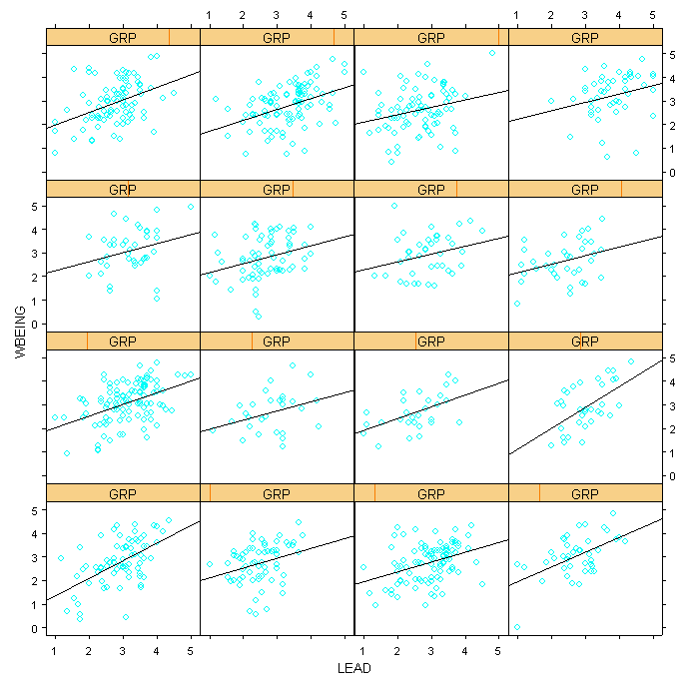
Leadership and Well-Being Example

Slide 315
Leadership and Well-Being Example
> tmod.rs<-lme(WBEING~LEAD,random=~LEAD|GRP,
data=bh1996)
> VarCorr(tmod.rs)
GRP = pdLogChol(LEAD)
Variance StdDev Corr
(Intercept) 0.16440592 0.4054700 (Intr)
LEAD 0.01045513 0.1022503 -0.953
Residual 0.64410168 0.8025595
Note the high correlation between the intercept and slope values. Can lead to estimation problems.
Note the variance value of .16 in the non-centered model. Contrast this with the grand-mean centered model.

Slide 316
Leadership and Well-Being Example
> tmod<-lme(WBEING~I(LEAD-mean(LEAD)),
random=~I(LEAD-mean(LEAD))|GRP,bh1996)
> VarCorr(tmod)
GRP = pdLogChol(I(LEAD - mean(LEAD)))
Variance StdDev Corr
(Intercept) 0.02344350 0.1531127 (Intr)
I(LEAD - mean(LEAD)) 0.01045517 0.1022505 -0.592
Residual 0.64410166 0.8025594
The correlation between the intercept and slope values drops from -.953 to -.592.
The estimate of the intercept variance decreases from .164 to .023

Slide 317
Leadership and Well-Being Example
Estimates of intercept variance in models with random slopes represent variance when x is zero
Values change if x is re-scaled
Variance typically reduced when x is centered at zero (close to null model estimate)
Example: Add a large constant
> tmod<-lme(WBEING~I(LEAD+10),random=~I(LEAD+10)|GRP,bh1996)
> VarCorr(tmod)
GRP = pdLogChol(I(LEAD + 10))
Variance StdDev Corr
(Intercept) 1.99975406 1.4141266 (Intr)
I(LEAD + 10) 0.01045494 0.1022494 -0.996
Residual 0.64410173 0.8025595

Slide 318
Leadership and Well-Being Example
When the slope is fixed for each group, the variance of the intercept term (τ₀₀) is the same for different values of X
The estimate of τ₀₀ is not impacted by centering
Fixed Slope
5
4
3
Well-Being
2
1
0
1
2
3
4
5
Leadership Consideration
Notes:
tmod<-lme(WBEING~LEAD,random=~1|GRP,data=bh1996)
plot(bh1996$LEAD,bh1996$WBEING,xlab="Leadership Consideration",
ylab="Well-Being",type="n")
COEF.DAT<-coef(tmod)
apply(COEF.DAT,1,abline)
********************
tmod<-lme(WBEING~LEAD,random=~LEAD|GRP,data=bh1996)
plot(bh1996$LEAD,bh1996$WBEING,xlab="Leadership Consideration",
ylab="Well-Being",type="n")
COEF.DAT<-coef(tmod)
apply(COEF.DAT,1,abline)

Slide 319
Leadership and Well-Being Example
With random slopes, the estimate of τ₀₀ is dependent on the zero point of X
Group mean centered vs. Leadership plus 10
Notes:
tmod<-lme(WBEING~I(LEAD-mean(LEAD)),random=~I(LEAD-mean(LEAD))|GRP,data=bh1996)
plot(bh1996$LEAD,bh1996$WBEING,xlab="Leadership Consideration",
ylab="Well-Being",type="n",xlim=c(-3,3))
COEF.DAT<-coef(tmod)
apply(COEF.DAT,1,abline)
bh1996$LEAD10<-bh1996$LEAD+10
tmod<-lme(WBEING~LEAD10,random=~LEAD10|GRP,data=bh1996)
plot(bh1996$LEAD10,bh1996$WBEING,xlab="Leadership Consideration+10",
ylab="Well-Being",type="n",xlim=c(0,15),ylim=c(-5,5))
COEF.DAT<-coef(tmod)
apply(COEF.DAT,1,abline)

Slide 320
Leadership and Well-Being Example
Interpreting Fixed Effects (raw variables)
> summary(tmod.rs)$tTable
Value Std.Error DF t-value
Intercept) 1.2905131 0.05709755 7282 22.60190
LEAD 0.5124108 0.01669078 7282 30.70024
Raw Score: Expected value of Y_{ij} when X_{ij} equals zero
Expect a soldier who has a leadership score of zero to have a well-being score of 1.29

Slide 321
Leadership and Well-Being Example
Interpreting Fixed Effects (grand-mean variables)
> summary(tmod.rs.grand)$tTable
Value Std.Error DF t-value
(Intercept) 2.7716485 0.01863378 7282 148.74
LEAD 0.5123878 0.01693707 7282 30.25
Grand Mean Centered: Expected value of Y_{ij} for an individual with an “average” level of X_{ij}.
Expect a soldier who has an average leadership score to have a well-being score of 2.77

Slide 322
Centering: Interpreting Intercepts
Effects - Mathematical:
Variance of Intercept (τ₀₀) reduced (only when random slope present)
Observed variance in τ₀₀ is typically more similar to null model estimate than when raw variables are used
Covariance/correlation between Intercept and slope (τ₀₁) reduced

Slide 323
Centering: Grand Mean
Theoretical Issues
Relationships between raw level-1 variables almost always contain a mix of between-group and within-group effects
Same holds for Grand-Mean centered variables.
Grand-mean Centering (and raw variables) confound within and between-group effects in
The slope estimate (γ₁₀)
The intercept variance estimate (τ₀₀)

Slide 324
Grand-Mean Centering
Example
Work Hours -- General Well-Being Slope (γ₁₀)
Best estimate of pooled slope for HRS in contextual model is -0.0465 (within-group effect)
Best estimate of between-group slope for Group Average Work Hours was -0.1269
tmod<-lme(WBEING~HRS+G.HRS,random=~1|GRP,
data=bh1996)
round(summary(tmod)$tTable,dig=4)
Value Std.Error DF t-value p-value
(Intercept) 4.7408 0.2137 7282 22.1867 0
HRS -0.0465 0.0049 7282 -9.5051 0
G.HRS -0.1269 0.0194 97 -6.5416 0
Notes:
tmod<-lm(WBEING~HRS+G.HRS,data=bh1996)
summary(tmod)
tmod<-lm(WBEING~HRS,data=bh1996)
summary(tmod)
tmod<-lme(WBEING~1,random=~1|GRP,data=bh1996)

Slide 325
Grand-Mean Centering
Example
Variance of Intercept Term (τ₀₀)
Best estimate from null model is .0358
> VarCorr(lme(WBEING~1,random=~1|GRP,
+ data=bh1996))
GRP = pdLogChol(1)
Variance StdDev
(Intercept) 0.03580077 0.1892109
Residual 0.78949727 0.8885366
Notes:
tmod<-lm(WBEING~HRS+G.HRS,data=bh1996)
summary(tmod)
tmod<-lm(WBEING~HRS,data=bh1996)
summary(tmod)
tmod<-lme(WBEING~1,random=~1|GRP,data=bh1996)

Slide 326
Grand-Mean Centering
Estimate the following model
GWB_{ij} = β_{0j} + β_{1j}(HRS_{ij} - HRS••)+r_{ij}
β_{0j} = γ₀₀+ u_{0j}
β_{1j} = γ₁₀
>TDAT<-bh1996[,c("GRP","WBEING","HRS")]
>TDAT[,3]<-scale(TDAT[,3],scale=F)
>tmod.rs.grand<-lme(WBEING~HRS,random=~1|GRP,data=TDAT)
SAME AS
> tmod<-lme(WBEING~I(HRS-mean(HRS)),random=~1|GRP,bh1996)

Slide 327
Grand-Mean Centering
Example (cont.)
Slope (γ₁₀)
Estimate is of grand-mean centered variable is identical to raw variable (-0.0520)
Value of -0.0520 includes some group-level effects since the best estimate of the within effect is -0.0464
Variance of Intercept Term (τ₀₀)
Estimate is .0243 (versus 0.0353 from null model).
The level-1 variable HRS reduced level-2 intercept variance

Slide 328
Grand-Mean: Level-2 Models
Example (cont.)
γ₁₀ will provide accurate estimate of within-group slope if Group Mean is introduced as a predictor of β_{0j}
β_{0j} = γ₀₀+ γ₀₁GHRS_{j}+u_{0j}
>TDAT<-bh1996[,c("GRP","WBEING","HRS","G.HRS")]
>TDAT[,3]<-scale(TDAT[,3],scale=F)
>tmod.rs.grand<-lme(WBEING~HRS+G.HRS,random=~1|GRP,TDAT)
SAME AS
> tmod<-lme(WBEING~I(HRS-mean(HRS))+G.HRS,random=~1|GRP,
bh1996)

Slide 329
Grand-Mean Centering
Example (cont.)
Slope (γ₁₀)
Estimate is -.0465 (same as model with raw HRS).
Between-Group Slope (γ₀₁)
Estimate is -0.1269 (same as model with raw HRS).

Slide 330
Grand-Mean Centering
To get accurate estimate of between-group and within-group effects in grand-mean centered models
Must include grand-mean centered variable and the Group Mean for that variable (e.g., I(HRS-mean(HRS)) & G.HRS as predictors)
No different from what one needs to do with raw variables

Slide 331
Grand-Mean: Level-2 Variables
Adding Level-2 Predictors
Level-2 variables in grand-mean centered (and raw) models test whether level-2 variables account for unique variance, above that accounted for by level-1 variables
Significant Mean-X value indicates that relationships among group means differs from relationships at the lower level.
Group membership matters…

Slide 332
Grand-Mean: Level-2 Variables
Adding Level-2 Interactions
The within-group and between-group effects confound cross-level interactions
Y_{ij} = β_{0j} + β_{1j}(X_{ij} - X••)+r_{ij}
β_{0j} = γ₀₀+ γ₀₁G_{j} + u_{0j}
β_{1j} = γ₁₀ + γ₁₁G_{j} + u_{1j}
γ₁₁ confounds
Cross-Level interaction (X_{ij} - X_{j})G_{j}
Between-Group Interaction X_{j}G_{j}

Slide 333
Grand Mean: Level-2 Variables
Example: Two Data Sets
Data Set 1: Cross-Level Interaction
1000 normally distributed numbers for a Y variable
Create first 500 X variables having a positive correlation with Y, and second 500 X variables having a negative correlation with Y
Create a Group ID Variable: 100 groups of size 10
Create a Group Variable (G): First 50 groups get a value of 0, and second 50 groups get a value of 1
Group-level variable (G) will moderate individual-level X-Y relationship
Notes:
Y<-rnorm(1000,10,1)
Xa<-sam.cor(Y[1:500],rho=.4)
Xb<-sam.cor(Y[1:500],rho=-.4)
X1<-c(Xa,Xb)
G1<-rep(0:1,each=500)
GID<-rep(1:100,each=10)
CENEX1<-data.frame(Y,X1,G1,GID)

Slide 334
Grand Mean: Level-2 Variables
set.seed(234323)
Y<-rnorm(1000,10,1)
Xa<-sam.cor(Y[1:500],rho=.4)
Xb<-sam.cor(Y[1:500],rho=-.4)
X1<-c(Xa,Xb)
G1<-rep(0:1,each=500) #Group-level predictor
GID<-rep(1:100,each=10) #Group ID
CENEX1<-data.frame(Y,X1,G1,GID)
tmod<-lme(Y~X1,random=~1|GID,CENEX1,control=list(opt="optim"))
tmod2<-update(tmod,random=~X1|GID)
> anova(tmod,tmod2)
Model df AIC BIC logLik Test L.Ratio p-value
tmod 1 4 2877.316 2896.939 -1434.658
tmod2 2 6 2875.055 2904.489 -1431.527 1 vs 2 6.261004 0.0437

Slide 335
Grand-Mean: Level-2 Variables
> xyplot(Y~X1|GID,CENEX1[c(1:180,821:1000),],
type=c("p","g","r"))
]
18 Groups from:
Sample corr = -0.38
]
18 Groups from:
Sample corr = 0.43

Slide 336
Grand-Mean: Level-2 Variables
> tmod<-lme(Y~I(X1-mean(X1))*G1,random=~1|GID,CENEX1)
> round(summary(tmod)$tTable,dig=4)
Value Std.Error DF t-value p-value
(Intercept) 9.8983 0.0442 898 224.1426 0.0000
I(X1 - mean(X1)) 0.4511 0.0424 898 10.6466 0.0000
G1 0.1748 0.0625 98 2.7994 0.0062
I(X1 - mean(X1)):G1 -0.4097 0.0613 898 -6.6824 0.0000
γ₁₁ ((X1-X1••)*G1) indicates the within-group slope significantly varies as a function of G1
Correct, but we wouldn’t know this in most cases
Raw X1 value produces same output except for intercept value

Slide 337
Grand-Mean: Level-2 Variables
Example: Two Data Sets
Data Set 2: Between-Group Interaction
Create 100 G1 and G2 Variables assuming G2 is only measured at the group level
Create a Group Y variable that is a product of G1 and G2: GY=G1*G2
Replicate GY, G1 and G2 10 times to create individual-level variables, Y, X1 and X2.
Add some random variance to Y, X1 and X2.
Notes:
set.seed(1234134)
G1<-rnorm(100,mean=10,sd=1)
G2<-sam.cor(G1,rho=.3)
GY<-(G1*G2)
X1<-rep(G1,rep(10,100))+rnorm(1000)
GX2<-rep(G2,rep(10,100)) #Creates a group-level variable for G2
Y<-rep(GY,rep(10,100))+rnorm(1000)
GID<-rep(1:100,each=10)
CENEX2<-data.frame(Y,X1,GX2,GID)
tdat<-aggregate(CENEX2[,c("Y","X1")],list(CENEX2$GID),mean)
names(tdat)<-c("GID","GY","GX1")
CENEX2<-merge(CENEX2,tdat,by="GID")
TDAT<-CENEX2[!duplicated(CENEX2$GID),]
tmod<-lm(GY~GX1*GX2,data=TDAT)
summary(tmod)$coef

Slide 338
Grand Mean: Level-2 Variables
set.seed(1234136)
# Create 3 "group-level" Variables
G1<-rnorm(100,mean=10,sd=1)
G2<-sam.cor(G1,rho=.3)
GY<-(G1*G2)
X1<-rep(G1,rep(10,100))+rnorm(1000) #creates an indiv-level X var
GX2<-rep(G2,rep(10,100)) #replicates G2 mean for each indiv
Y<-rep(GY,rep(10,100))+rnorm(1000) #creates an indiv-level Y var
GID<-rep(1:100,each=10) #create a Group ID
CENEX2<-data.frame(Y,X1,GX2,GID)
tdat<-aggregate(CENEX2[,c("Y","X1")],list(CENEX2$GID),mean)
names(tdat)<-c("GID","GY","GX1")
CENEX2<-merge(CENEX2,tdat,by="GID")

Slide 339
Grand-Mean: Level-2 Variables
> xyplot(Y~X1|GID,CENEX2[order(CENEX2$GX2)[c(1:180,821:1000)],],
type=c("p","g","r"))
]
18 Groups with high
Group X2 values
]
No apparent cross-
level interaction
18 Groups with low
Group X2 values

Slide 340
Grand-Mean: Level-2 Variables
If we model group means in an OLS model there is a significant interaction:
> TDAT<-CENEX2[!duplicated(CENEX2$GID),]
> tmod<-lm(GY~GX1*GX2,data=TDAT)
> round(summary(tmod)$coef,dig=4)
Estimate Std. Error t value Pr(>|t|)
(Intercept) -0.0859 0.4456 -0.1926 0.8476
GX1 -0.0002 0.0443 -0.0043 0.9965
GX2 0.1260 0.3349 0.3764 0.7075
GX1:GX2 0.9895 0.0333 29.6878 0.0000
Notes:
TDAT<-CENEX2[!duplicated(CENEX2$GID),]
tmod<-lm(GY~GX1*GX2,data=TDAT)
summary(tmod)$coef

Slide 341
Grand-Mean: Level-2 Variables
The cross-level interaction term γ₁₁ ((X1-X1••)*GX2) is significant indicating that the within-group slope (X1) varies as a function of GX2 (incorrect conclusion)
γ₁₁ would also be significant with a raw X1 value
> tmod<-lme(Y~I(X1-mean(X1))*GX2,random=~1|GID,CENEX2)
> round(summary(tmod)$tTable,dig=4)
Value Std.Error DF t-value p-value
(Intercept) 0.3170 0.1153 898 2.7505 0.0061
I(X1 - mean(X1)) -0.0060 0.0326 898 -0.1839 0.8541
GX2 9.9175 0.1128 98 87.9306 0.0000
I(X1 - mean(X1)):GX2 0.1164 0.0316 898 3.6782 0.0002

Slide 342
Grand-Mean: Level-2 Variables
How can you determine whether significant γ₁₁ value is due to:
Cross-Level interaction (X_{ij} - X_{j})G_{j}
Between-Group Interaction X_{j}G_{j}

Slide 343
Grand-Mean: Level 2 Variables
Estimate this model:
Y_{ij} = β_{0j} + β_{1j}(X_{ij} - X_{j})+r_{ij}
β_{0j} = γ₀₀+ γ₀₁X_{j} + γ₀₂G_{j} + γ₀₃(X_{j}G_{j}) + u_{0j}
β_{1j} = γ₁₀ + γ₁₁G_{j} + u_{1j}
Example
tmod<-lme(Y~I(X1-mean(X1))*GX2+GX1*GX2,
random=~I(X1-mean(X1))|GID,CENEX2)
Where:
Xij-Xj (Group-Mean Centered X)
Xj Group Mean of X
Gj Level-2 predictor

Slide 344
Grand-Mean: Level-2 Variables
Model applied to data with between-group interaction. Notice that cross-level interation γ₁₁ ((Xij-Xj)*Gj) is not significant, but γ₀₃ (Xj*Gj) is.
> tmod<-lme(Y~I(X1-mean(X1))*GX2+GX1*GX2,random=~I(X1- mean(X1))|GID,CENEX2)
> round(summary(tmod)$tTable,dig=4)
Value Std.Error DF t-value p-value
(Intercept) -0.0800 0.5569 898 -0.1436 0.8858
I(X1 - mean(X1)) 0.0006 0.0335 898 0.0176 0.9860
GX2 0.1825 0.4721 96 0.3867 0.6998
GX1 -0.0008 0.0555 96 -0.0141 0.9888
I(X1 - mean(X1)):GX2 0.0057 0.0334 898 0.1698 0.8652
GX2:GX1 0.9838 0.0472 96 20.8577 0.0000
Notes:
G1<-rnorm(100,10,1)
G2<-pop.cor.1(.3,G1)
GY<-(G1*G2)
X1<-rep(G1,rep(10,100))+rnorm(1000)
GX2<-rep(G2,rep(10,100))
Y<-rep(GY,rep(10,100))+rnorm(1000)
GID<-sort(rep(1:100,10))
CENEX2<-data.frame(Y,X1,GX2,GID)
TX1<-tapply(CENEX2$X1,CENEX2$GID,mean)
GX1<-rep(TX1,rep(10,100))
CENEX2<-data.frame(CENEX2,GX1)
summary(lme(Y~I(X1-GX1)+GX1+GX2+GX1:GX2+
GX2:I(X1-GX1),
random=~I(X1-GX1)|GID,data=CENEX2))

Slide 345
Centering: Grand Mean
Summary
Changes interpretation of intercept otherwise equivalent to raw variable models
Main advantage
Can reduce multicollinearity between slope and intercept and facilitate model estimation
Potential Disadvantages (same as raw)
Can provide confounded estimates of:
Pooled within-group slope
Variance of Intercept
Cross-level Interactions

Slide 346
Centering: Group Mean
Group-mean Centering (x_{ij}-x_{•j})
Involves subtracting the group-mean score from the individual score
Equivalent to our within-group variables in WABA
NOT equivalent to raw score models or to Grand-Mean Centered Models
Serves different purposes and tests different models

Slide 347
Centering: Group Mean
Centering choice has implications for:
Interpretation of the intercept term (γ₀₀)
(Co)variance Terms
The variance of the intercept term (τ₀₀)
The Covariance of the Intercept and Slope (τ₀₁)
The pooled within-group slope estimate (γ₁₀)
Interpretation of the Level-2 coefficients
Intercept Predictors
Slope Predictors (discussed earlier)

Slide 348
Group-Mean: Interpretation
Interpretation of Intercept Term
Can make the intercept more interpretable
Intercept is equal to the expected value of Y_{ij} for an individual whose X_{ij} value is equal to their group’s mean

Slide 349
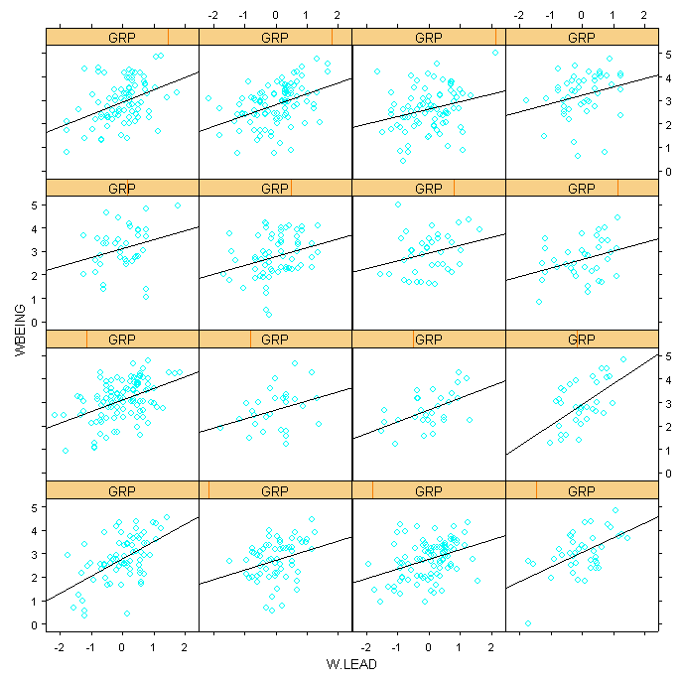
Group-Mean: Interpretation
3.20
2.93

Slide 350
Group-Mean Centering
Variance Terms
In Group Mean centered models Level-1 intercept variance is equal to the between group variance in the outcome variable
Notes:
Y<-rnorm(1000)
X1<-pop.cor.1(.3,Y)
X2<-pop.cor.1(.3,Y)
X3<-pop.cor.1(.5,Y)
G<-(X1+X2+X3)
GID<-sort(rep(1:100,10))
TX1<-tapply(X1,GID,mean)
GX1<-rep(TX1,rep(10,100))
TX2<-tapply(X2,GID,mean)
GX2<-rep(TX2,rep(10,100))
TX3<-tapply(X3,GID,mean)
GX3<-rep(TX3,rep(10,100))
GMCX1<-X1-GX1
GMCX2<-X2-GX2
GMCX3<-X3-GX3
TG<-tapply(G,GID,mean)
GG<-rep(TG,rep(10,100))
CENEX3<-data.frame(Y,GID,X1,GX1,GMCX1,X2,GX2,GMCX2,
X3,GX3,GMCX3,G,GG)

Slide 351
Group-Mean Centering
> tmod<-lme(WBEING~1,random=~1|GRP,data=bh1996)
> VarCorr(tmod)
GRP = pdLogChol(1)
Variance StdDev
(Intercept) 0.03580079 0.1892110
Residual 0.78949727 0.8885366
> tmod<-lme(WBEING~W.HRS,random=~1|GRP,
data=bh1996)
> VarCorr(tmod)
GRP = pdLogChol(1)
Variance StdDev
(Intercept) 0.03593696 0.1895705
Residual 0.77993178 0.8831375
Notes:
Y<-rnorm(1000)
X1<-pop.cor.1(.3,Y)
X2<-pop.cor.1(.3,Y)
X3<-pop.cor.1(.5,Y)
G<-(X1+X2+X3)
GID<-sort(rep(1:100,10))
TX1<-tapply(X1,GID,mean)
GX1<-rep(TX1,rep(10,100))
TX2<-tapply(X2,GID,mean)
GX2<-rep(TX2,rep(10,100))
TX3<-tapply(X3,GID,mean)
GX3<-rep(TX3,rep(10,100))
GMCX1<-X1-GX1
GMCX2<-X2-GX2
GMCX3<-X3-GX3
TG<-tapply(G,GID,mean)
GG<-rep(TG,rep(10,100))
CENEX3<-data.frame(Y,GID,X1,GX1,GMCX1,X2,GX2,GMCX2,
X3,GX3,GMCX3,G,GG)

Slide 352
Group-Mean: Intercept Variance
Between-Group Variance estimate in the DV is un-confounded when using group-mean centered variables
Null Model Estimate = .0358
Estimate of intercept variance with Group-Mean Centered IV (WHRS) = .0359
Recall estimate of intercept variance with raw IV (HRS) and Grand-Mean Centered IV = .0243

Slide 353
Group-Mean: Intercept-Slope Corr
> tmod<-lme(WBEING~LEAD,random=~LEAD|GRP,data=bh1996)
> VarCorr(tmod)
GRP = pdLogChol(LEAD)
Variance StdDev Corr
(Intercept) 0.16084989 0.4010610 (Intr)
LEAD 0.01006764 0.1003376 -0.952
Residual 0.64424573 0.8026492
> tmod<-lme(WBEING~W.LEAD,random=~LEAD|GRP,data=bh1996)
> VarCorr(tmod)
GRP = pdLogChol(LEAD)
Variance StdDev Corr
(Intercept) 0.16715411 0.4088448 (Intr)
LEAD 0.01080318 0.1039384 -0.902
Residual 0.64474366 0.8029593

Slide 354
Group Mean: Within Group Slope
Pooled Within-Group Slope (γ₁₀)
Recall that the raw variables and grand-mean centered variables do not provide “clean” estimates of the pooled within-group slope (γ₁₀)
Unlike raw variables and grand-mean centered variables, group-mean centered variables do provide un-confounded estimates of γ₁₀

Slide 355
Group-Mean: Level-2 Variables
Interpretation of Level-2 variables
Represent the group-level relationship between X_{j} and Y_{j} NOT adjusted for level-1 effects
Data Set 3 (example)
1000 normally distributed numbers for a Y variable
Three X variables correlated with Y (X1, X2, X3)
One Group-Level Variable (G) created by summing X1, X2 and X3 and taking group average
Create a Group ID Variable: 100 groups of size 10
G should not be significant if X1, X2 and X3 are controlled

Slide 356
Grand Mean: Level-2 Variables
set.seed(1234136)
X1<-rnorm(1000)
X2<-X1+rnorm(1000)
X3<-X1+rnorm(1000)
Y<-X1+X2+X3+rnorm(1000)
X<-(X1+X2+X3)/3
GID<-rep(1:100,10)
TDAT<-data.frame(GID,Y,X,X1,X2,X3)
GDAT<-aggregate(TDAT[,c("X","X1","X2","X3")],list(TDAT$GID),mean)
names(GDAT)<-c("GID","GX","GX1","GX2","GX3")
TDAT<-merge(TDAT,GDAT,by="GID")

Slide 357
Group-Mean Centering
> tmod<-lme(Y~I(X-GX)+GX,random=~1|GID,TDAT)
> round(summary(tmod)$tTable,dig=4)
Value Std.Error DF t-value p-value
(Intercept) 0.0346 0.0317 899 1.0898 0.2761
I(X - GX) 2.9592 0.0294 899 100.7262 0.0000
GX 2.9574 0.0826 98 35.8255 0.0000
VERSUS Raw (or Grand Mean Centered)
> tmod<-lme(Y~X+GX,random=~1|GID,TDAT)
> round(summary(tmod)$tTable,dig=4)
Value Std.Error DF t-value p-value
(Intercept) 0.0346 0.0317 899 1.0898 0.2761
X 2.9592 0.0294 899 100.7262 0.0000
GX -0.0018 0.0876 98 -0.0201 0.9840

Slide 358
Group-Mean Centering
Same example just using three X variables separately
Value Std.Error DF t-value p-value
(Intercept) 0.0346 0.0317 897 1.0898 0.2761
I(X1 - GX1) 1.0001 0.0569 897 17.5862 0.0000
I(X2 - GX2) 0.9707 0.0325 897 29.8956 0.0000
I(X3 - GX3) 0.9913 0.0333 897 29.7280 0.0000
GX 2.9574 0.0826 98 35.8255 0.0000
Value Std.Error DF t-value p-value
(Intercept) 0.0349 0.0317 897 1.1008 0.2713
X1 0.9578 0.0541 897 17.7141 0.0000
X2 0.9789 0.0315 897 31.1088 0.0000
X3 1.0134 0.0315 897 32.1275 0.0000
GX -0.0043 0.0875 98 -0.0488 0.9612

Slide 359
Centering: Group Mean
> tmod<-lme(WBEING~COHES+G.COHES,random=~1|GRP,
data=bh1996)
> summary(tmod)$tTable
Value Std.Error DF t-value
(Intercept) 1.81107287 0.29785486 7282 6.080387
COHES 0.24948825 0.01190356 7282 20.959131
G.COHES 0.06509809 0.09776323 97 0.665875
> tmod<-lme(WBEING~W.COHES+G.COHES,random=~1|GRP,
data=bh1996)
> summary(tmod)$tTable
Value Std.Error DF t-value
(Intercept) 1.8110729 0.29785486 7282 6.080387
W.COHES 0.2494882 0.01190356 7282 20.959131
G.COHES 0.3145863 0.09703584 97 3.241960

Slide 360
Group-Mean: Level-2 Variables
Group-Mean Centering helps identify true cross-level interactions
Recall Data Set 2: Between-Group Interaction
Create 100 G1 and G2 Variables assuming G2 is only measured at the group level
Create a Group Y variable that is a product of G1 and G2: GY=G1*G2
Replicate GY, G1 and G2 10 times to create individual-level variables, Y, X1 and X2.
Add some random variance to Y, X1 and X2.
Notes:
set.seed(1234134)
G1<-rnorm(100,mean=10,sd=1)
G2<-sam.cor(G1,rho=.3)
GY<-(G1*G2)
X1<-rep(G1,rep(10,100))+rnorm(1000)
GX2<-rep(G2,rep(10,100)) #Creates a group-level variable for G2
Y<-rep(GY,rep(10,100))+rnorm(1000)
GID<-rep(1:100,each=10)
CENEX2<-data.frame(Y,X1,GX2,GID)
tdat<-aggregate(CENEX2[,c("Y","X1")],list(CENEX2$GID),mean)
names(tdat)<-c("GID","GY","GX1")
CENEX2<-merge(CENEX2,tdat,by="GID")
TDAT<-CENEX2[!duplicated(CENEX2$GID),]
tmod<-lm(GY~GX1*GX2,data=TDAT)
summary(tmod)$coef

Slide 361
Grand Mean: Level-2 Variables
set.seed(1234136)
# Create 3 "group-level" Variables
G1<-rnorm(100,mean=10,sd=1)
G2<-sam.cor(G1,rho=.3)
GY<-(G1*G2)
X1<-rep(G1,rep(10,100))+rnorm(1000) #creates an indiv-level X var
GX2<-rep(G2,rep(10,100)) #replicates G2 mean for each indiv
Y<-rep(GY,rep(10,100))+rnorm(1000) #creates an indiv-level Y var
GID<-rep(1:100,each=10) #create a Group ID
CENEX2<-data.frame(Y,X1,GX2,GID)
tdat<-aggregate(CENEX2[,c("Y","X1")],list(CENEX2$GID),mean)
names(tdat)<-c("GID","GY","GX1")
CENEX2<-merge(CENEX2,tdat,by="GID")

Slide 362
Group-Mean: Level-2 Variables
> xyplot(Y~X1|GID,CENEX2[order(CENEX2$GX2)[c(1:180,821:1000)],],
type=c("p","g","r"))
]
18 Groups with high
Group X2 values
]
No apparent cross-
level interaction
18 Groups with low
Group X2 values

Slide 363
Grand-Mean: Level-2 Variables
Recall, with Grand-Mean centering γ₁₁ is significant
Would also be significant with raw X1 value
> tmod<-lme(Y~I(X1-mean(X1))*GX2,random=~1|GID,CENEX2)
> round(summary(tmod)$tTable,dig=4)
Value Std.Error DF t-value p-value
(Intercept) 0.3170 0.1153 898 2.7505 0.0061
I(X1 - mean(X1)) -0.0060 0.0326 898 -0.1839 0.8541
GX2 9.9175 0.1128 98 87.9306 0.0000
I(X1 - mean(X1)):GX2 0.1164 0.0316 898 3.6782 0.0002

Slide 364
Grand-Mean: Level-2 Variables
With Group-Mean centering γ₁₁ is NOT significant when interaction involves group-means
> tmod<-lme(Y~I(X1-GX1)*GX2,random=~1|GID,CENEX2)
> round(summary(tmod)$tTable,dig=4)
Value Std.Error DF t-value p-value
(Intercept) 0.3710 0.1278 898 2.9034 0.0038
I(X1 - GX1) 0.0006 0.0335 898 0.0176 0.9860
GX2 9.9048 0.1250 98 79.2370 0.0000
I(X1 - GX1):GX2 0.0057 0.0334 898 0.1698 0.8652

Slide 365
Centering: Group Mean
Summary
Not equivalent to raw or grand-mean model
Changes interpretation of intercept
Main advantages
Reduces slope-Intercept correlation
Provides un-confounded estimates of:
Intercept variance
Pooled within-group slope estimates
Ensures that cross-level interactions are really cross-level
Potential Disadvantages
Must be careful interpreting Level-2 predictors

Slide 366
Choosing Centering Options
No Mathematically Correct Choice
Must be based on Theory
Four Paradigms (Hofmann & Gavin, 1998)
Incremental
Mediational
Moderational
Separate

Slide 367
Choosing Centering Options
Incremental
Do group-level variables add unique variance after controlling for individual-level factors
Traditional Contextual Models (Firebaugh, 1978)
No variance in within-group slopes predicted
Centering choice
Grand-Mean or Raw

Slide 368
Choosing Centering Options
Incremental (cont.)
In special case of Mean-X (X_{j})
Either grand-mean or group mean
With Group-Mean centering and X_{j} added back in
Test whether γ₁₀ (pooled within slope) is different from γ₀₁ (group-mean slope)

Slide 369
Choosing Centering Options
Mediational
Group-level variables influence individual variables indirectly through other mediating mechanisms
Ex. Level of centralization -> Perceived Autonomy -> Individual Job Satisfaction
Main Effect Model controlling for individual-level variables
Grand-mean Centering or Group-Mean with X_{j} re-introduced

Slide 370
Choosing Centering Options
Moderational
Group-level variables moderate the relationship between two variables
Ex. Collective efficacy (a group-level variables) moderates the relationship between an individual’s perception of work overload and his or her job satisfaction
Should use group-mean centering because grand-mean centering (and raw) confounds cross-level and between-group interactions
Current advice is to use raw or grand-mean and then re-estimate models with group-mean to verify

Slide 371
Choosing Centering Options
Separate
Separate structural models for both the within-group and between-group (Lincoln & Zeitz, 1980)
Frog-pond perspective (Markham, 1988)
Variance must be partitioned into separate within and between components
Only group-mean centering provides this partitioning

Slide 372
Centering Options Summary
No mathematically “correct” choice
Choice can impact interpretations
Raw and grand-mean centering
Confounds within-group and between-group effects (like ordinary OLS regression)
Group-mean centering
Separates between-group and within-group effects

